Slide 1
Psychology – (AQA)
Seaford college sixth form
Head of Psychology – Mrs A yates

Slide 2
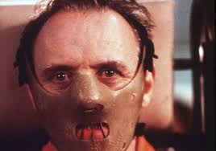
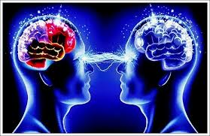
What A Level Psychology is NOT all about…..
Serial killers & psychopaths
Derren Brown and how to mind read
No spec includes sports psychology – but…

Slide 3
Entry requirements
Grade 6 minimum:
English, Science (and Maths – although more flexible with this)
Higher Tier

Slide 4
Expectations of students
Organised and determined: not an‘easy option’
- be able to memorise lots of information
Interest in Science:
a third of the AL = research methods
Accept debates:
- lots of uncertainties
Literacy
–reading; extended writing
Motivation & Independence!
- a fair amount of work on your own…1 hr outside for every 1 hour in lessons

Slide 5
Skills learnt
Skills:
Different perspectives
Plan/conduct investigations
Analyse and interpret data
Critical evaluation and reasoning
Improve communication
Build better relationships

Slide 6
Course content – P1 – Introductory topics
Social influence
conformity & obedience;
independent behavior,
minority influence & social change
Memory
models of memory;
forgetting
eyewitness testimony ,
Notes:
Memories malleable
Testimonies inaccurate → cognitive interviews
Provocative articles in the media about working parents and childcare
Milgram & electrocution expt – obedience
SCZ etc.

Slide 7
Course content – P1 – Introductory topics
Attachment –
animal studies of attachment,
explanations, types, cultural variations,
deprivation & institutionalization
Psychopathology –
defining & explaining psychological ‘abnormality’
relating to phobias, depression, OCD;
treatments
Notes:
Memories malleable
Testimonies inaccurate → cognitive interviews
Provocative articles in the media about working parents and childcare
Milgram & electrocution expt – obedience
SCZ etc.

Slide 8
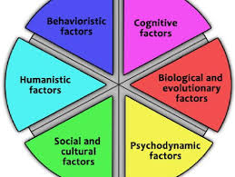
Course content– P 2 – Psychology in context
Approaches
Origins of psychology
Behaviourist approach ( classical & operant conditioning
Social learning theory
Cognitive approach
Biological approach
Psychodynamic approach
Humanistic approach
Notes:
Memories malleable
Testimonies inaccurate → cognitive interviews
Provocative articles in the media about working parents and childcare
Milgram & electrocution expt – obedience
SCZ etc.

Slide 9
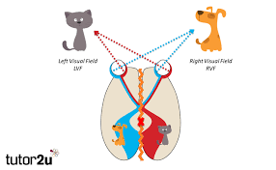
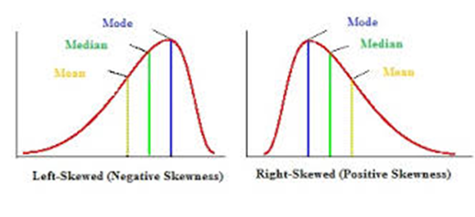
Course content – P 2 – Psychology in context
Biopsychology
Nervous system, Neurons and synaptic transmission
Endocrine system; Fight-or-flight response
Brain – split-brain research, plasticity & functional recovery
Ways of studying the brain
Biological rhythms - Circadian, ultradian, infradian rhythms
Research Methods –
Processes & Techniques
Data Handling & Analysis
Inferential testing
Notes:
Memories malleable
Testimonies inaccurate → cognitive interviews
Provocative articles in the media about working parents and childcare
Milgram & electrocution expt – obedience
SCZ etc.

Slide 10
Course content - P3 – Issues & Options
Section A – Issues and debates
Section B - D – 3 optional topics
Issues & Debates:
compulsory
Notes:
Memories malleable
Testimonies inaccurate → cognitive interviews
Provocative articles in the media about working parents and childcare
Milgram & electrocution expt – obedience
SCZ etc.

Slide 11
Course content - P3 – Issues & Options
Option 1:
Cognition & Development
Relationships
Gender
Option 2:
Schizophrenia
Eating behavior
Stress
Issues & Debates:
compulsory
Option 3:
Aggression
Forensic psychology
Addiction
Notes:
Memories malleable
Testimonies inaccurate → cognitive interviews
Provocative articles in the media about working parents and childcare
Milgram & electrocution expt – obedience
SCZ etc.

Slide 12
Assessment

Slide 13
Future pathways
If going on to study Psychology at university, another science or Maths may be required – DEPENDS ON COURSE
Many Psychology courses don’t have these requirements, but many do
Wide variety of courses offered - you will need to research individual universities and courses
Notes:
Not anymore – may have been 20 years ago.
Reassure.

Slide 14
Future pathways
Clinical Psychologist
Neuropsychologist
Counselling Psychologist
Educational Psychologist
Occupational Psychologist
Forensic Psychologist- assessment & treatment of offenders;
Health psychologist – improving public health
Teaching & research
Psychotherapy
Sports & Exercise Psychologists

Slide 15
Further info:
BPS – British Psychological Society
Digest
For all sorts of information – careers, highlights of current research findings.
AQA website – GCE A Level Psychology
Talk to students who are studying it now in Year 12
Look at textbooks – old or new spec –– to get a feel for the content

Slide 16
Any questions?

