Slide 1
A Level Geography
Seaford college
Head of GEOGRAPHY & BTEC Travel & tourism – Mr David Willcox

Slide 2
Why should you choose A-Level Geography?
'The study of geography is about more than just memorizing places on a map. It's about understanding the complexity of our world, appreciating the diversity of cultures that exists across continents. And in the end, it's about using all that knowledge to help bridge divides and bring people together'. Barack Obama

Slide 3
Why should you choose A-Level Geography?
Geography is highly valued by universities as an A Level choice, and combines well with both arts and science subjects.
It can be a facilitating subject provide multiple future employment opportunities.
Choosing facilitating subjects will keep more options at university-level.
Geography opens doors to other degrees.
Geography is a science for UCAS applications.
Geography was also found to be the most relevant A Level subject in teaching students about climate change (YouGov/RGS 2020).

Slide 4
A-Level Geography or BTEC Travel & Tourism?
A-Level Geography
7 is preferable
Make a decision based on YOUR grade
BTEC Travel & Tourism
Working towards 4 in Geography
Ideal for those who like exams and essay writing (exams are essay based)
2 exams at the end of course
1 Non-examined-assessment consisting of a University style dissertation
No re-takes or re-submissions
Ideal for those that will find essay writing hard
2 external assessments ( can be re-taken)
Internal Assignments set in class
Opportunity to re-submit assignments and re-take external assessments/exams

Slide 5
Differences between BTEC Travel & Tourism and A-Level Geography?
A-Level Geography | BTEC L3 Travel & Tourism (Extended Certificate)
80% Exam / 20% Coursework No re-sits or re-submissions Can achieve A*/A/B/C/D/E Fieldwork expectation (4 days) Exams in May/June of Year 13 Essay based | 58% Exam/ 42% Coursework Re-sits & Re-submissions Can achieve Distinction*/ Distinction / Merit / Pass (A*/ A / C / E) No B or D grade equivalent No fieldwork Exams in May of Year 12 & January/May of Year 13 Mixture of short response and longer response questions

Slide 6
Year 12 & Year 13 Pathway
Year 12 Topics | Year 13 Topics
Coasts (Physical) | Hazards (Physical)
Water & Carbon Cycles (Physical) | Global Systems & Governance (Human)
Contemporary Urban Environments (Human) | NEA (students own time outside of lessons-December hand in)
Changing Places (Human) | Revision
NEA (One teacher leads on this in Year 12) | Exams
Note: 12 lessons a fortnight, 2 teachers, 1 human teacher (6 lessons) and 1 physical teacher (6 lessons)

Slide 7
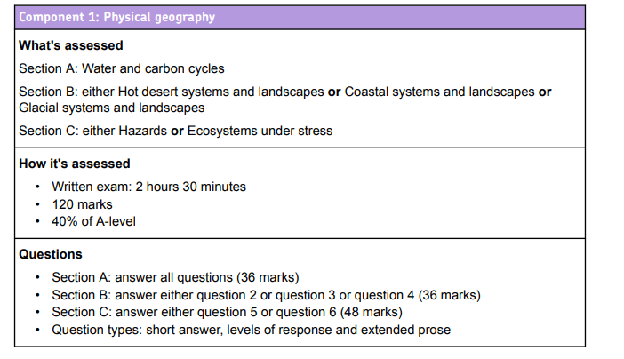
A-Level Course content & Assessment
Coastal Systems, Water and Carbon
&
Hazards
3 x 20 mark essays in the exam
Essay writing needs to be of a high standard- consider your English grade

Slide 8
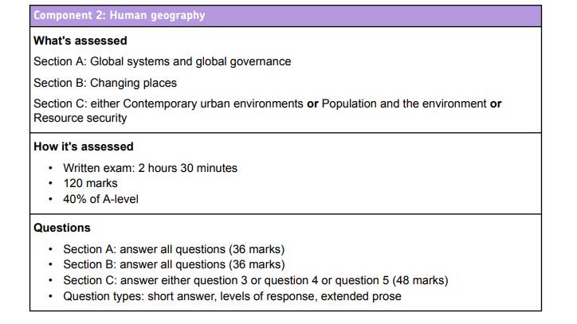
A-Level Course content & Assessment
Contemporary Urban Environments, Changing Place & Global Systems and Governance
3 x 20 mark essays in the exam
Essay writing needs to be of a high standard- consider your English grade

Slide 9
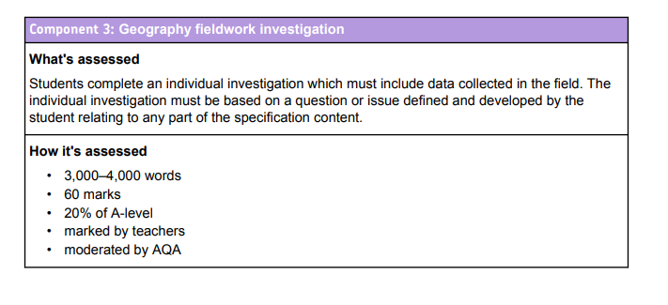
Course content & Assessment
Fieldwork week
Lake District in Summer of Year 12
Blencathra FSC Centre TBC.
Independent piece of work
Students expected to carry out fieldwork in own time and research

Slide 10
NEA- Non - Examined Assessment (Coursework)
Fieldwork will be an essential part of your A Level course - you will be required to complete an independent non-examined assessment (NEA).
This provides an excellent opportunity to conduct a fieldwork study in relation to physical and human processes.
All students are required to undertake fieldwork in relation to processes in both physical and human geography.
Students must undertake four days of fieldwork during their A-level course.
Fieldwork can be completed in a number of ways: locally or further afield, on full days or on part days. (TBC)
Some stages of the investigation must be carried out independently. Other parts of the investigation may be carried out collaboratively, either as a class, group or pair.
The write up of your study will provide an excellent insight into producing a concise university-style dissertation.
You are expected to do the data collection and start the write up over the summer holidays in Year 12 to submit in Year 13. You must do you own investigation and write it up independently, guided by staff and aided by the week residential in the summer term of Year 12.

Slide 11
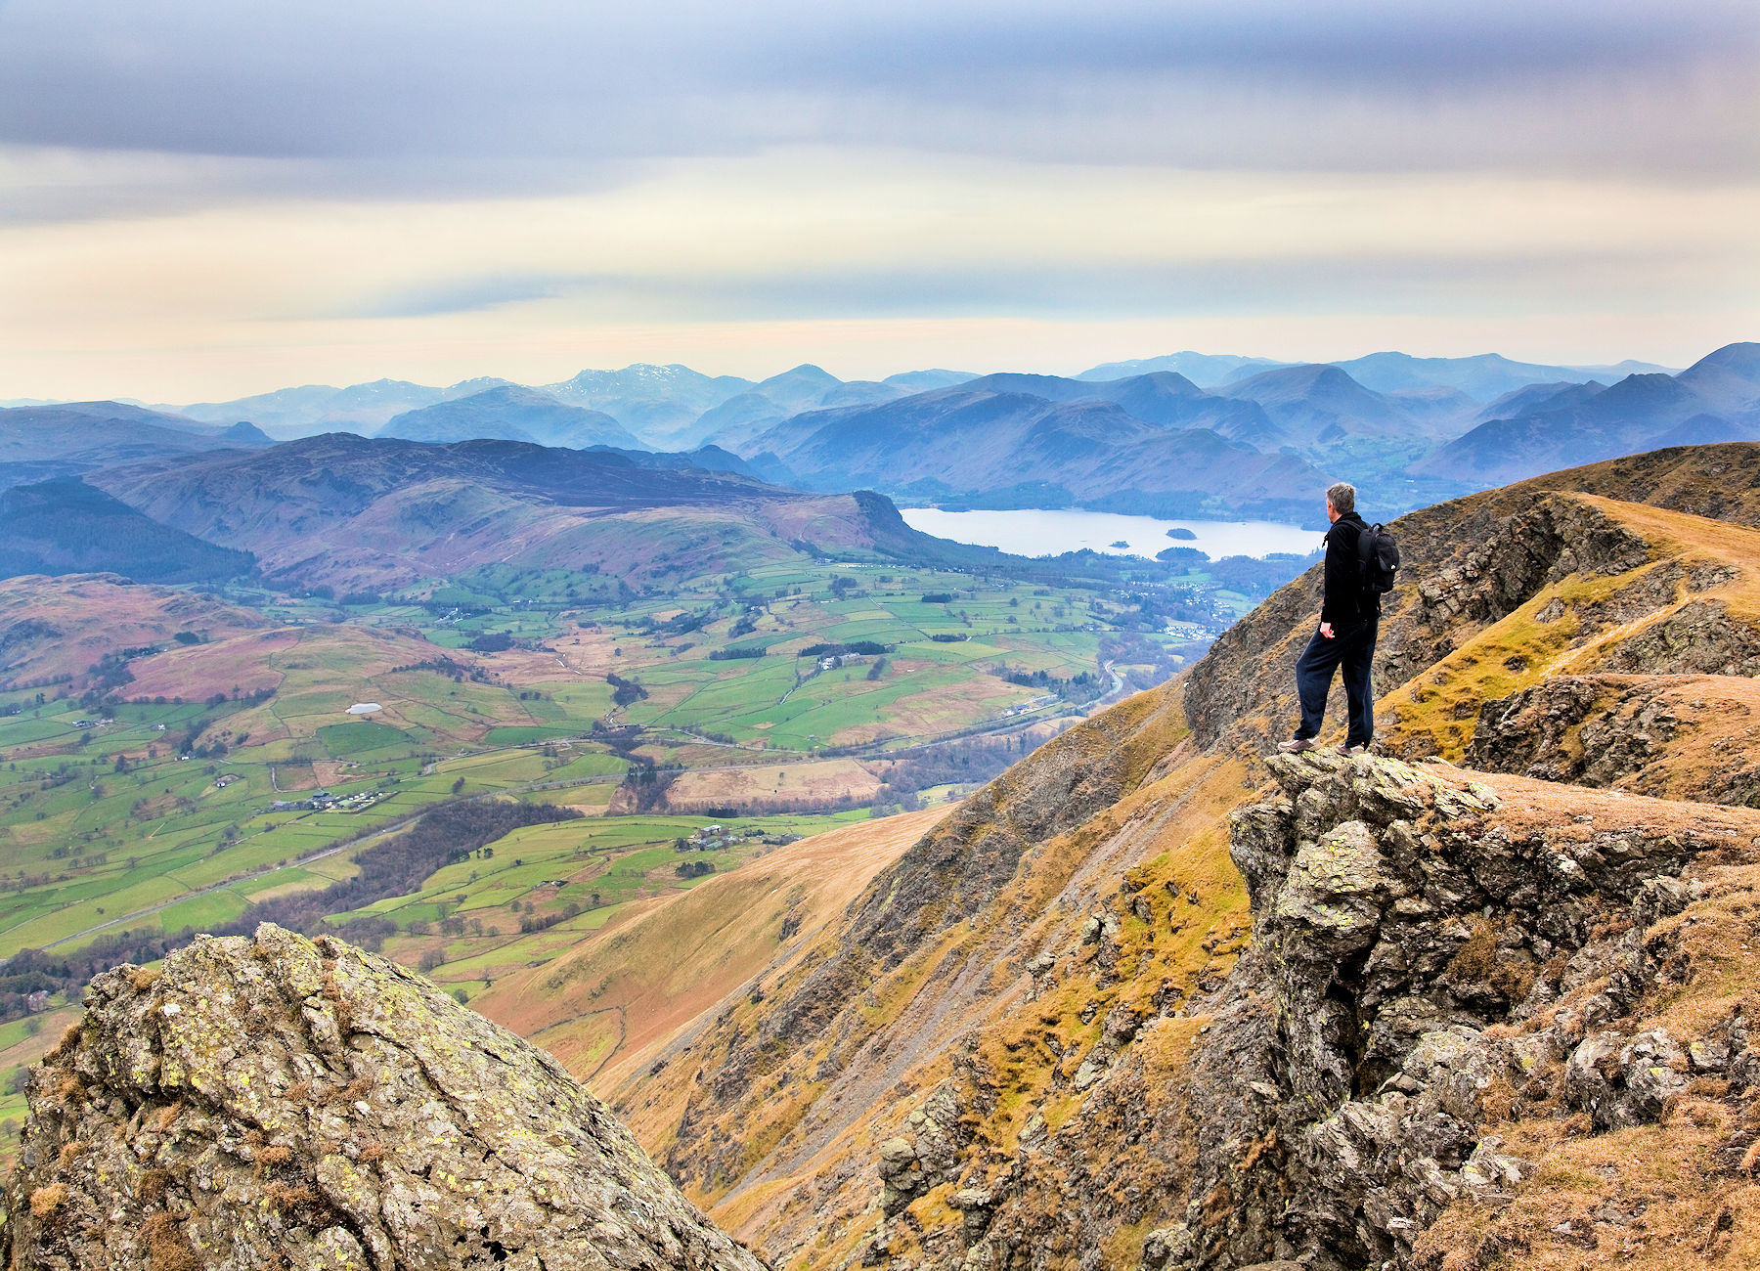
Y12 Residential- Blencathra FSC- Lake District (Summer Term)
We will be going to the Lake District in June 2025 for a week (Sunday to Friday) TBC
Here we and the FSC will introduce you to the NEA, show you how to conduct fieldwork and all of the processes needed to be successful.
After this you are expected to go and conduct your own field work and investigation over this summer break and write this up.
This is a big commitment and worth 20% of your grade.
To be clear this is not a jolly or a holiday! You are working and will be working most of the day and in the evenings too.
Cost: £500 TBC, this does include all travel, accommodation, all meals (apart from lunch on Sunday), hiring of the centre which includes study facilities, equipment and fully qualified mountain leaders/teachers from the FSC who lead the sessions.

Slide 12
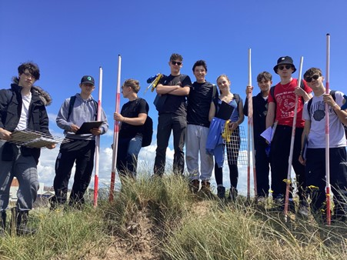
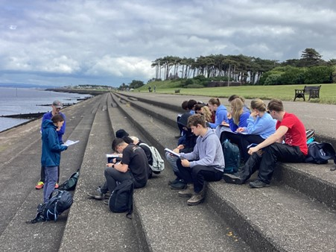
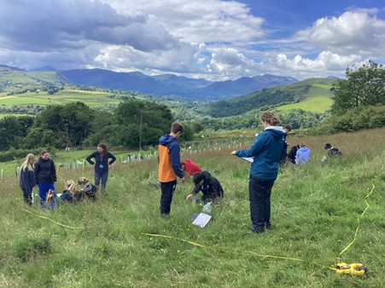
Y12 Residential- Blencathra FSC- Lake District (Summer Term)

Slide 13
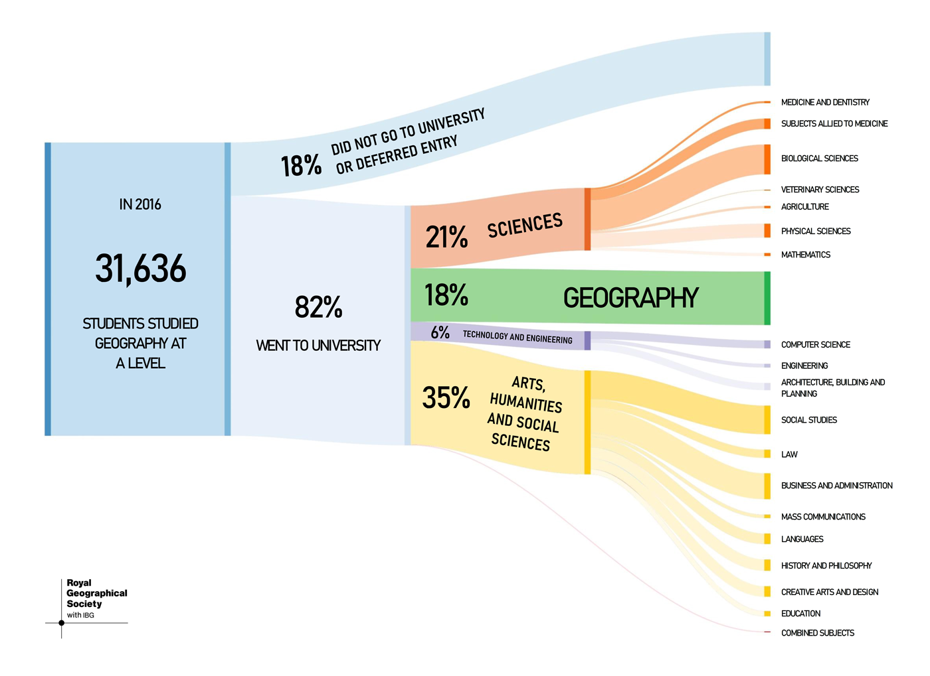
Geography A level can lead to a variety of degrees and careers
Opens many doors, regarded highly by
‘The Russell Group’

Slide 14
A-Level Expectations of students
Grade 7 in Geography preferable, 6 minimum
GCSE grades 7 in Science and English preferable​- essay writing, mathematical formulae, Geography is a science in its own right
Essay writing and skills are essential, 20-mark essays are examined​.
Wider engagement, reading and research​ into contemporary Geography.
NEA- commit to collecting data and starting write up of the NEA over the summer break of Year 12.
We recommend a student membership of the GA and/or RGS​.
Some students may attend online lectures for free from universities (RGS & GA also offer these as part of their membership packages)​.
To get a top grade you will need to read around the subject in newspapers and through magazine and internet articles; TV and radio documentaries are a rich source of current issues too. ​
Debunking a common Myth: Geography is easy!
Geography is not easy; you may be interested in the world as a hobby but not as discipline!

Slide 15
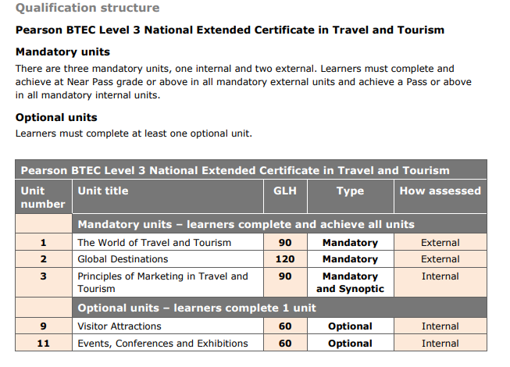
BTEC Course content & Assessment
Year 12 | Year 13
Unit 2: Global Destinations (Exam May Year 12, 3 hours medium control, 2 pages of notes allowed) | Unit 1: The World of Travel & Tourism (Exam January Year 13)
Unit 9: Visitor Attractions (Internal coursework assignments x 3) | Unit 3: Principles of Marketing (Internal coursework assignments x 2)
Note: 12 lessons a fortnight, 2 teachers. E.G. Year 12
Teacher 1: Unit 2, 8 lessons
Teacher 2: Unit 9, 4 lessons

Slide 16
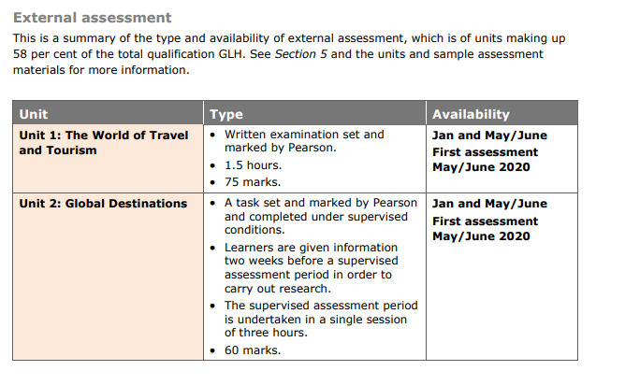
BTEC Course content & External Assessment
UNIT 1: January Year 13 Exam
UNIT 2: May Year 12 Exam
Units 1 & 2 are externally assessed written exam (1) and pre-release materials (2)
(2) Is a 3 hour exam done in medium control conditions

Slide 17
BTEC Future pathways
Learners can progress to degree courses and areas of work such as:
Hospitality, Leisure, Sport, Tourism
Sport Management, Business, Business Management
Travel Management; Event Management; Tourism Management; Transport Studies; Hospitality Management;
Accounting, Finance, Marketing & International Tourism Management

Slide 18
BTEC Expectations of students
Grade 4 in Geography/working towards
The ability to learn independently
The ability to research actively and methodically
Be able to give presentations and being working in a group
Wider reading and research​ (researching essential skill at BTEC)
Commitment to 2-3 hours of reading and ‘prep’ each week​​
Reading technical texts
Effective writing
Analytical and evaluative skills

Slide 19
Differences between BTEC Travel & Tourism and A-Level Geography?
A-Level Geography | BTEC L3 Travel & Tourism (Extended Certificate)
80% Exam / 20% Coursework No re-sits or re-submissions Can achieve A*/A/B/C/D/E Fieldwork expectation (4 days) Exams in May/June of Year 13 Essay based | 58% Exam/ 42% Coursework Re-sits & Re-submissions Can achieve Distinction*/ Distinction / Merit / Pass (A*/ A / C / E) No B or D grade equivalent No fieldwork Exams in May of Year 12 & January/May of Year 13 Mixture of short response and longer response questions

Slide 20
Any questions?

