Slide 1
AQA
GCSE
Design and Technology 8552
Sources, origins and properties
Unit 5B
Timber based materials
1

Slide 2
Objectives
Understand the main processes involved in producing workable forms of timber including:
conversion,
seasoning and
the creation of manufactured timbers
Be aware of sustainability and ethical factors in timber production and use
Understand the advantages and disadvantages of manufactured board compared with natural wood

Slide 3
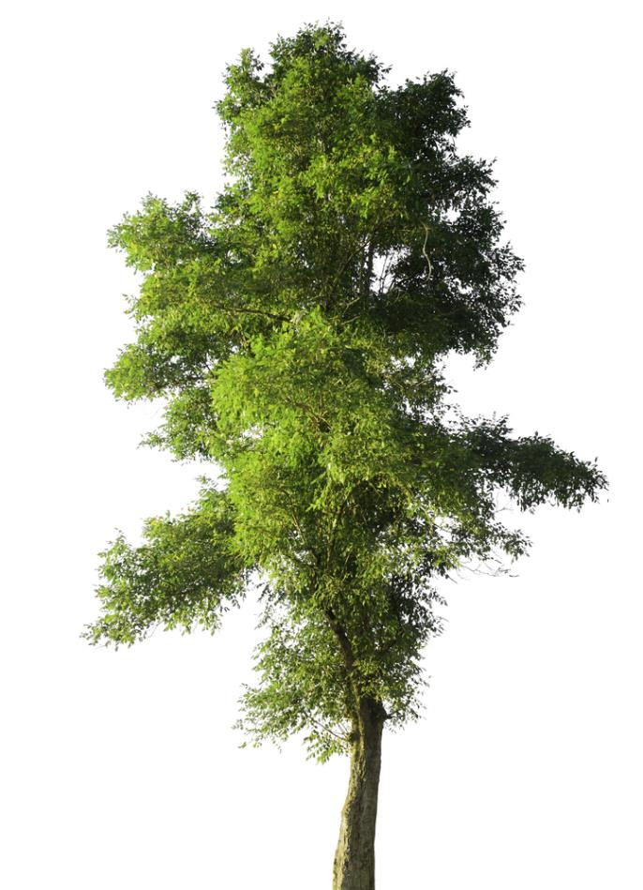
Trees
Wood has been used as a material and a fuel for thousands of years
Wood is a durable material, which should last a lifetime if well cared for
Our planet is home to over 23,000 different kinds of trees
What wooden products or objects have you encountered this morning?

Slide 4
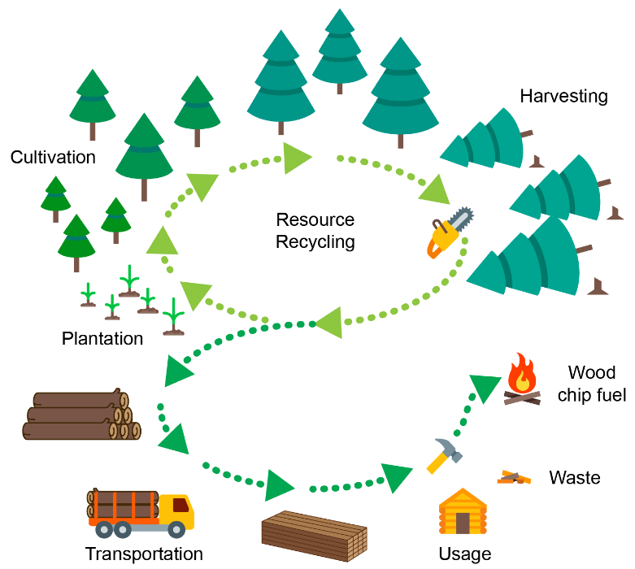
Forestry management
If managed properly, forestry is a sustainable cycle
Well managed forests offer many benefits:
Provide an environment for leisure activities
Employment
What other benefits do you think managed forests offer?

Slide 5
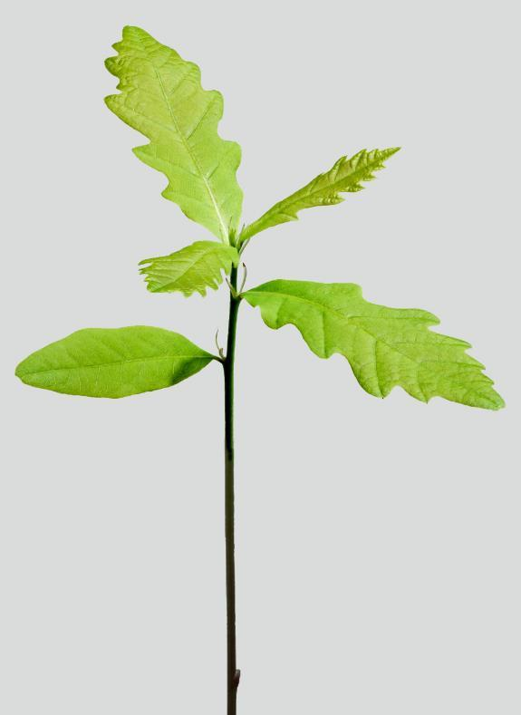
Thinning forests
Managed forests contain trees of different ages
When trees are finally felled they are replaced with new seedlings
Young trees are thinned at around five years old
Why do you think it is usual to 'thin' trees every five years?
What do you think the thinnings might be used for?

Slide 6
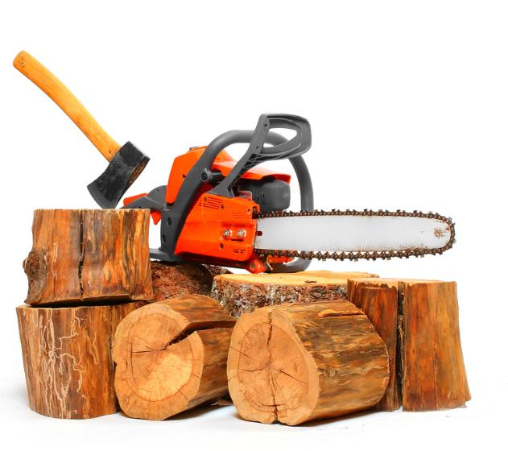
Felling
A tree is ‘felled’ when it is cut down
Traditionally this was done using a hand axe or long saw
Modern felling is done using a chainsaw or agricultural logging machinery that can fell a tree, de-branch it and cut it into equal length logs in one action
What are the advantages and disadvantages of using mechanised felling methods over manual methods?

Slide 7
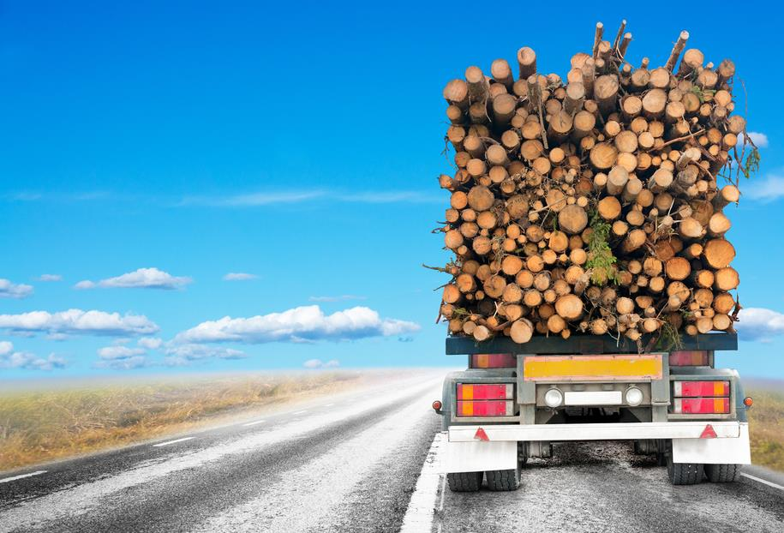
Product mileage
How much mileage might wood take from tree to end user?
What stages might there be on its journey?

Slide 8
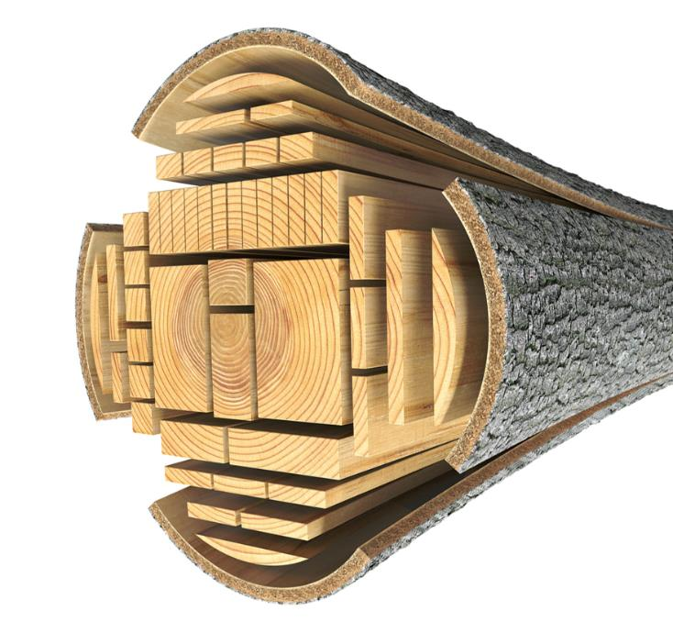
Timber conversion
Felled trees are cut into manageable lengths to be converted into timber planks and boards
Timber is supplied in two main finishes: rough sawn or planed all round (PAR)
Rough sawn timber is often used for exterior tasks
PAR is smoother and has been planed down on all sides
Where might PAR timber be used?
What happens to off-cuts?

Slide 9
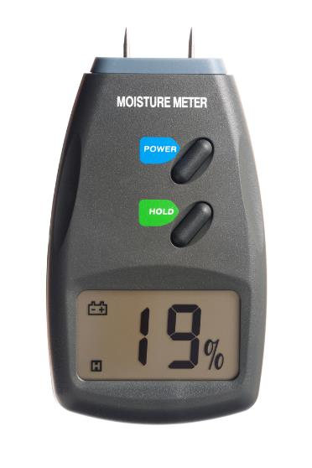
Green timber
Newly felled unseasoned trees are known as 'green'
Green timber is very wet, with more than 50% moisture content
Green timber can be more difficult to work with for interior applications
Timber for exterior applications should have a moisture content of less than 20%
Timber for domestic furniture should have a moisture content of less than 10%
Why is it necessary to remove the moisture from timber?

Slide 10
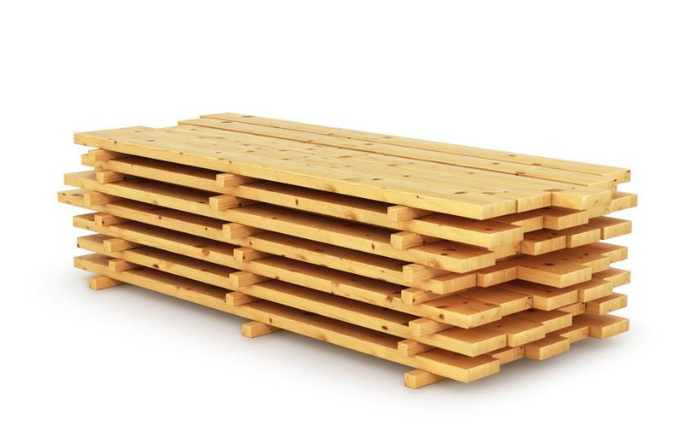
Seasoning
Seasoning timber reduces its moisture content
The two methods of seasoning are air or kiln drying
What do you think the environmental advantages of air drying timber are?
Aside from being faster, might there be any other advantages to kiln drying?

Slide 11
Faults
Faults can occur as timber dries. These include:
Bowing
Splitting / cracking
Springing
Cupping
Twisting

Slide 12
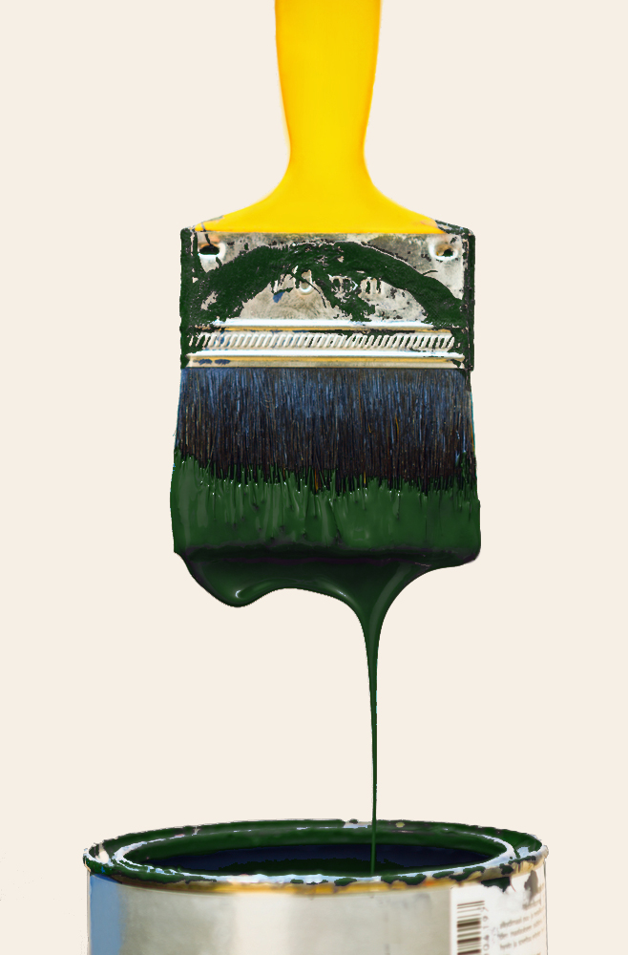
Reducing faults
Faults can make the timber unusable and increase the amount of wastage
Why is kiln dried timber less prone to faults than air drying?
Why do you think the end grain of timber planks is often covered with a special sealant?

Slide 13
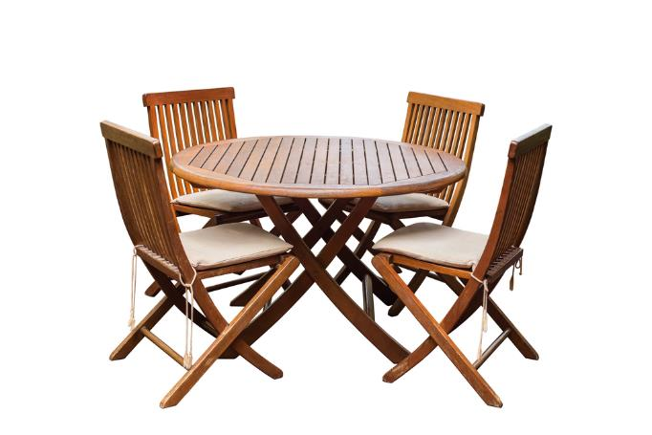
Sustainability
Trees are one of our most valuable resources and yet we have not always treated them as such
For a long time the rate of use has exceeded trees' rate of growth
Demand for more exotic timbers like teak and mahogany has created a huge illegal logging industry

Slide 14
Consequences of illegal logging
Illegal logging destroys vast areas of rainforest and causes desertification, deforestation and ultimately plays a role in global warming
What do you consider to be the possible consequences of desertification, deforestation and global warming?

Slide 15
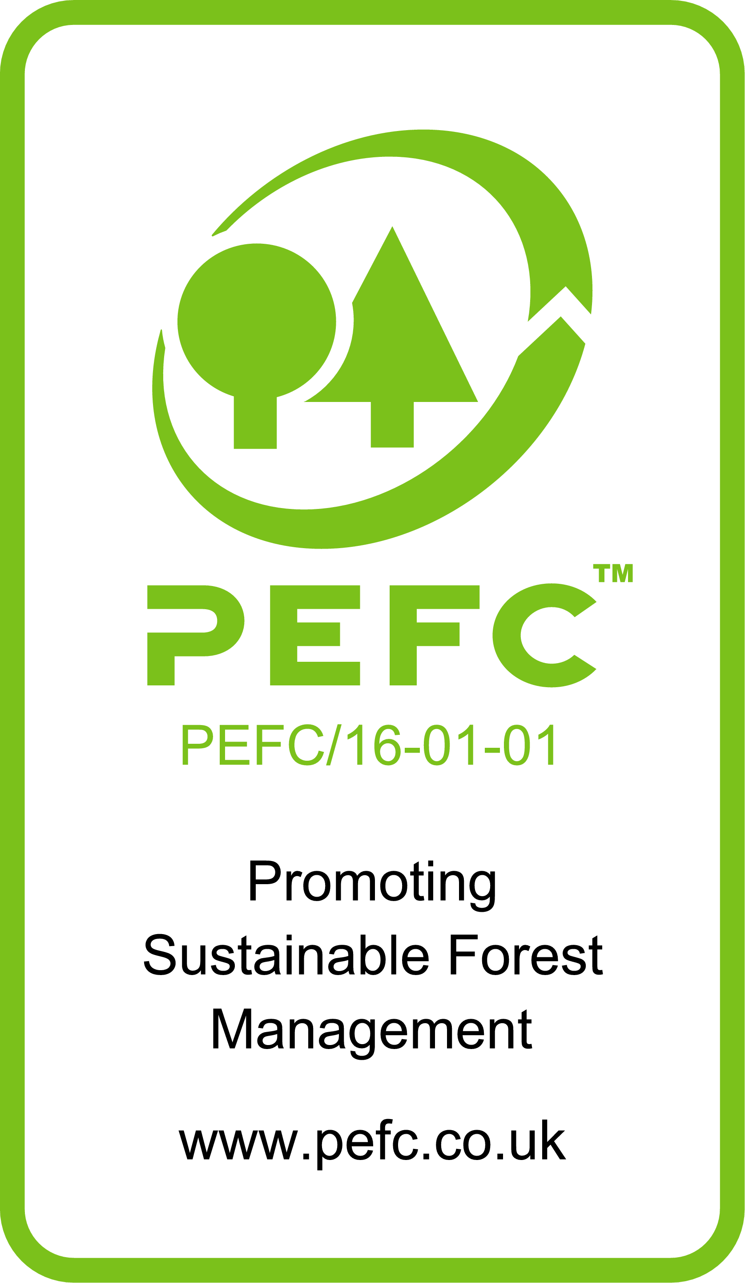
Timber provenance
Timber provenance is regulated by bodies such as:
FSC® (Forest Stewardship Council®)
PEFCTM (Programme for the Endorsement of Forest Certification)
In the UK, sustainably managed forests must be FSC or PEFC accredited
How do you think the FSC and PEFC regulate the industry?

Slide 16
Kit house construction
Complete Task 1 of Worksheet 1

Slide 17
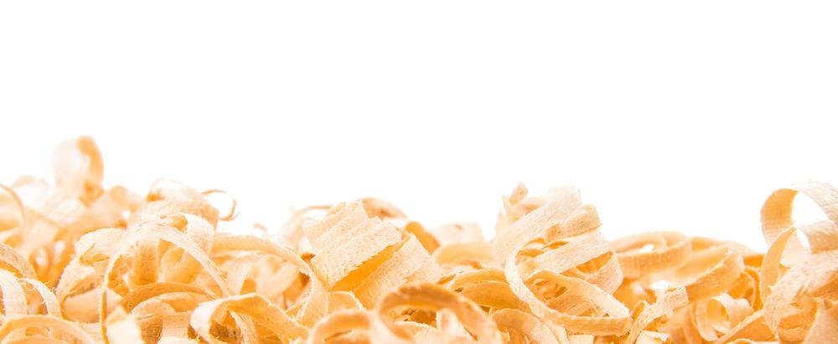
Manufactured boards
Manufactured boards come in large sheets, often made from waste or recycled wood and adhesives
Manufactured boards are usually produced using lamination or compression techniques
Manufactured boards are often covered with veneers of higher quality timber
Why do you think we can class manufactured boards as 'composite materials'?

Slide 18
Laminated boards
Lamination is the technique of layering materials using heat, pressure and adhesives
Veneers (thin layers) are layered with the grain direction of each layer at 90° to each other
Why are an odd number of layers always used?
How does lamination improve the material properties?
Are there are any aesthetic advantages of laminated manufactured boards?

Slide 19
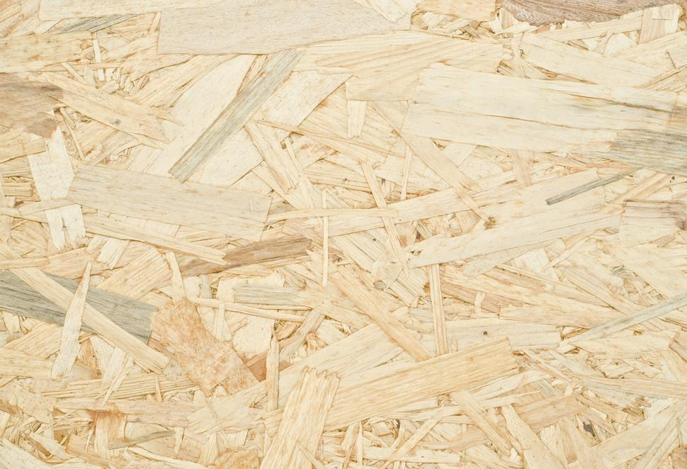
Compression
Compression uses adhesives, heat and pressure to combine shreds, chips or pulp to produce a larger board
Oriented strand board comprises compressed shreds of wood
Chipboard and MDF are often covered with a melamine or Formica® laminate
Where might we obtain the raw materials for making compressed manufactured boards?
Why are compressed boards weaker than laminated boards?

Slide 20
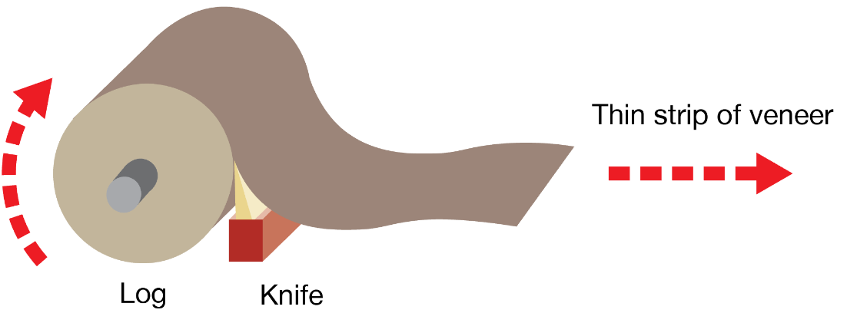
Rotational veneer production
Veneer can be made by rotating a tree trunk on a large industrial machine similar to a wood lathe
This creates a long ribbon of veneer that can be cut to length

Slide 21
Using manufactured board
Advantages | Disadvantages
Available in large sheets with few faults or defects | Adhesives used in manufacture can be hazardous when inhaled
Aesthetic flaws like knots can be eliminated, boards require very little finishing | Adhesives used in manufacture can also blunt tools quickly
Made of wood that might otherwise go to landfill | Many traditional woodworking joints cannot be used and the edges are hard to finish
Available in a vast range of surface finishes | Boards are prone to absorbing moisture

Slide 22
Worksheet 1
Complete Task 2 on the worksheet

Slide 23
Plenary
Forestry is the managed growing of trees for the timber industry
When trees reach maturity they are felled using a chainsaw or industrial cutting machines
What happens next in the production process?
How do environmental and ethical factors play a part?

