Slide 1
AQA
GCSE
Design and Technology 8552
Working with timber based materials and fixings
Unit 5B
Timber based materials
2

Slide 2
Objectives
Know and understand the commercial stock forms, types and sizes of timber based materials and components in order to calculate quantities
Be aware of school based cutting, forming and processing techniques, tools and equipment

Slide 3
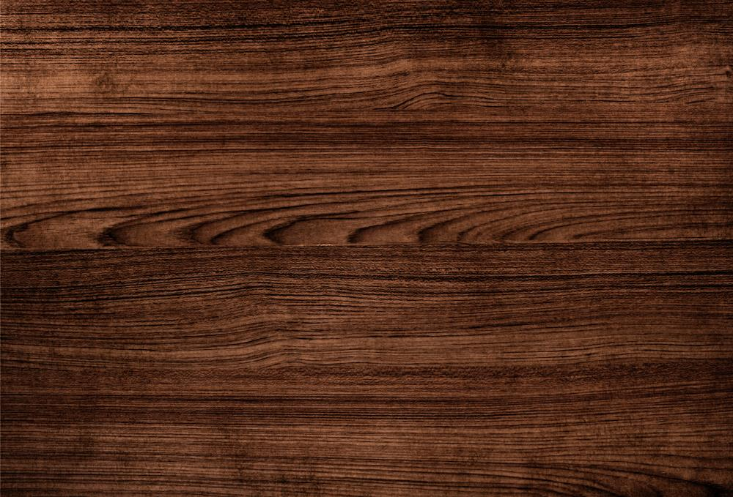
Working with timber
Timber and board materials are widely used in the school workshop
They are readily available
They can be cut and shaped using common tools and machines in the workshop
They can be formed and bent using jigs and moulds
They can be joined using a variety of joints and fixings
What other factors do you think make timber based materials a popular choice for the school workshop?

Slide 4
PPE
What common Personal Protective Equipment is required in the workshop when using different tools, machinery, materials and products?
What additional precautions might be required?

Slide 5
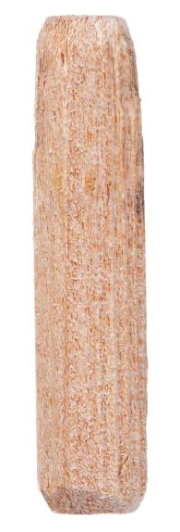
Stock forms, types and sizes
Timbers and components are commercially available
Planks, boards and standard mouldings,
Sold by length, width, thickness and diameter,
Using standard components such as woodscrews, hinges or knock-down fittings
What are the advantages of having stock forms, types and sizes of components?

Slide 6
Standardisation
Timber comes in a range of standardised sizes
Initially standardised sizes were imperial
The UK now works in the nearest metric sizes (millimetres 'mm') to the old standard imperial sizes
Lists of standard sizes are widely available
What problems could arise when building a house if the architect has not worked to standard sizing?

Slide 7
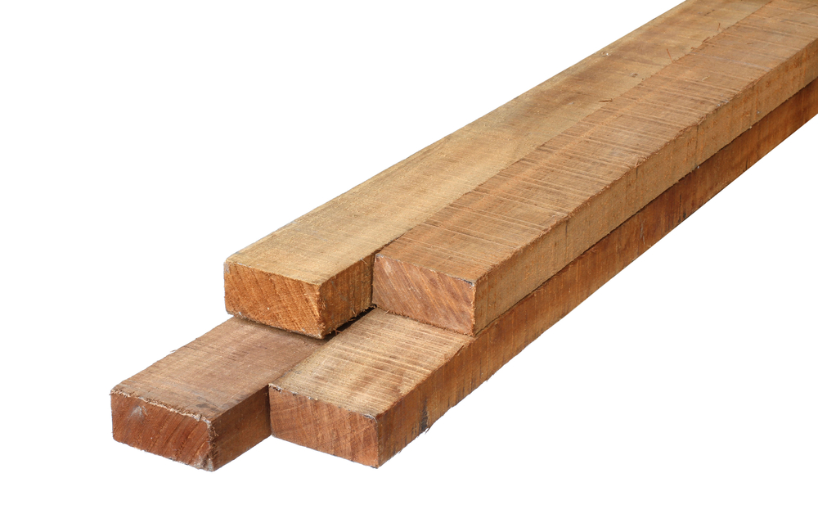
PAR and rough sawn
Planks and boards are stocked with different finishes: planed all round, and rough sawn
If ordering PAR timber (planed all round), the standard size will be reduced
This accounts for the material removed in planing
Where might rough sawn timber be most suitable for?

Slide 8
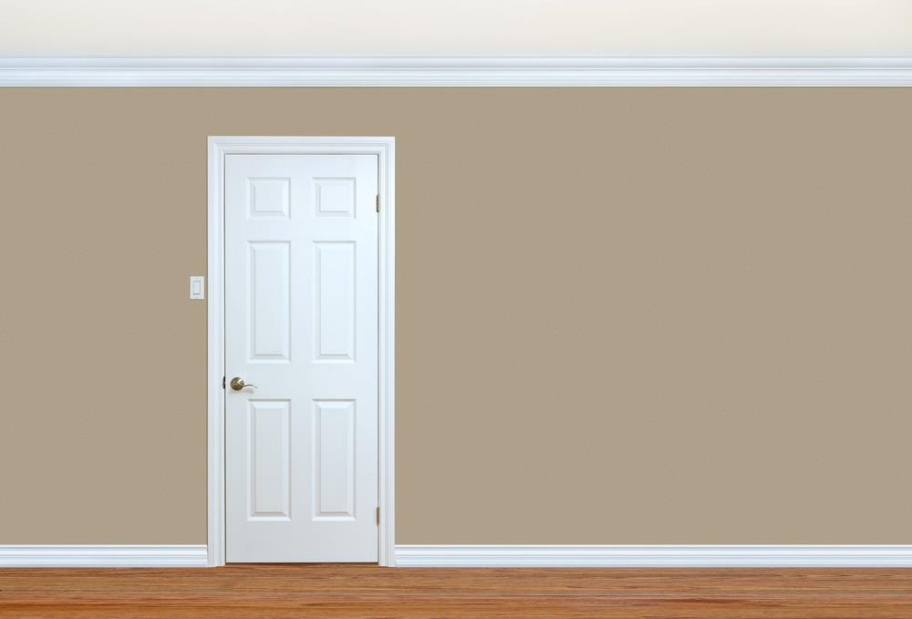
Standard mouldings
Mouldings are decorative timber components with a shaped profile
Where in a house are mouldings commonly used?
Mouldings can be made from natural timber or manufactured boards
How are mouldings produced?
How might they be pre-finished?

Slide 9
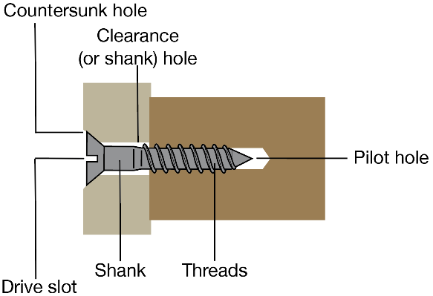
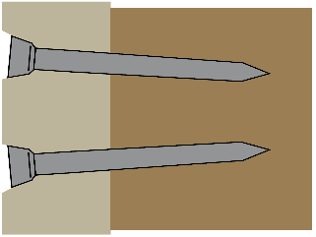
Wood fixings and components
Screws and nails
Dowel rods
Hinges
What are the advantages of 'countersinking' a screw?
If using nails to reinforce a timber joint, would you drive them in straight or at an angle and why?

Slide 10
Knock-down fittings
Knock down fittings (KDF) are often used for self-assembly furniture and kitchen carcasses
Why do many people favour flat-pack furniture over ready assembled pieces?
What tools may be required to assemble flat-pack furniture?
Connecting or block fitting
Cross dowel fitting
Cam lock fitting

Slide 11
Flat-pack furniture
Complete Task 1 of Worksheet 2

Slide 12
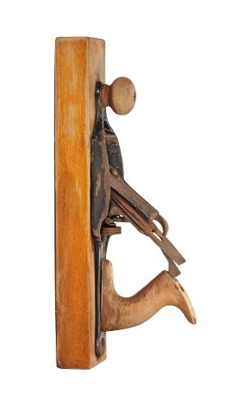
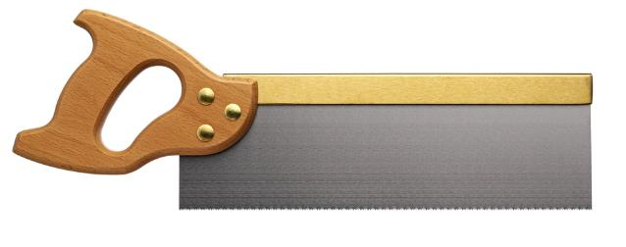
Specialist tools and equipment
Specialist hand tools can be used to accurately remove and shape wood
How many are you familiar with?

Slide 13
Wasting and abrading
Specialist tools include:
Planes, chisels, saws, surforms and rasps
Abrasive paper and sanding tools are also used to prepare a surface for finishing
The phrase 'measure twice cut once' is often used by crafts people. What do you think this means?
If you had three grades of glass paper – 80 grit, 120 grit and 200 grit, which one would you use first, which one second and which one would you use last?

Slide 14
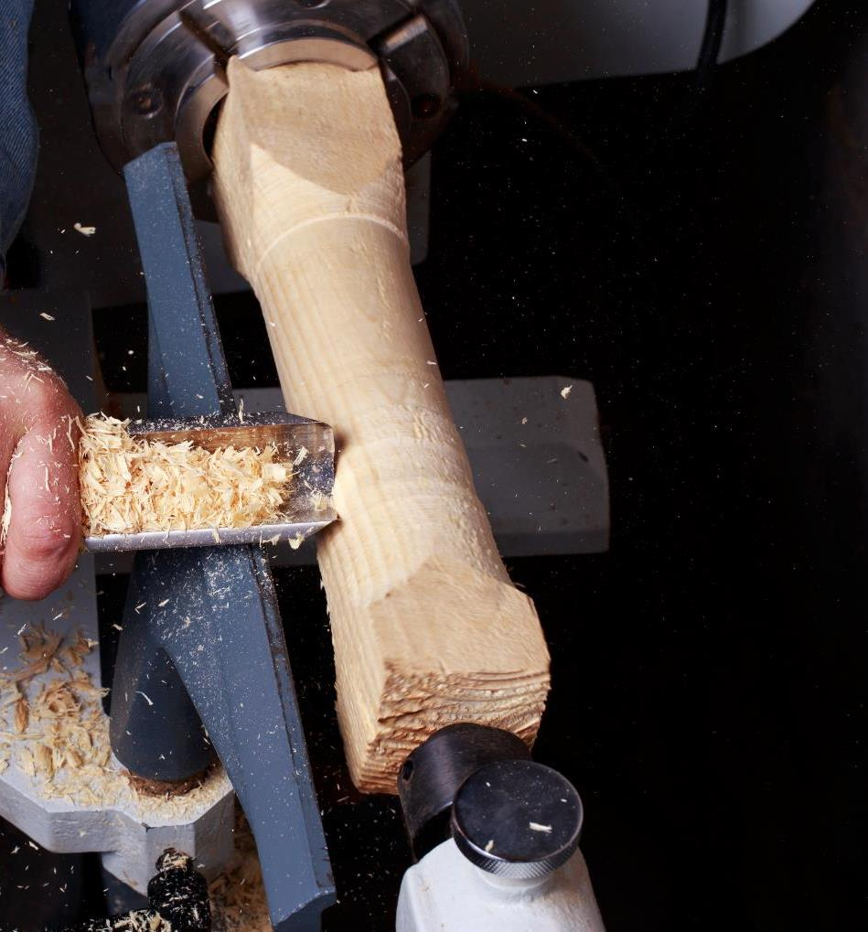
Wood turning
Lathes are used to 'turn' wood on a plate or between two points whilst it is shaped with tools
The speed of the lathe is adjusted depending on the size of the wood being turned
Why would it be wise to select a lower speed if turning a large bowl or dish?
When might you require a higher speed setting?

Slide 15
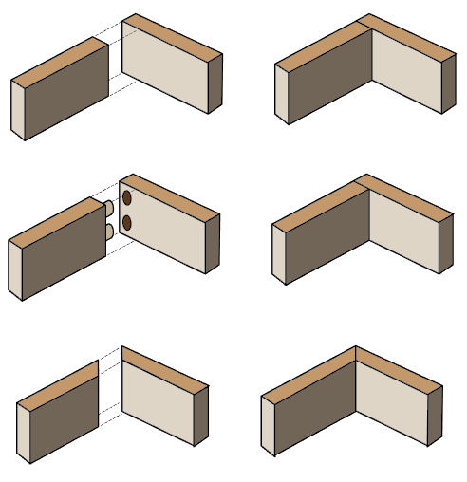
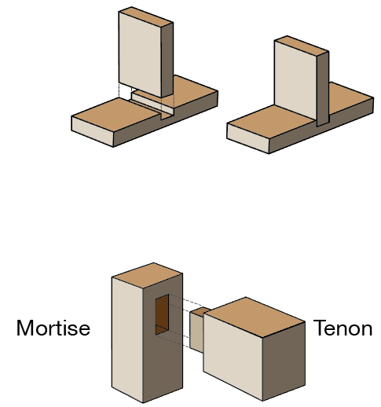
Wood joints
Wood joints are widely used where a strong join is needed
What are the advantages of using a dowelled joint over a simple butt joint?
How could you protect work from marking when using clamps?
Butt joint
Housing joint
Dowelled joint
Mortise and tenon joint
Mitre joint

Slide 16
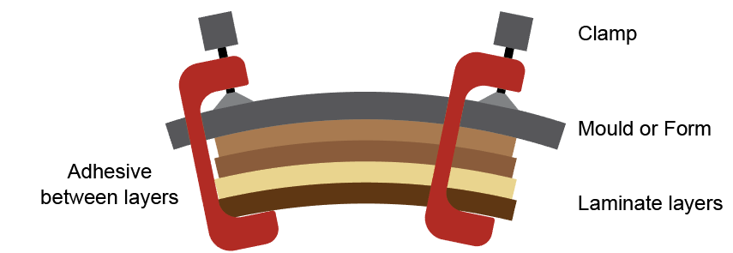
Lamination
Laminating means layering. It is often used to create curved components
Strips of timber are glued and placed over a jig or former
Either clamps or a vacuum press are used to exert pressure on the lamination while the adhesive dries or cures
Why is a laminated structure stronger than regular timber?

Slide 17
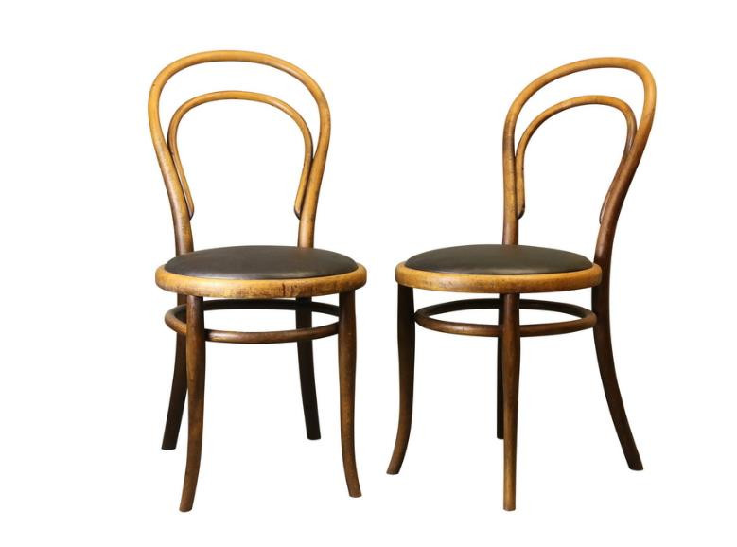
Bending
Solid wood can be bent into various shapes by increasing its moisture content
Wood can be soaked in water to make it more malleable
Using a hot steam box will speed up the process
The pre-softened timber is forced around a former or jig using a strap
It is then clamped and left to cool and dry out

Slide 18
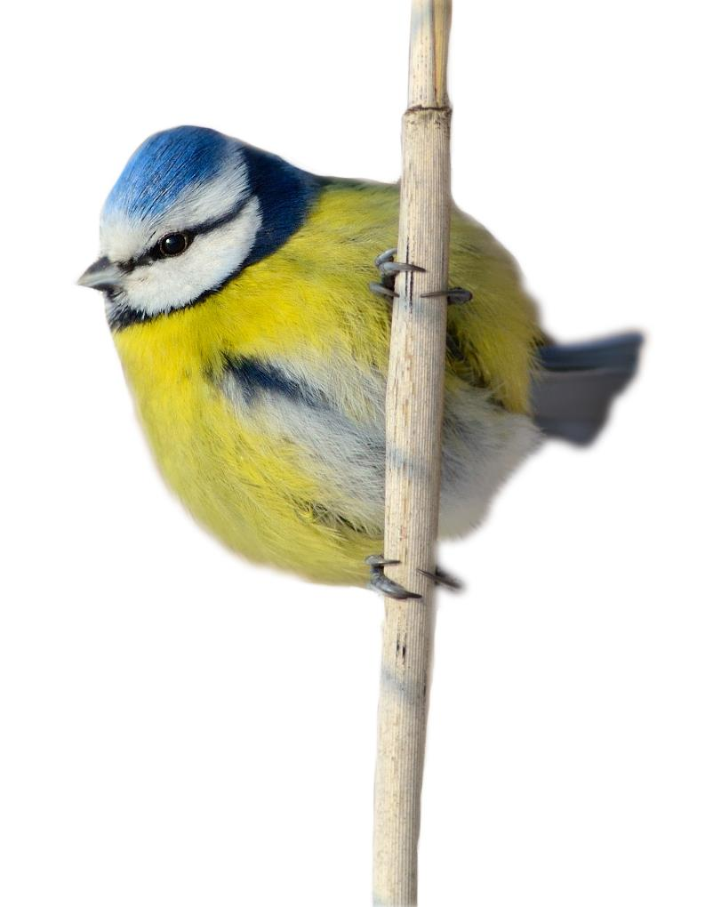
Task 2
Complete Task 2 of Worksheet 2
You should be familiar with common drilling, sanding, cutting and joining techniques and tools

Slide 19
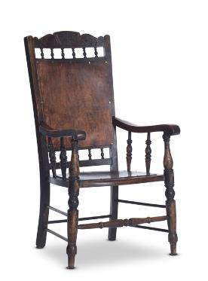
Plenary
Why are materials available in stock forms, types and sizes?
For the chair below, state where the processes of forming, deforming, wasting and abrading would occur:
What appropriate tools would be used for these tasks?

