Slide 1
AQA
GCSE
Design and Technology 8552
Commercial manufacturing,
treatments and finishes
Unit 5B
Timber based materials
3

Slide 2
Objectives
Know and understand how timbers and boards are selected and processed for commercial products
Learn how materials are cut, shaped and formed to a tolerance
Learn about the preparation and application of treatments and finishes to enhance functional and aesthetic properties

Slide 3
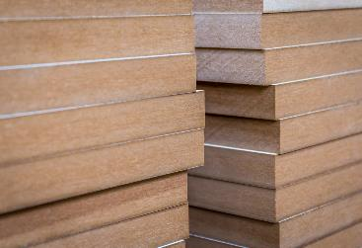
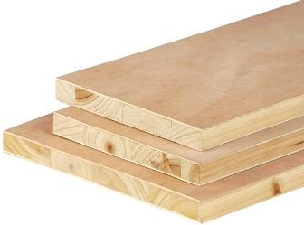
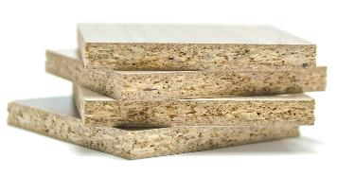
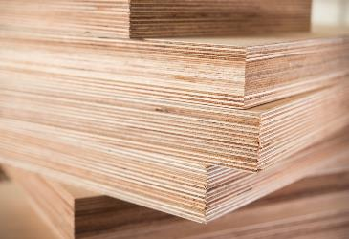
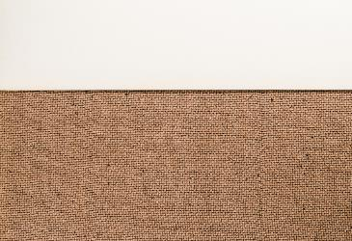
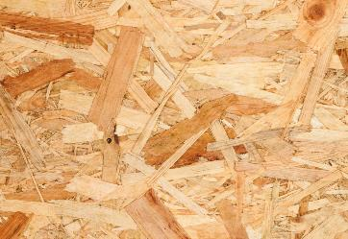
Manufactured boards
Identify the types of manufactured board shown below and suggest a use for each one

Slide 4
Engineered wood
Manufactured or engineered wood has many advantages over solid wood
May be mixed with glues to give greater strength and stability
Ideal for use in construction, industrial and domestic use
Efficient in its use of mixed materials and utilising waste wood
It can be made in a large sheets not limited by the diameter of a tree trunk
What would be three disadvantages of using man made board?

Slide 5
Flat-pack furniture
Manufactured boards are well suited to self-assembly products
They are generally less expensive than hand-made items
Arrives boxed making it easier to store and transport
Relatively straightforward to assemble with a basic tool kit
What properties of manufactured board make it suitable for flat-pack products?
Why do you think it may be less aesthetically appealing?

Slide 6
Choice of material
A day in the life of a child’s toy is a tough one!
They are thrown, dropped in water, left outside, stood on and chewed
Justify a suitable type of wood to make a child’s toy

Slide 7
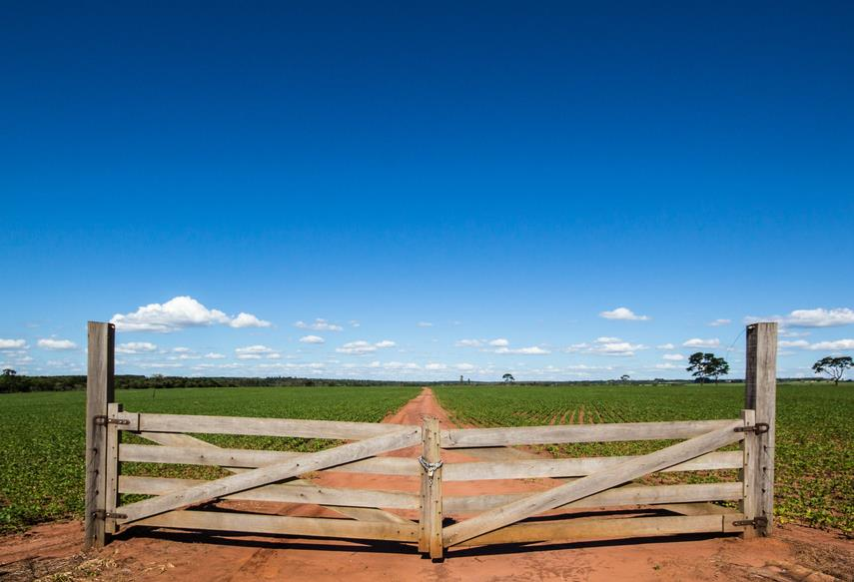
Natural or man-made
The type of material a product is made from will also influence the price of the end product
Similar products may be made from different timbers to appeal to different markets
Some timbers are traditionally used for certain products
Which timber would you select to make a gate? Give two reasons why?

Slide 8
Worksheet 3
Complete Task 1 of the worksheet

Slide 9
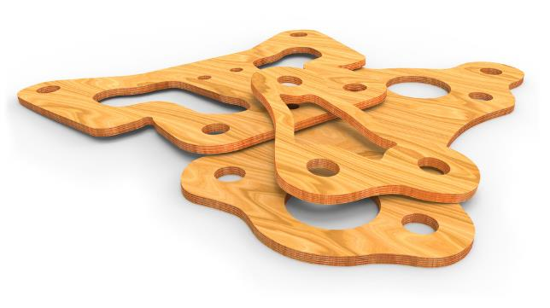
Commercial manufacturing
Mass produced timber components are produced using CNC machinery
This enables large quantities of equal- sized parts or products to be produced
Templates can be saved and reused to help minimise waste
Screw holes, slots and patterns can be cut in one process
What are the benefits to the manufacturer of minimising waste?
How could they dispose of the waste responsibly?

Slide 10
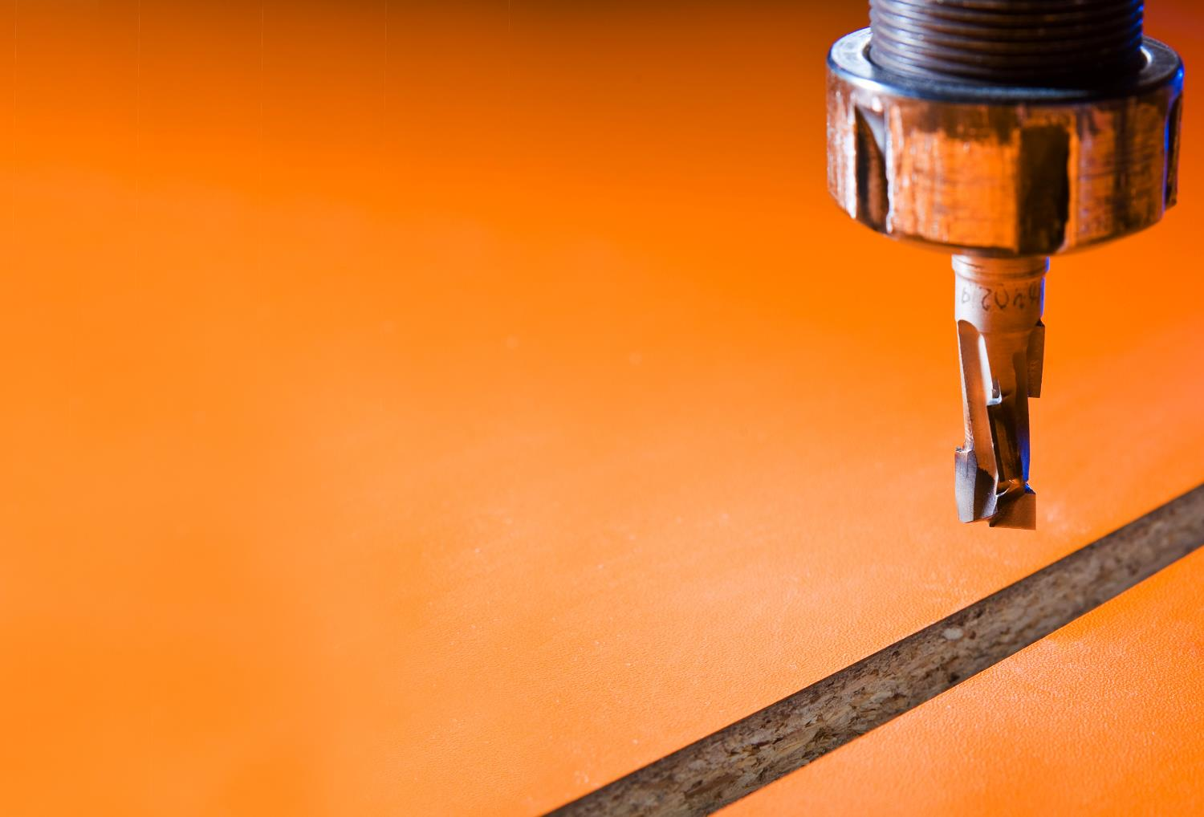
Commercial routing
CNC machinery can cut, drill, shape, mill and profile manufactured or natural timbers
Screw holes, slots and patterns can all be cut in one process
Machines can accommodate big sheets of material
Machines work quickly and efficiently enabling a product to get to market swiftly
What other advantages does CNC routing offer over hand cutting?

Slide 11
Commercial turning
CNC wood lathes produce cylindrical components
Once programmed they are very effective at producing complex shapes and spirals
Ideal for repeat production
Lathes can accept large and long pieces of material
What disadvantages would the introduction of CNC machinery present to a skilled workforce?

Slide 12
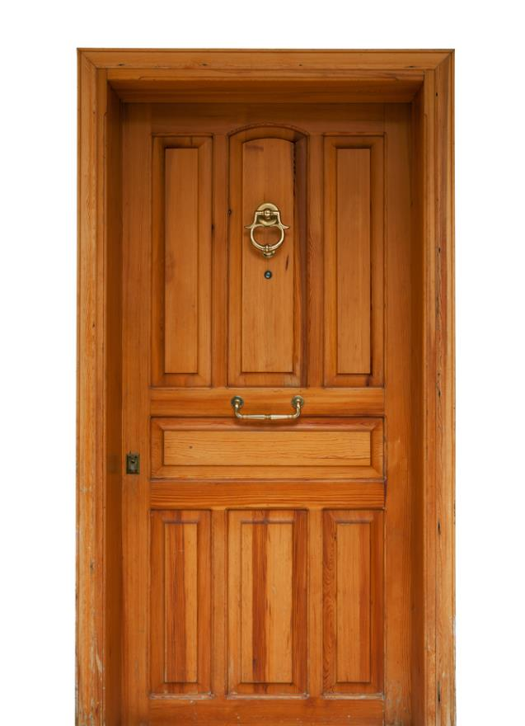
Routing and turning
These techniques are used to produce many day to day items
Think of five more examples

Slide 13
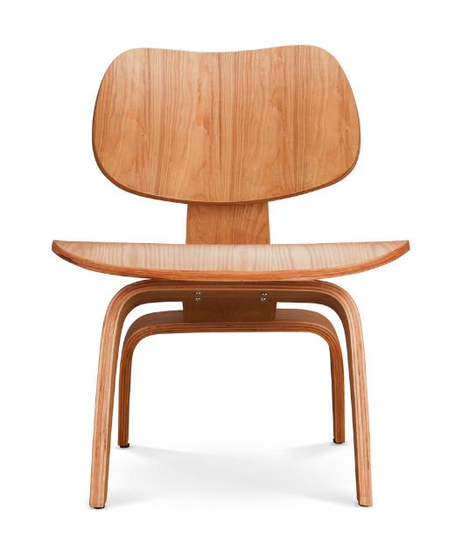
Mechanisation and automation
Automated machinery has changed the way industry manufactures timber based products
Improvements in manufacturing methods have been embraced by designers
Stringent quality control methods have increased consistency and accuracy
Increased availability of manufactured boards means products can be batch and mass produced
Discuss the differences between ‘mechanisation’ and ‘automation’

Slide 14
Quality Control – ‘QC’
The process where products are checked to ensure they meet the design specification
They should also:
function correctly
be free of defects
be consistent and accurate
meet set size tolerances
Make a sketch of the wooden shape sorter and compile your own QC checklist listing the key areas to check

Slide 15
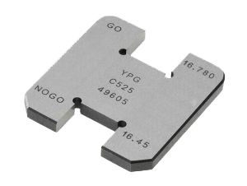
Tolerance
The total amount a specific dimension or property is permitted to vary
This can apply to hole depth, length, angle, thickness, weight and elasticity
A gauge can be inserted into a gap or hole to check if the sizes fall within tolerance
If parts do not fit within the specified tolerances they are discarded or recycled
Why is it important for a manufacturer to ensure they have rigorous quality control systems in place?

Slide 16
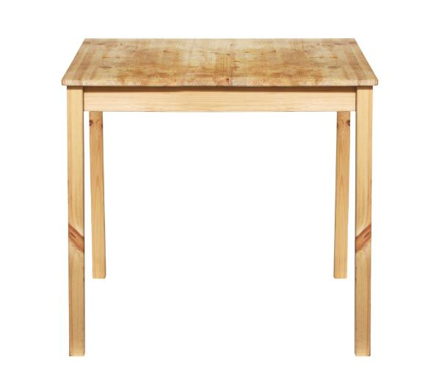
Go / No Go?
The required thickness for a table leg in a flat packed table is 25mm
Four legs are measured. The tolerance is +/- 0.5mm
Are they Go or No Go?
Leg 1: 25.46mm
Leg 2: 24.42mm
Leg 3: 25.51mm
Leg 4: 24.68mm

Slide 17
Go / No Go?
The required thickness for a table leg in a flat packed table is 25mm
Four legs are measured. The tolerance is +/- 0.5mm
Are they Go or No Go?
Leg 1: 25.46mm Go
Leg 2: 24.42mm No Go
Leg 3: 25.51mm No Go
Leg 4: 24.68mm Go
What are the consequences if the table leg doesn’t fit within the tolerance?

Slide 18
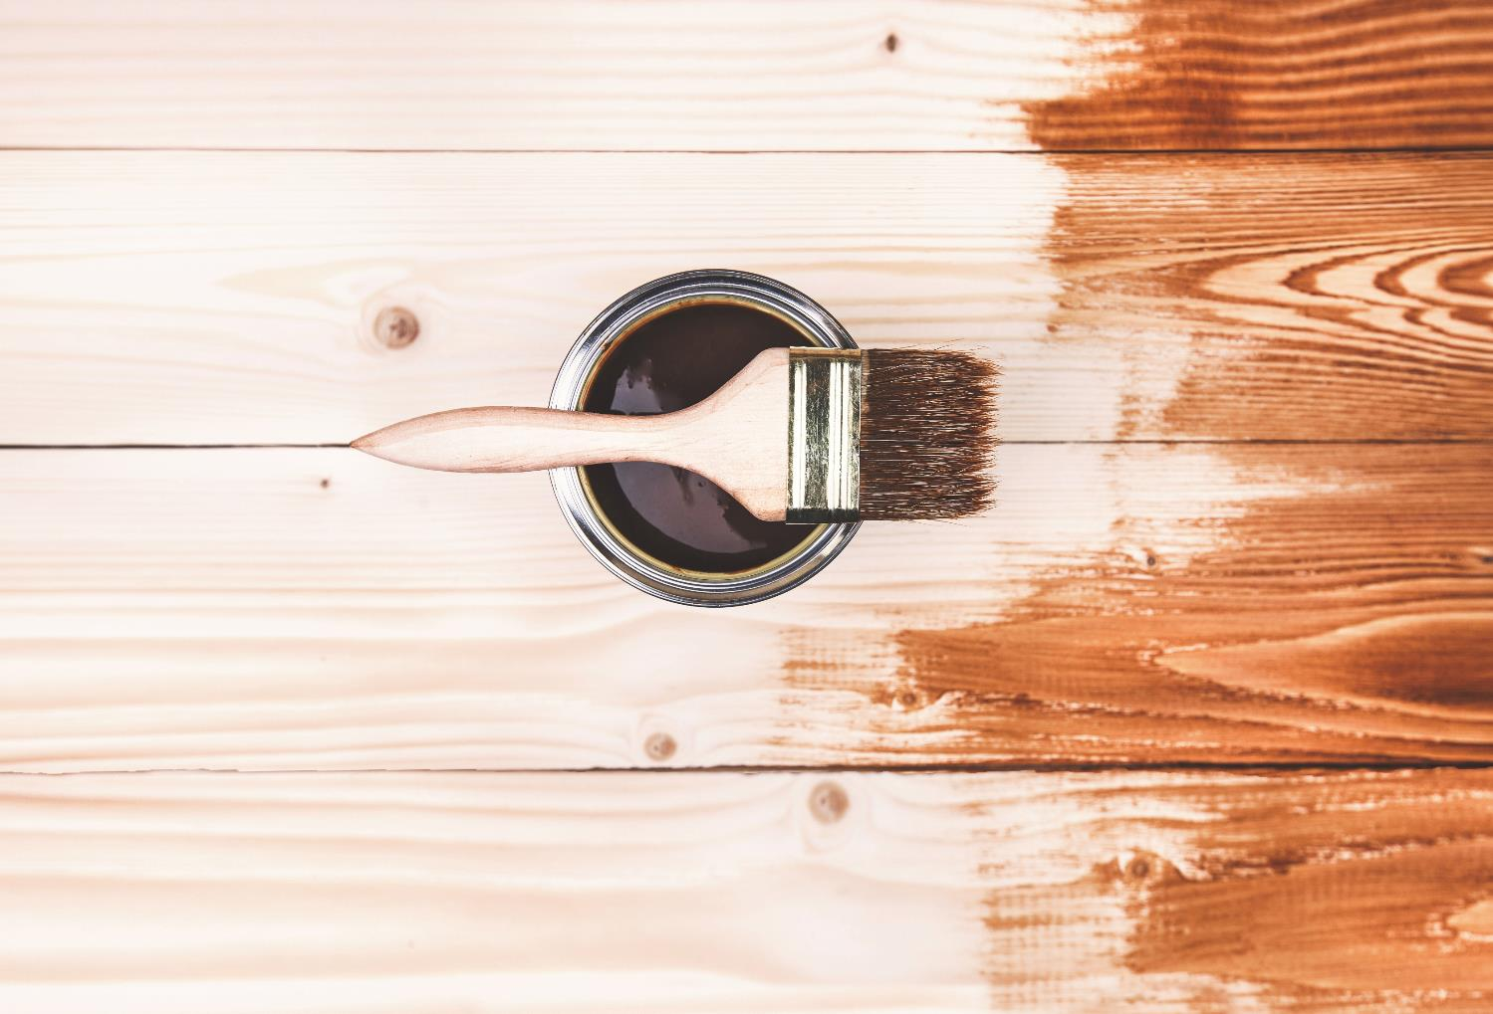
Surface treatments and finishes
Wood can be protected and visually enhanced using:
Preservative
Wax
Oil
Paint
Stain
Varnish
Finishes can be applied by brushing, rubbing or spraying
What treatments and methods would you use to finish a garden shed, a toy wooden boat and a cricket bat?

Slide 19
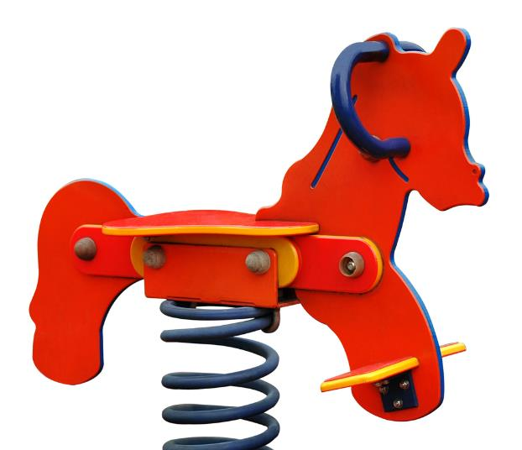
Enhancing the appearance
As well as improving the function, finishes can make a product more appealing
How would you enhance the natural grain of wood?
Why would you choose to paint a child’s toy rather than leaving it bare?

Slide 20
Wood preservation
Treating timber can help extend its life for decades
Tanalising is the process in which timber is immersed in a preservative
Hydraulic pressure forces the treatment deep into the timber
Helps delay the rotting process
Protects against insect and fungal attack
Where might you find tantalised timber in use?

Slide 21
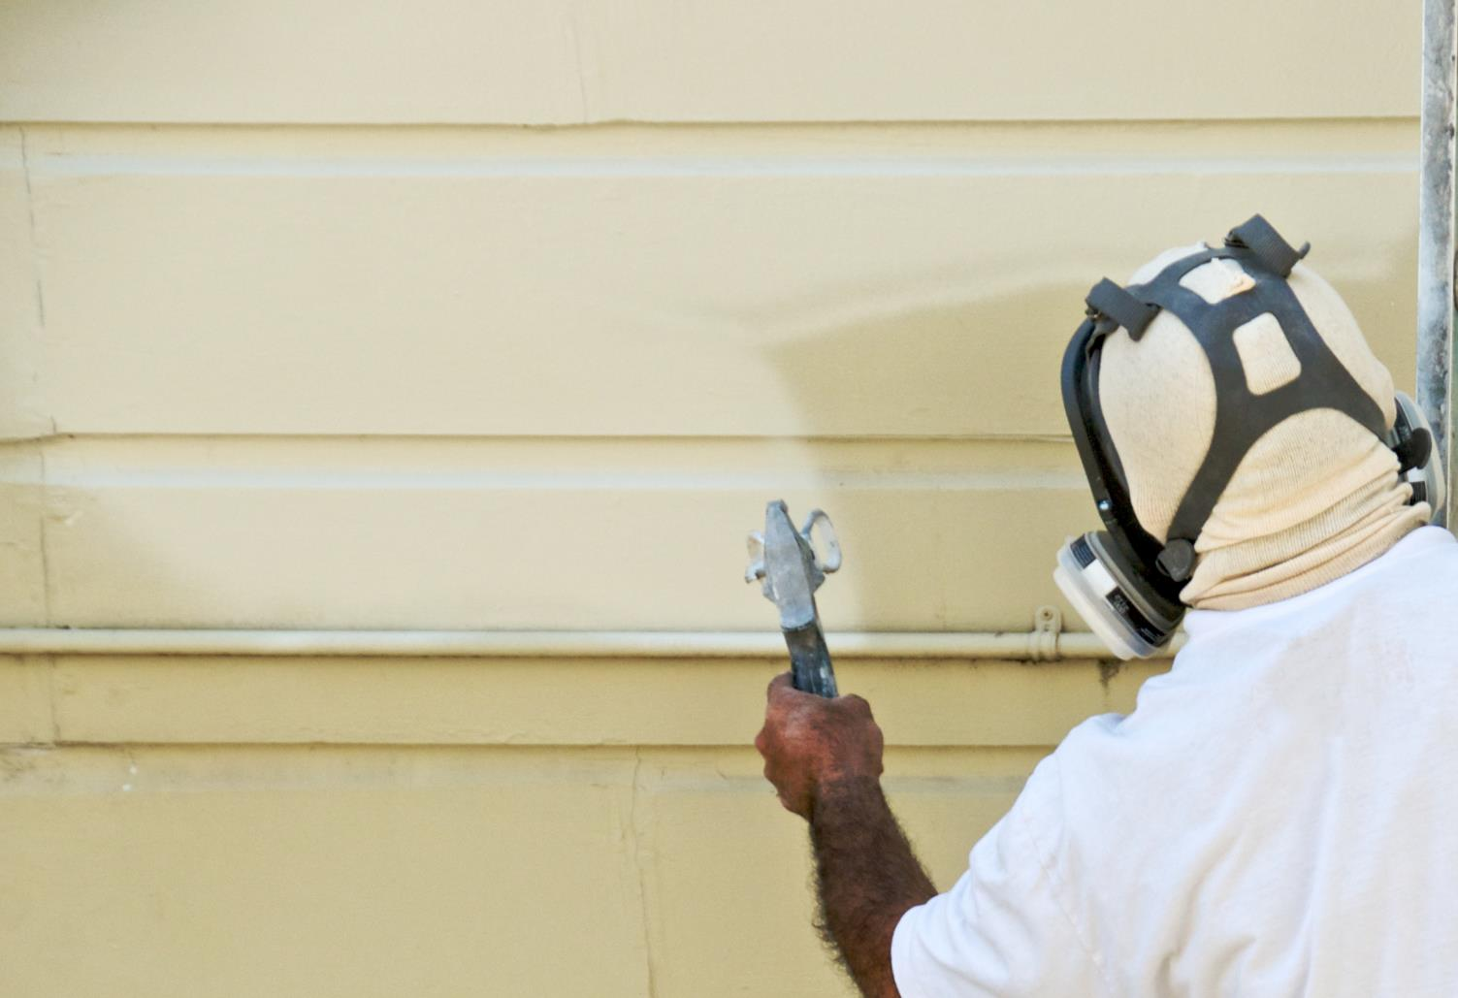
Commercial finishing
Modern finishes can extend the life of timber based products
Products can be sprayed by hand or machine
Patterns, logos or wording can be printed onto the surface
One of the fastest ways of painting is using a ‘curtain coater’ which gives a smooth and even coat
What are the advantages of applying a finish on a production line?

Slide 22
Environmental impacts
Traditional paints and finishes can have harmful effects on the environment
Oil or solvent based products offer long lasting finishes, but contain high levels of VOCs – Volatile Organic Compounds
Water based products are kinder to the environment
Paint can be made from recycled latex and even milk
What items of PPE would you use when using a solvent based finish on a wooden floor?

Slide 23
Worksheet 3
Complete Task 2 on the worksheet

Slide 24
Plenary
What factors would a furniture manufacturer consider when selecting a material to make flat-pack furniture?
How has machinery improved the production of mass produced timber components?
Why are tolerances so important to check as part of the quality control process?
Which products help protect or improve the aesthetics of timber based materials?

