Slide 1
AQA
GCSE
Design and Technology 8552
Commercial manufacturing and quality control
Unit 5D
Polymers
3

Slide 2
Objectives
Understand how the properties of different polymers influence use and affect performance
Be aware of commercial processing techniques for plastics
Understand the application and use of quality control during manufacture
Understand how preparation and the application of surface treatments and finishes affect the functional and aesthetic properties of polymer-based products

Slide 3
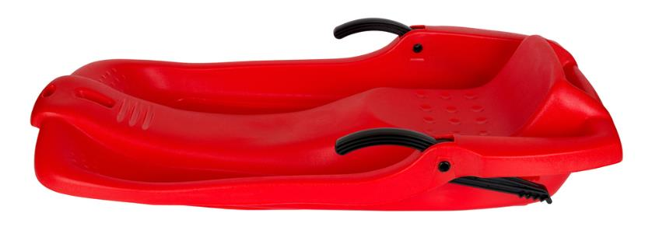
Polymer seating
Plastic is used for this sledge seat
What functions must a sledge perform?
What conditions is a sledge expected to withstand?
What properties does a sledge require in order to do its job?
Which category of plastic best lends itself to these properties?

Slide 4
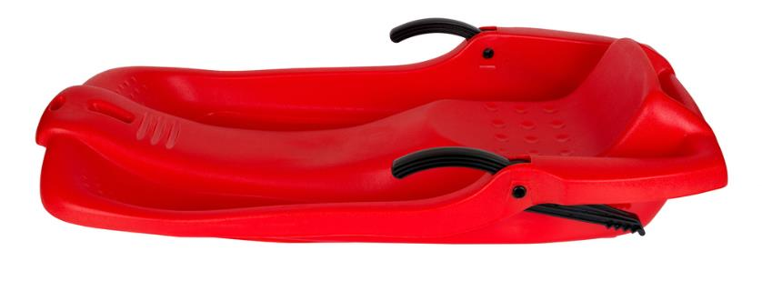
Properties of thermoplastics
Waterproof
Lightweight
Durable
Good strength to weight ratio
Easy to mould
Tough
Easily coloured
Scratch resistant
Corrosion resistant
Chemically resistant
Good flexibility

Slide 5
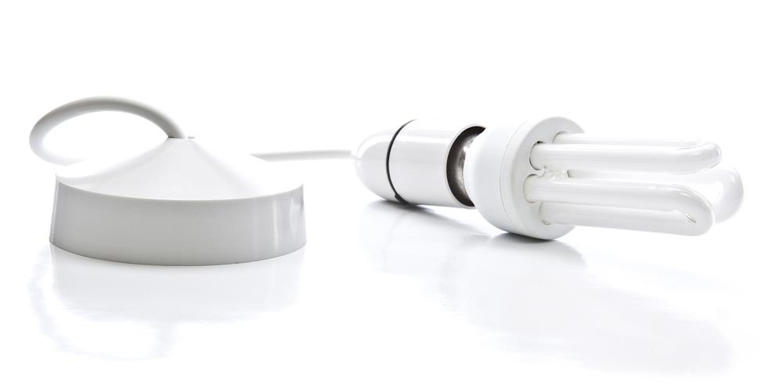
Electrical fittings
Why is plastic used for electrical fittings?
What properties does it need to withstand heat?
What properties does it need to ensure safety?
Which category of plastic best lends itself to these properties?

Slide 6
Properties of thermoset plastics
Waterproof
Durable
Hard
Scratch resistant
Resists high temperatures
Electrical insulator

Slide 7
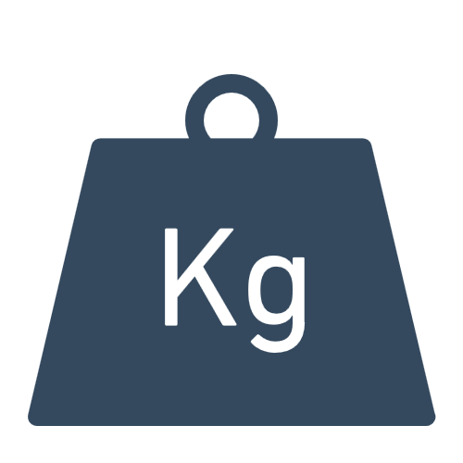
Worksheet 3
Choosing the right plastic for a given task depends on a number of factors
What are some of these factors?
Complete Task 1 in the worksheet

Slide 8
Factors to consider
Aesthetics – including the required finish
Cost and availability of plastic
Weight of plastic – is it appropriate to the end product?
Size of product and size of material available
Where is it going to be used?
Workability – can it be easily cut and used?
Stability of material
Durability - how long does it need to last?
Desired properties of the product

Slide 9
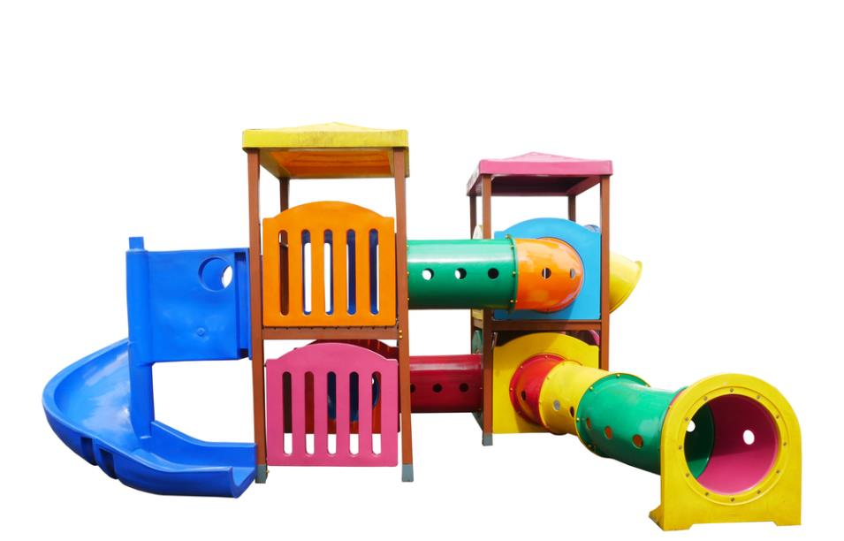
Commercial production
Many different plastic processing methods are used in industry including:
Injection moulding
Extrusion
Blow moulding
Rotational moulding
Vacuum forming

Slide 10
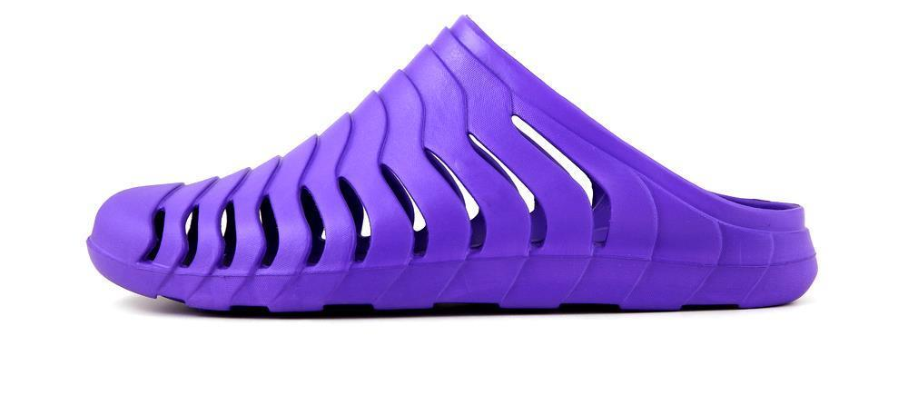
Injection moulding
Used for a wide variety of plastic products including:
Beach shoes
Small electrical appliance casings
Building blocks
Seating

Slide 11
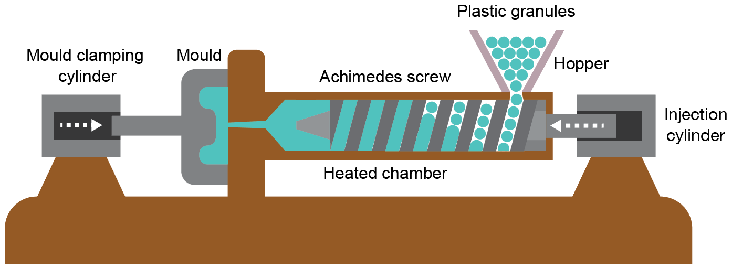
Injection moulding
High-volume production process
Parts produced at a rapid rate
Tooling costs are high but once moulds are made the unit costs are relatively low

Slide 12
Injection moulding process
Complete the stages in the process below:
Granules or pellets are fed into the _________
The hopper feeds the ________________ that drags the granules past a heater, where they melt
The plastic is _______ as it reaches the end of the screw, where it collects until there is enough to fill the mould
At this point an _______________ forces the molten plastic into the mould under pressure, filling it up
The plastic sets quickly, the mould is separated and the ________________ releases the moulding

Slide 13
Injection moulding process
Complete the stages in the process below:
Granules or pellets are fed into the hopper
The hopper feeds the Archimedes screw that drags the granules past a heater, where they melt
The plastic is softened as it reaches the end of the screw, where it collects until there is enough to fill the mould
At this point an injection cylinder forces the molten plastic into the mould under pressure, filling it up
The plastic sets quickly, the mould is separated and the clamping cylinder releases the moulding

Slide 14
Injection moulding
After watching the video on how the Panton chair is manufactured, complete Task 2
What are the advantages of injection moulding the chair?

Slide 15
Extrusion process
Extrusion uses a die instead of a mould and this sets the profile shape
A continuous flow of molten plastic passes through the die at just the right temperature to hold the shape
The extruded plastic then passes onto a cooling table or cooling trough where it fully solidifies

Slide 16
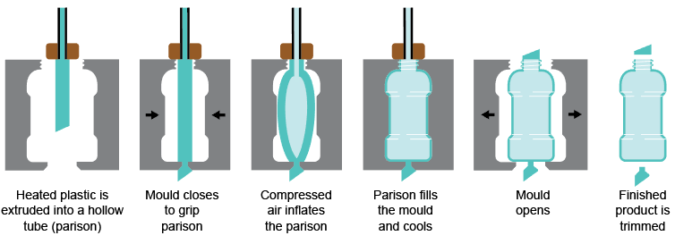
Blow moulding
A manufacturing process often used for bottles
An extruded tube (parison) is blown into a desired shape
Why is the mould cooled with chilled water?

Slide 17
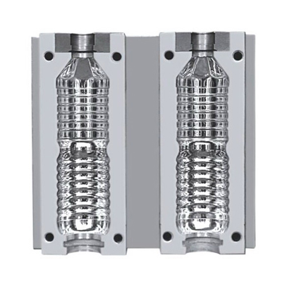
Tooling for blow moulding
A plastic parison is inserted into the mould top
Warm air inflates the parison to fill bottle mould

Slide 18
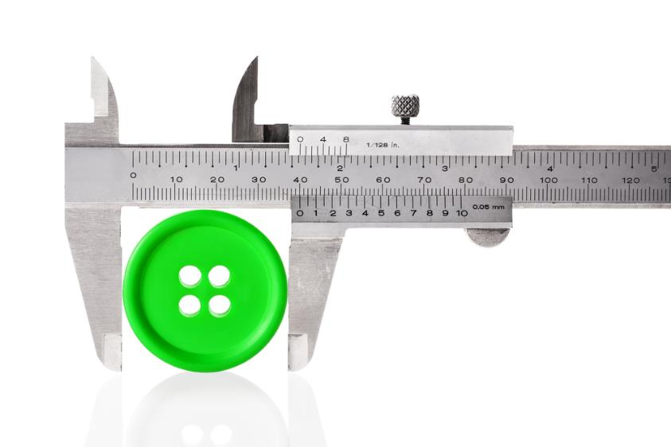
Quality control
Quality Control (QC) checks are carried out to ensure that each product is being produced to the correct specification
QC checks are made to make sure that each product meets a specific standard and is safe to use

Slide 19
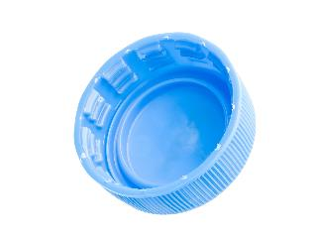
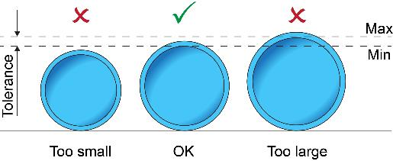
Quality control
The most common checks might include:
Dimensional accuracy (e.g. within tolerance)
Weight
Pressure testing and checks for leaks
Flammability tests
Example: An injection moulded plastic bottle top could be tested after 10, 1,000 or 1,000,000 of them have been produced
What might the test include?

Slide 20
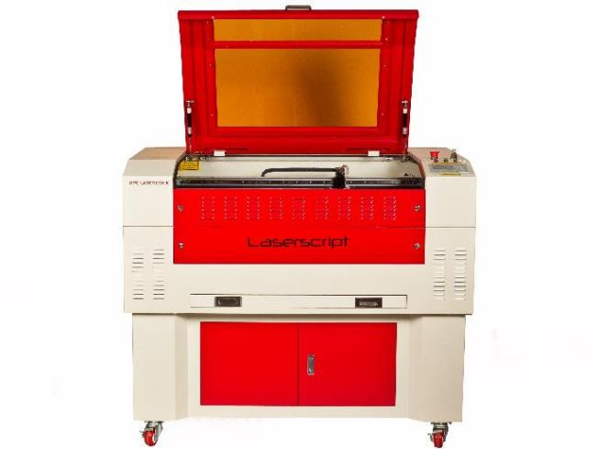
Laser cutting
This is one of the most accurate ways to cut different types of thermoforming polymer sheets
The laser can follow a design to a very fine tolerance
Laser cutters are a safe way to create objects if set up correctly
Extraction is used to remove and filter harmful fumes
What advantages are there to laser cutting?

Slide 21
Laser cutting settings
Laser cutters must be set up correctly taking the following into consideration:
Kerf allowance: This is what the laser removes when cutting (somewhere between 0.1-1mm normally)
Power and speed settings: Lasers cut using a combination of speed and power (deeper cuts are made with slow speeds and high power settings)
Focusing the beam: The focal length of the laser will affect the quality of the cut or etch
Clean mirrors and lenses: This prevents a reduction of power as the head moves away from the source of the laser

Slide 22
Surface treatments and finishes
The main reasons for finishing materials are:
Protection - To make the plastic last longer (more durable)
Aesthetics - To make the plastic more appealing
Functionality - To improve its properties e.g. grip
Most plastics are self-finishing but protection can make it less prone to UV damage and colour fade
A number of specialist techniques are on offer, depending on the desired finish
Can you think of any methods to finish plastic?

Slide 23
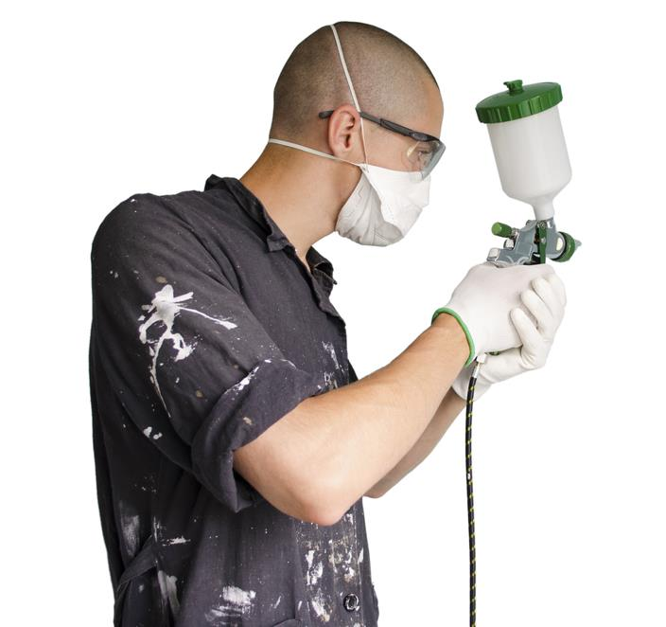
Spray primer and paint
Plastics are primed and sprayed with paints for aesthetics and protection from UV degradation
Quick to apply but contain VOCs (volatile organic compounds) which are hazardous fumes
What two things can you do to avoid inhalation when using spray paint?

Slide 24
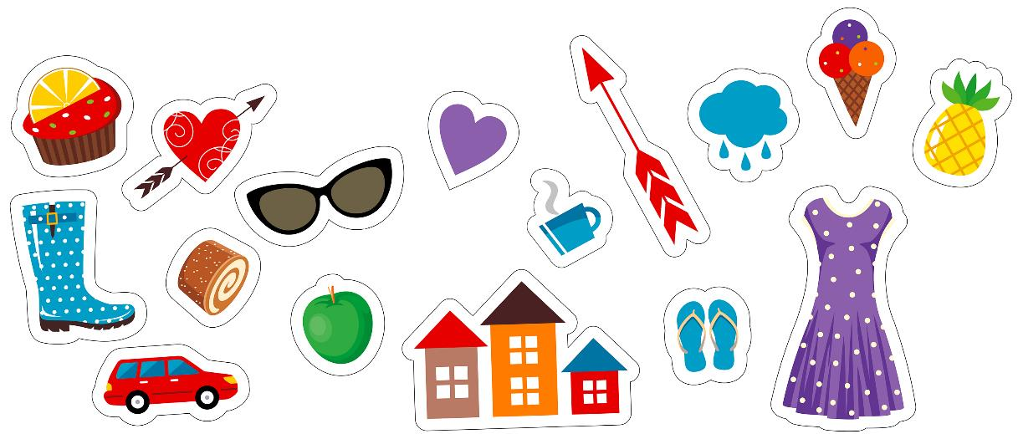
Vinyl decals
Printed and cut self-adhesive vinyl can be attached to most surfaces
These are relatively easy to make and use in your projects if you have access to a CAD program and a vinyl sticker machine

Slide 25
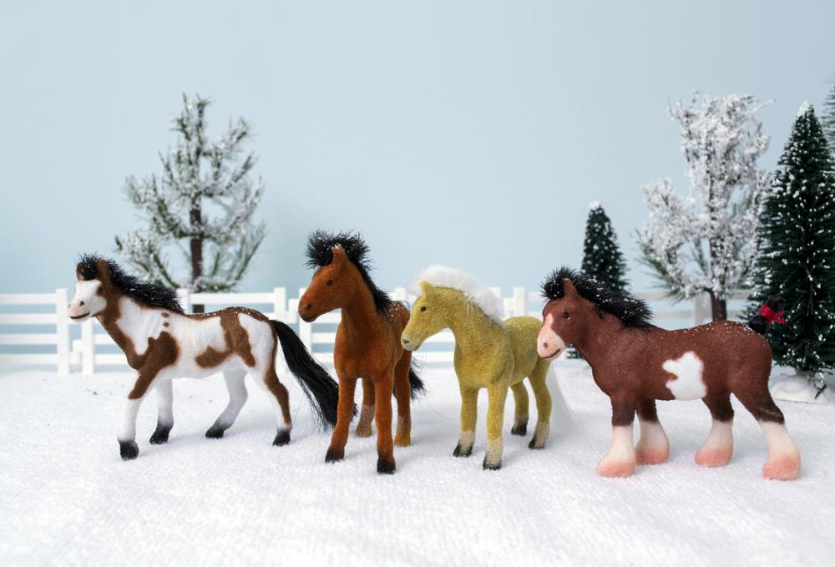
Flocking
Polymer flocking fibres are bonded to statically charged materials with adhesive

Slide 26
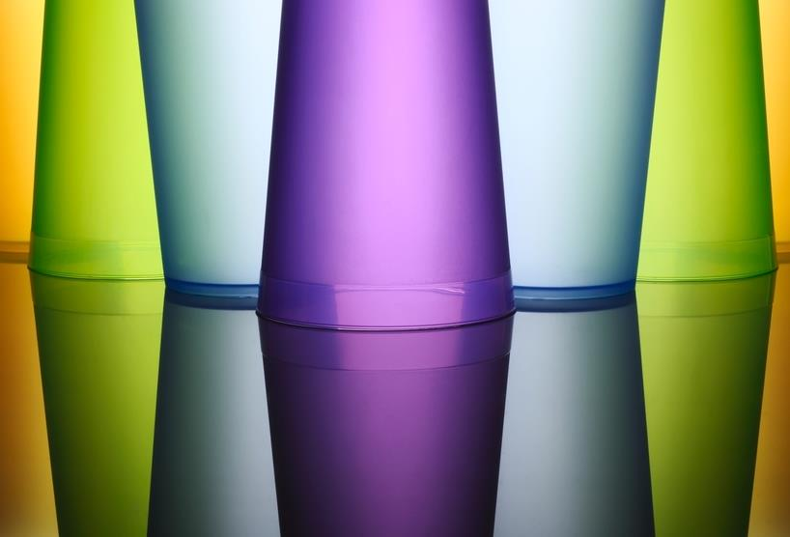
Etching and frosting
Laser-etched surfaces can reflect light effectively
Frosting covers larger areas to make plastic opaque

Slide 27
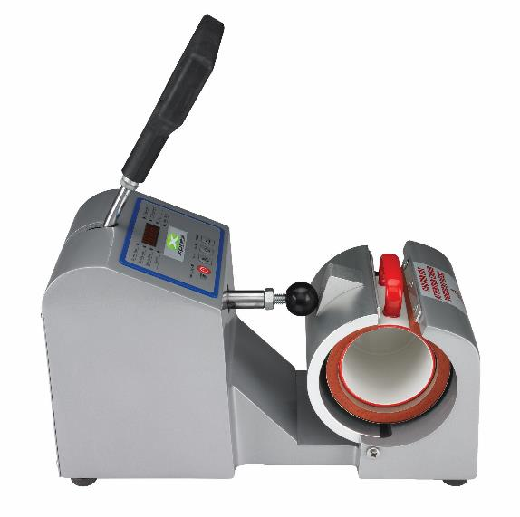
Heat transfer printing
Image is printed onto special transfer paper and bonded onto the surface with a heat press
This is commonly used to personalise mugs and clothing

Slide 28
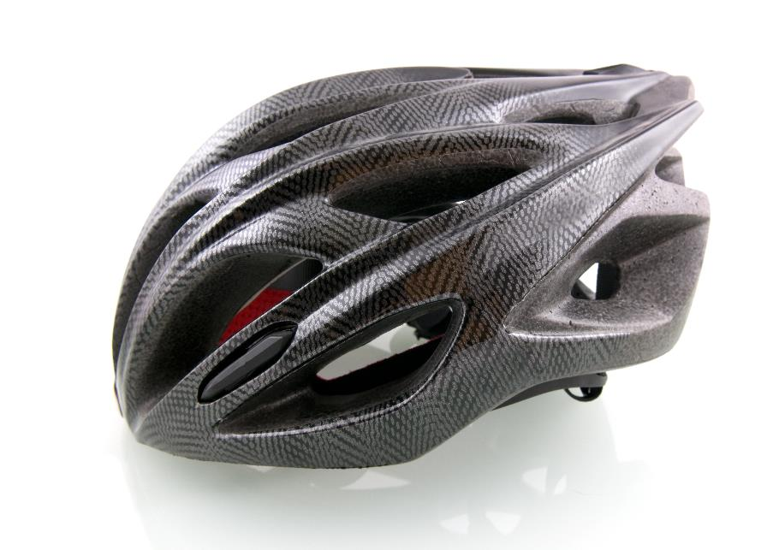
Hydrographic printing
Colour images are printed onto water soluble film which floats in a tank
The product is submerged and the image wraps around it

Slide 29
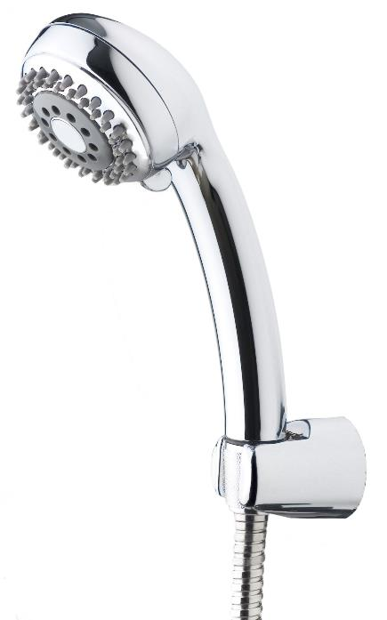
Electroplating
Plastics are covered in a conductive layer or etched before plating
Used predominantly in the automotive industry (car trims), in electronics, bathroom fixtures and various household goods
What benefits does electroplating have?
Why are shower heads chrome plated rather than being made of solid metal?

Slide 30
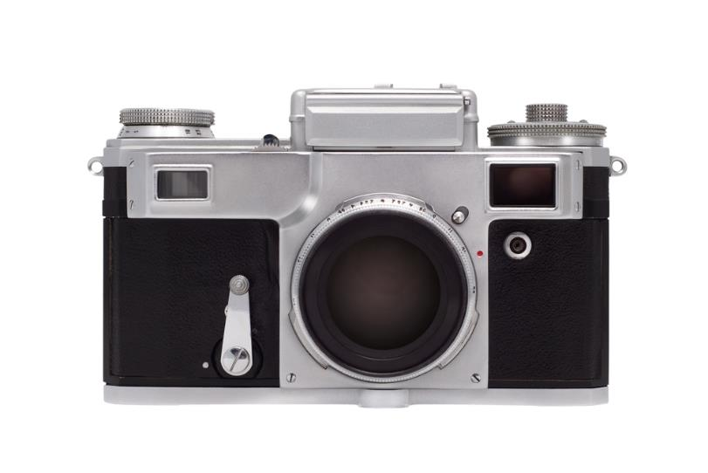
Rubberising spray
A slightly textured coating with a matt finish
Sprayed onto various materials to provide grip
Where might rubberising spray be used on this camera?

Slide 31
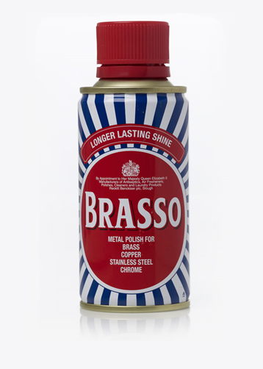
Polishing
Plastic can become rough or scratched when processed and can become weathered or faded if left outside
Polishing techniques are used to restore a high quality finish
Brasso® is often used to give a lustrous shine to plastics

Slide 32
Summary
Plastic can be shaped or formed using a variety of industrial processes such as injection moulding and extrusion
There are a number of finishing techniques that can be used to give a particular colour or texture to a plastic
Quality control is an essential stage of manufacture

Slide 33
Plenary
Suggest three different surface treatments for plastic
What advantages are there to adding a surface treatment or finish to plastic products?
Why is it important to carry out quality checks before and during manufacture?
Name three different commercial processing techniques for plastics

Slide 34
Plenary Answers
Polishing, rubberised spray, spray painting, electroplating, hydrographic printing, etching and frosting, flocking, vinyl decals
Improves durability and aesthetics of a product
To ensure consistency in each product produced
Extrusion, injection moulding, laser cutting, blow moulding, vacuum forming

