Slide 1
A Level Sociology
Seaford college sixth form
Head of SOCIOLOGY – MR KEVIN RICH

Slide 2
What is sociology anyway?

Slide 6
What does this famous clip tell us about gender?

Slide 7
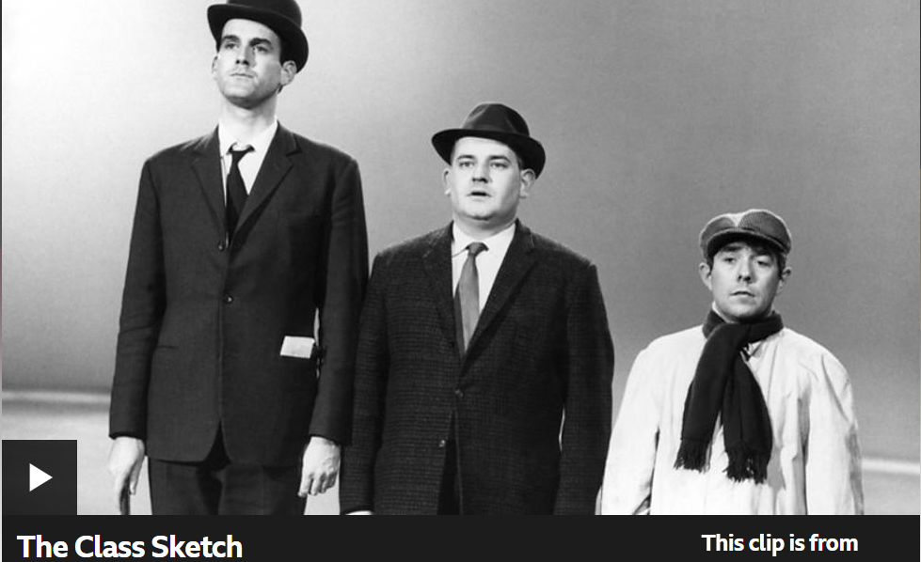
What does this famous clip tell us about social class?

Slide 12
Functionalists suggest crime and deviance is inevitable. It provides a safety valve for society to regulate. Some people will naturally rebel when they feel frustration or cannot achieve their goals. Punishment reinforces the shared values of the majority.
Marxists may present a view about the alienation and exploitation of certain groups. People who have been stuck at the bottom of society – feeling trapped they vent they anger in different criminal ways. They argue that Capitalism itself is criminogenic.
So how might a sociologist explain this?
The New Right will blame violence and unrest on the inadequate socialisation of young people due to family breakdown and anomie – a mistrust of norms and values.
Interactionists may argue that individuals can interpret themselves as deviant because of being labelled by authorities or police. This leads them to behave in ways that supports the creation of a self-fulfilling prophecy.

Slide 14
How people and society interweave...
It provides a strong basis for future study in a wide range of academic subjects at degree level.
It stimulates an awareness of key social and cultural issues that affect society.
It provides a vehicle for developing essay writing skills, appreciating alternative viewpoints and drawing upon theoretical perspectives on contemporary issues.
It provides a different educational pathway from anything students have experienced to date.

Slide 15
Course content
Year 12
Families & Households
Crime & Deviance
Education and Methods
Year 13
Stratification and Differentiation
Theories of Sociology
Research methods in context - Education

Slide 16
Examinations
Three two-hour written exams
No coursework
All papers are 80 marks and equal weighting
Mixture of 4, 6, 10, 20 and 30 mark essay questions
All done at the end of year 13

Slide 17
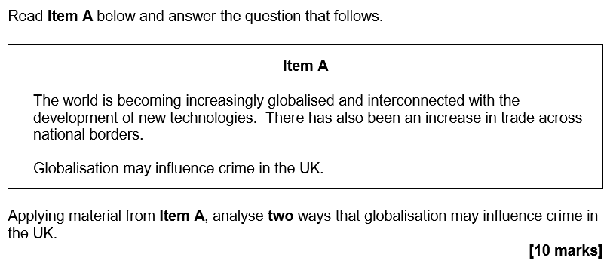
Typical question

Slide 18
Future pathways
Possible related career options:
Social work
Human resources
Advertising
Policing
Marketing
Journalism
Law
Teaching
Research.
… and many more.
Possible degree options:
According to bestcourse4me.com, the top
six degree courses taken by students who have an A-level in sociology are:
Sociology
Psychology
English studies
Business studies
Law
Teaching.
You can also do a number of joint honours degrees e.g. Sociology and Criminology

Slide 19
So, what should I expect?
Sociology is a rigorous, academic, and largely essay based subject (much like History, English Literature, Geography, Politics and Economics)
All assessment is exam based and will come at the end of the second year.
You should have a reasonable interest in social psychology, politics and current affairs.
It is a challenging, but highly rewarding subject, due to its relevance for helping us know what factors shape and influence our lives.

Slide 20
Why should you choose it?
Because....
It is fascinating
It is enjoyable
It is a challenge
It is intellectually demanding
It provokes great discussions
It inspires us to change things for the better
It helps us to understand ourselves
It broadens our horizons

Slide 21
How might I get on?
72% A-C Summer results 2024 (100% A-D)​
Current sociology students at Seaford. (Very popular A level choice)
​
31 students in year 13
33 students in year 12.

Slide 22
You will be the fourth cohort of a new(ish) and exciting subject offering at Seaford.
Please feel free to ask questions?

