Slide 1
English Literature A Level
English Language A Level

Slide 2
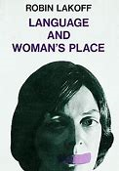
English Language A Level
Do men and women talk differently?
How do children acquire language?
How do you respond to different accents?
Is textspeak destroying the English language?
How and why are American and British English different?
How do advertisers use language to make you buy their products?
How and why does language change?

Slide 3
English Language A Level - AQA
Language, the Individual and Society - Analysis of a unseen texts, exploring how language affects representation plus a discursive essay on child language acquisition. (2 hours 30 mins exam - 40%)
Language, Diversity and Change - Discussion and analysis of texts relating to how language differs according to context and changes over time. Responses to language issues such as gender, occupation, technology and race. (2 hours 30 mins exam - 40%).
Language in Action - Coursework folder, comprising a language investigation on a topic of your choice and some original writing with an accompanying commentary (3500 words - 20%).

Slide 4
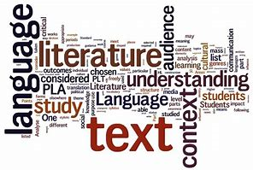
English Language A Level
Fascinatingly wide-ranging
Overlaps with aspects of Psychology, Sociology etc…
Content and skills
Creative writing aspect – you will become a better writer
Need to be interested in language in the real world
Can do alongside English Literature as they complement each other
Minimum grade 7 at GCSE

Slide 5
English Literature A Level
Do you love reading poetry, prose and drama?
Have you enjoyed English Literature GCSE?
Do you like looking beneath the surface of texts?
Do you like debating and discussing interpretations?
Are you enthusiastic about doing wider reading?
Have a go at reading Birdsong, Small Island or Atonement. Go to the Globe and watch a Shakespeare play. Read some Larkin poetry.

Slide 6
English Literature A Level - Edexcel
Drama – students study Shakespeare’s Othello or Twelfth Night and Tennessee Williams’ A Streetcar Named Desire.(Exam – 2hrs 15mins, 30%)
Prose – 1hr exam – students study Margaret Atwood’s The Handmaid’s Tale and Mary Shelley’s Frankenstein.(Exam – 1hr, 20%)
Poetry – students study a selection of post-2000 poetry in The Forward Book of Poetry and Chaucer’s The Wife of Bath’s Prologue and Tale.(Exam – 2hrs 15mins,30%)
Coursework- students choose two texts not studied in the rest of the course on which to write a comparative essay of 2500 –3000 words. The texts are of the student’s choice but must be agreed by the exam board. Past textual choices have included F. Scott Fitzgerald’s The Great Gatsby, JD Salinger’s The Catcher in the Rye and Sebastian Faulks’ Birdsong. (Coursework –20%)

Slide 7
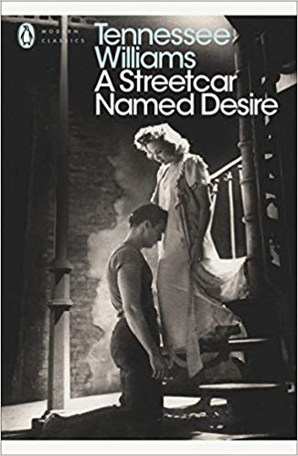
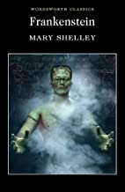
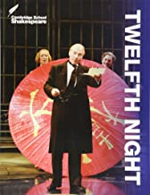
English Literature A Level
Security of the text
Develops your analytical and writing skills
Complements other subjects well
Spend two years doing what you love!
Only choose it if you love reading!
Choose Lang or Lit based on interest, not grades

