Slide 1
Psychology
Mrs Yates

Slide 2
True/False
You only use 10% of the brain
Its all about body language and mind reading and we can tell who is lying by observing these things
You can tell from TV appeals for missing persons whether they are lying and have been involved in the disappearance.
Psychologists can diagnose mental illness
I don’t need maths skills for psychology
Psychologists and psychiatrists are the same
It is easier than other subjects
Left brain artistic - right brain maths
We sit around and talk about our feelings – psychology lessons are basically therapy
It isn’t a science
Its all about mental health
It’s all about criminals and serial killers
Listening to Mozart can make you cleverer
Romantic partner choices are a product of our culture

Slide 3
Psychology is ......
The science of understanding brain and behaviour

Slide 4
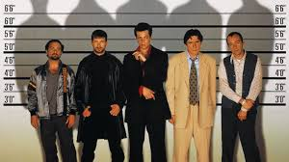
Course overview – P1 – Introductory topics
Social influence
conformity
obedience;
independent behavior,
minority influence & social change
Memory
Models of Memory;
Types of Long term memory
forgetting
Eyewitness testimony ,
cognitive interviews
Notes:
Memories malleable
Testimonies inaccurate → cognitive interviews
Provocative articles in the media about working parents and childcare
Milgram & electrocution expt – obedience
SCZ etc.

Slide 5
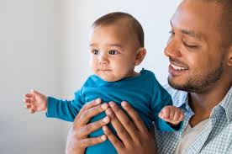
Course overview – P1 – Introductory topics
Attachment –
caregiver-infant interactions,
animal studies of attachment,
explanations,
types, cultural variations,
Deprivation & institutionalization
Psychopathology –
Defining & explaining psychological abnormality
relating to phobias, depression, OCD;
Treating abnormality (phobias, depression, OCD)
Notes:
Memories malleable
Testimonies inaccurate → cognitive interviews
Provocative articles in the media about working parents and childcare
Milgram & electrocution expt – obedience
SCZ etc.

Slide 6
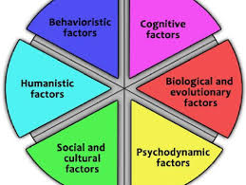
Course overview – P 2 – Psychology in context
Approaches
Origins of psychology
Behaviourist approach ( classical & operant conditioning
Social learning theory
Cognitive approach
Biological approach
Psychodynamic approach
Humanistic approach
Notes:
Memories malleable
Testimonies inaccurate → cognitive interviews
Provocative articles in the media about working parents and childcare
Milgram & electrocution expt – obedience
SCZ etc.

Slide 7
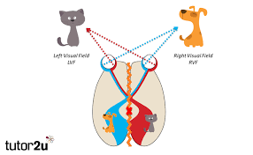
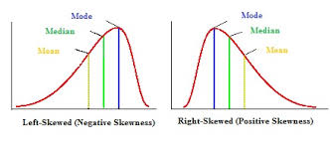
Course overview – P 2 – Psychology in context
Biopsychology
Nervous system, Neurons and synaptic transmission
Endocrine system
Fight-or-flight response
Brain – localisation and lateralization, split-brain research
Plasticity and functional recovery of the brain
Ways of studying the brain
Biological rhythms - Circadian, ultradian, infradian rhythms
Research Methods –
Processes & Techniques
Data Handling & Analysis
Inferential testing
Notes:
Memories malleable
Testimonies inaccurate → cognitive interviews
Provocative articles in the media about working parents and childcare
Milgram & electrocution expt – obedience
SCZ etc.

Slide 8
Paper 3: Issues & Options
Option 1:
Cognition & Development
Relationships
Gender
Option 2:
Schizophrenia
Eating behavior
Stress
Option 3:
Aggression
Forensic psychology
Addiction
Issues & Debates:
compulsory
Notes:
Memories malleable
Testimonies inaccurate → cognitive interviews
Provocative articles in the media about working parents and childcare
Milgram & electrocution expt – obedience
SCZ etc.

Slide 9
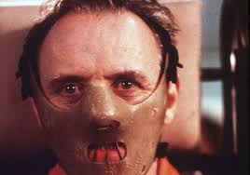
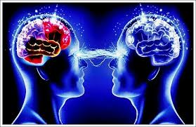
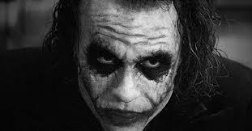
What A Level Psychology is NOT all about…..
Serial killers & psychopaths
Derren Brown and how to mind read
No spec includes sports psychology

Slide 10
Lessons
Theory via – board/PPT/video clips
Student activities:
Booklets/worksheets/exemplars/
Quizzes/Quizlet/Seneca
questionnaires/ tasks that researchers would use in research invetigations
Student presentations
prac tasks - (with food wherever possible!)
Analysing examples of student work/marking/exemplars from exams
Timed essays

Slide 11
How will I be assessed?
Paper 1 | Paper 2 | Paper 3
2 hours 96 marks 33.33%
MCQs Short- answer Qs (1-6 marks) Extended response Qs (8, 12,16)
4 sections: 1 per topic | 3 sections: 1 per topic | 4 sections: 1 per topic

Slide 12
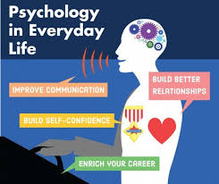
What skills do you learn?
Skills:
Different perspectives
Plan/conduct scientific investigations
Analyse and interpret data
Critical evaluation and reasoning
Improve communication
Build better relationships

Slide 13
What qualities will I need to succeed?
Organised and determined: Psychology isn’t easy and you will have to get your head around lots of information and lots of content to commit to memory.
Some interest in Science: some scientific concepts, conduct your own research and prac investigations. (a third of the AL = research methods)
An interest in people
A love of discussion: - be prepared to contribute.
Literacy & numeracy
Most importantly… be Independent! a fair amount of work and research on your own… so you must be motivated to work outside of the classroom!

Slide 14
What qualities will I need to succeed?
Willingness to:
accept uncertainties
consider & learn evidence from many of research studies
to face aspects of the course which may touch on personal or sensitive issues
The aim of psychology is to help you understand behaviour, not to judge yourself or others.

Slide 15
Entry requirements
For a challenge grade of C or above, ideally we recommend
English, Science and Maths
Higher Tier
Grade 6 or above
If entry on lower grades considered → likely a D/E challenge grade

Slide 16
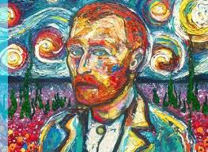
Does this subject complement others?

Slide 17
Psychology at the next level
If going on to study Psychology at university, another science or Maths may be required
Many Psychology courses don’t have these requirements
but many Russell Group universities do.
Wide variety of courses offered.
Notes:
Not anymore – may have been 20 years ago.
Reassure.

Slide 18
Career links
Clinical Psychologist
Neuropsychologist
Counselling Psychologist
Educational Psychologist
Occupational Psychologist
Forensic Psychologist- assessment & treatment of offenders;
Health psychologist – improving public health
Teaching & research
Psychotherapy
Sports & Exercise Psychologists
Notes:
Also as a general degree – big companies recruit for personnel etc.

Slide 19
To explore over the summer:
BPS – British Psychological Society
Digest - highlights of current research findings.
For all sorts of information – e.g.careers
AQA website – GCE A Level Psychology
Firefly Guest Page :
https://seaford.fireflycloud.net/yr11-to-yr12-bridging-work/a-levels-1/sciences/psychology

Slide 20
Psychology - myths
https://www.ted.com/talks/ben_ambridge_9_myths_about_psychology_debunked?language=en
Ben Ambridge - 9 myths about psychology debunked - TED

Slide 21
A beautiful mind
Starring: | Russell Crowe
What’s it about? | True story of mathematician John Nash and his struggle with schizophrenia
What topics is it useful for? | Psychopathology, Schizophrenia
Age rating: | 12
Realism rating: | *****
Rating: | *****

Slide 22
The skeleton cupboard
Author: | Tanya Byron
What’s it about? | A collection of stories from the early career of a clinical psychologist
What topics is it useful for? | Psychopathology, Schizophrenia
Difficulty level: | **
Rating: | ****

Slide 23
ayates@seaford.org

Slide 24
Exam paper questions

