Slide 1
PHYSICS

Slide 2
Welcome
Mr Richard Hypher

Slide 3
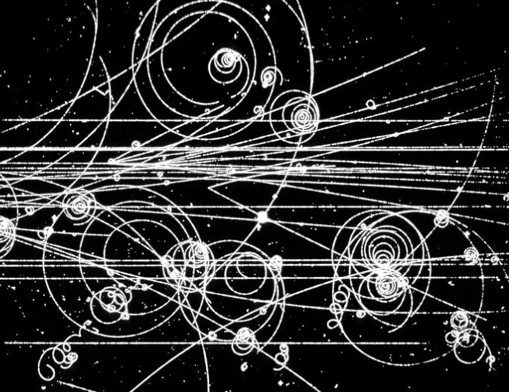
Course:
Physics A
Exam board: OCR
Oxford, Cambridge and RSA (Royal Society of Arts)

Slide 4
What will studying Physics do for me? What is in it for me?
Reasoning
Analytical & Problem solving
Mathematics
Teamwork
Numeracy
Communication – verbal and written
Practical skills
Independent study
Resilience
Planning
Course Skills:

Slide 5
What will studying Physics do for me? What is in it for me?
University or Jobs….. :
Physics
Engineering
Metallurgy
Aerospace
Energy resources
Environmental science
Astronomer
Nanotechnologist
Research scientist
Patent attorney
Software engineer
Telecommunications
Military pilot
Economics
Accounting
Finance
Teaching
Science writing
The skills and abilities required for Physics means the subject is looked upon in a very positive way by most employers and universities.

Slide 6
Teachers:
A class has three teachers:
Richard Hypher
Martin Saunders
Sugee Sriharan
(Head of A-level Physics)
More than 30 years of A-level teaching experience.

Slide 7
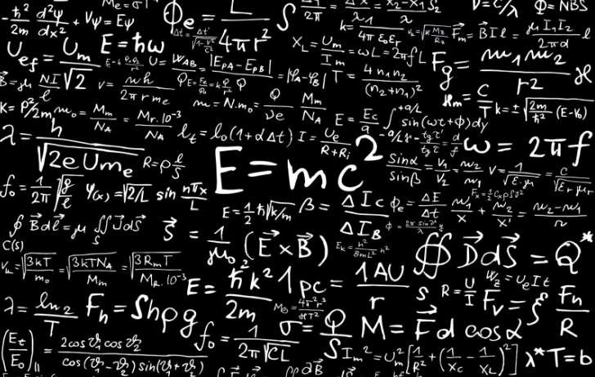
Good reasons to choose Physics:
- I need Physics to get onto a University course
e.g. Physics, Engineering, Astronomy, Medical Physics
- I am a hard-working, independent, intelligent, resilient learner
- I enjoy Physics

Slide 8
Course requirements:
In order to achieve a “C” grade or greater, it is strongly advised that the student has:
Grade 7 (A grade) at GCSE Science
and
Grade 7 (A grade) at GCSE Maths
Approximately 50% of the exam questions involve calculations, formulae and equations.

Slide 9
GCSE to A level:
A-level Physics is significantly more demanding than GCSE Physics:
There is a greater amount of detailed learning of definitions, processes, etc.
The calculations / maths skills involved are significantly more complex (choosing A-level Maths is highly recommended as a ‘partner’ A-level)
Most of the models and ideas are very abstract and can be difficult to visualise & apply
The exam questions require a large degree of interpretation, before you can use
your knowledge and understanding to actually answer them.

Slide 10
Year 1:
Teacher 1
A level
Motion
Circular motion
Forces
GCSE
Work, energy and power
Ideal gases
+ 4 core practicals
Materials
Thermal Physics
Newton’s laws

Slide 11
Year 1:
Teacher 2
A level
Charge and current
Energy, power, and resistance
GCSE
Electric fields
+ 7 core practicals
Electrical circuits
Capacitance
Waves
Quantum physics

Slide 12
Year 2: All new A level content; no GCSE content
study the foundation topics in further depth (more maths!)
gain an understanding how topics are related and linked
problem solve questions / situations by applying knowledge from different topics
learn to read, understand and accurately answer past paper questions
Further develop practical skills and interpret and analyse results

Slide 13
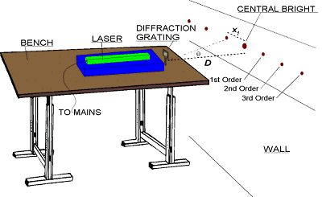
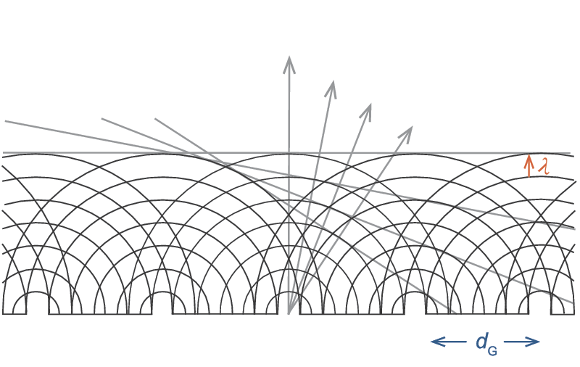
What about practical experiments?
students will carry out a minimum of 12 Core practicals (over 2 years)
a number of questions in the exams will relate to the skills learnt and developed in the core practicals
e.g. Use a diffraction grating to investigate wavelength:

Slide 14
Examination Assessment:
Assessment occurs at the end of the course (Summer 2023).
The exams are split into 3 papers:
Paper | Time | Marks | % contribution
Paper 1 | 2hr 15 min | 100 | 37 %
Paper 2 | 2 hr 15 min | 100 | 37 %
Paper 3 | 1 hr 30 min | 70 | 26 %
 |  | 270 | 100%

Slide 15
Grade boundaries:
The Physics grade boundaries are very high -
…probably because students need Physics to do
Physics and Engineering which is highly competitive and demanding.
If you need a B, B, B to get into the University of your choice, then taking Physics just to fill your 3rd option is
not a good idea.

Slide 16
….how do we support our students?
Mr Hypher, Ms Sriharan, and Mr Saunders live in the Science Department – we are always about…
Regular prep and frequent testing with guided feedback
Revision guides
Students spending their “study periods” in the 6th form Science workroom
Past paper questions to prepare for assessments and exams
UpLearn interactive learning
Encouraging students to send emails and popping in to see us

