Slide 1
AQA
GCSE
Design and Technology 8552
Working with polymer-based materials and fixings
Unit 5D
Polymers
2

Slide 2
Objectives
Know and understand the commercial stock forms, types and sizes of materials to calculate quantities
Be aware of school-based cutting, drilling, casting, deforming, printing and welding techniques

Slide 3
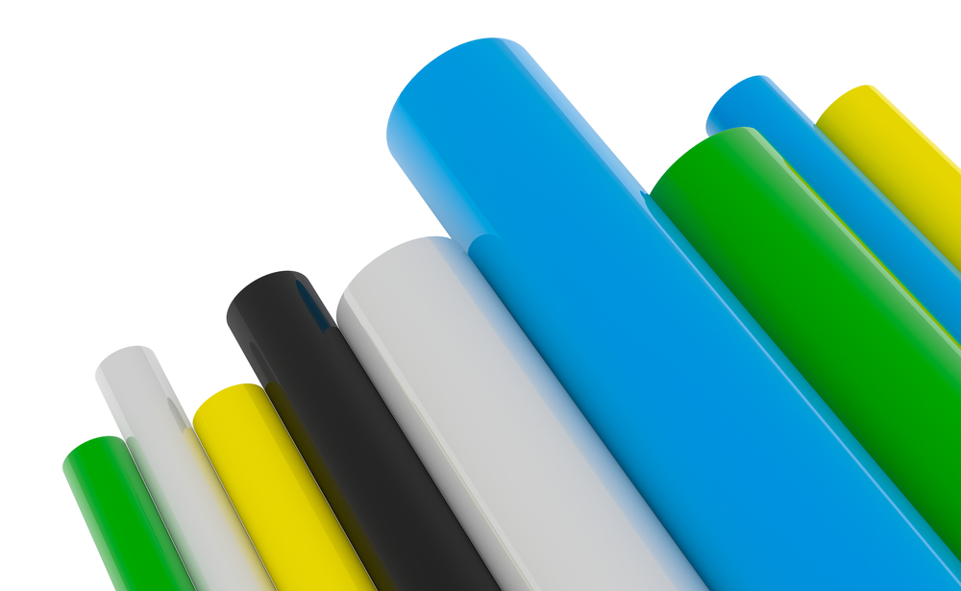
Stock forms, types and sizes
Plastics are available in a wide variety of standard shapes and sizes:
Sheets
Rods
Tubes

Slide 4
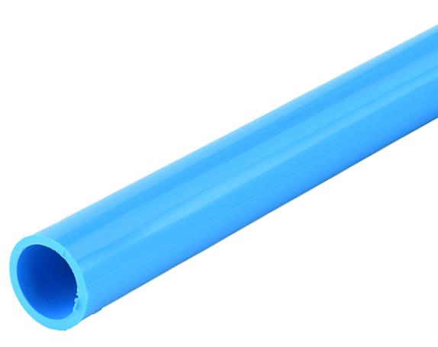
How to measure plastic
Standard materials are measured by:
Sheet: Length x width x thickness
Rod (solid): Length x diameter
Tubing or pipe (hollow): Length x diameter x wall thickness
Wall thickness
Length
Diameter

Slide 5
Gauge
Wall thickness is usually measured in millimetres
Traditionally it is known as the gauge and some tubed plastics may still be sold by gauge
As the gauge number increases, the wall thickness decreases
4
8
12
16
20
24

Slide 6
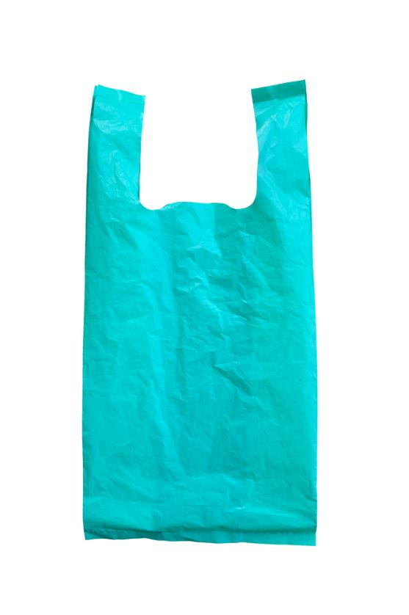
Plastic films
Film sheets are widely used for packaging, especially in the food industry
Films can be heat-sealed to be airtight and tamper proof
Tubes of film are commonly folded, bonded and cut to form plastic shopping bags

Slide 7
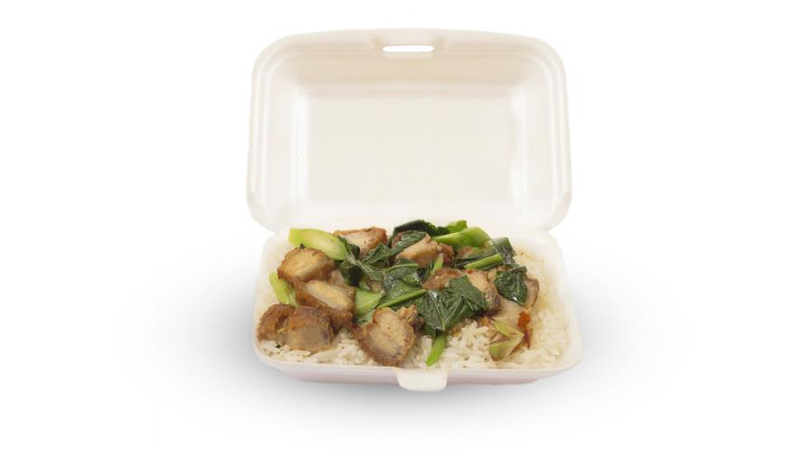
Expanded polystyrene
Expanded polystyrene (EPS) is used regularly as thermal insulation and packaging
What properties make it a good choice for food packaging?
What other uses does it have?

Slide 8
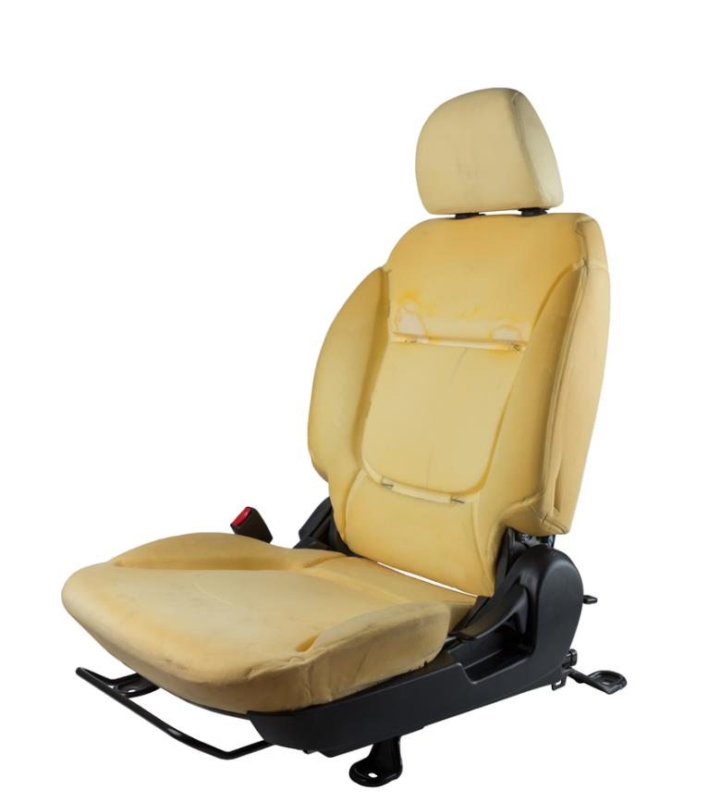
Foam
Plastic foams are used for:
Softening seating
Mattresses and bedding filler
Floor coverings
What properties of foam make it suitable for use with seating, bedding or flooring?

Slide 9
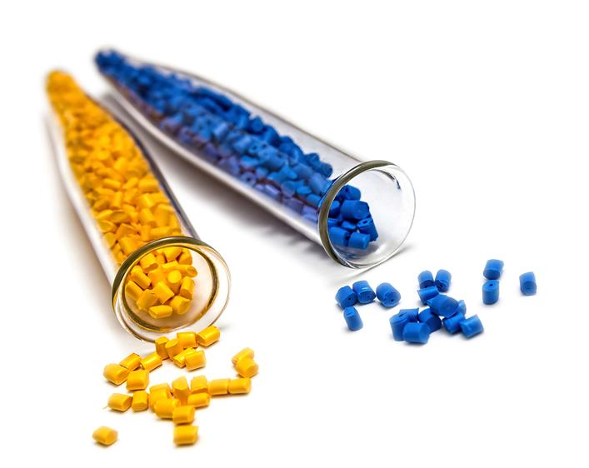
Other forms of plastic
Powder and granules
Used in plastic processing such as plastic dip coating, injection moulding and extrusion
Granules are heated until they become liquid and then shaped as required
Powdered plastics can be bonded to the surface of hot materials such as metals

Slide 10
Where did it come from?
For the range of simple products below, state which stock form they started life as:

Slide 11
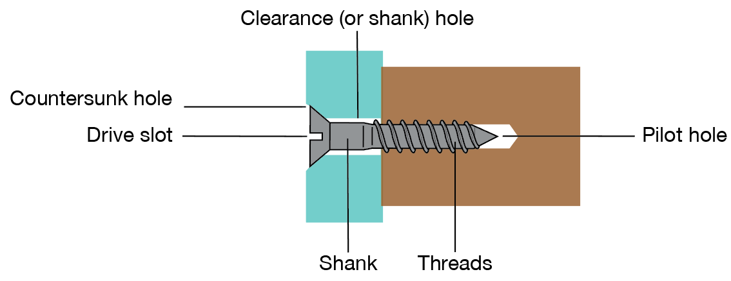
Connecting plastics
Self-tapping or machine screws can be used to join plastics and metals
What is one advantage of using self-tapping screws over machine screws?
Why is sometimes necessary to drill a pilot hole?
What type of drill bit should be used to keep the head flush?

Slide 12
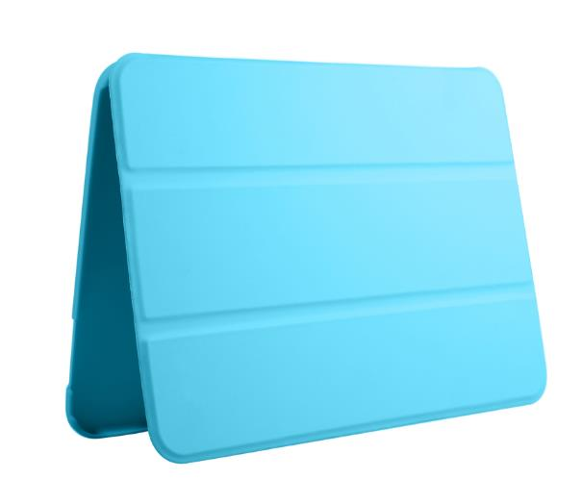
Hinge applications
Which types of hinge would be most suitable for each of the following applications?
Moped storage box
Glasses case
Tablet case
Acrylic door
What methods would you use to attach the hinges to each of the items?

Slide 13
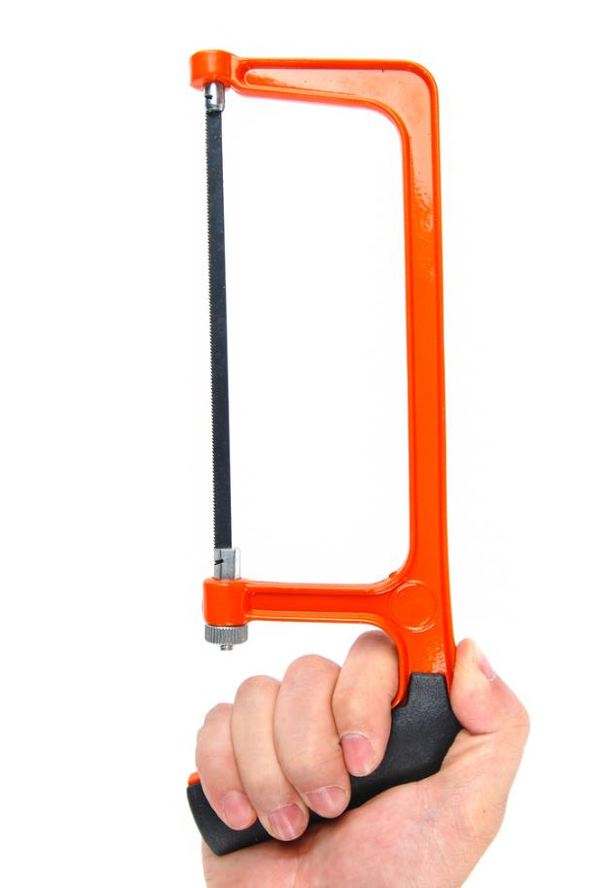
Wasting and abrading plastic
Removing material can be carried out through a number of methods:
Drilling
Cutting and sawing
Sanding
Shaping
Finishing
What are the advantages of manual sanding over other mechanical methods?

Slide 14
Worksheet 2
Look at the materials stock forms and components available and complete Tasks 1 to 3

Slide 15
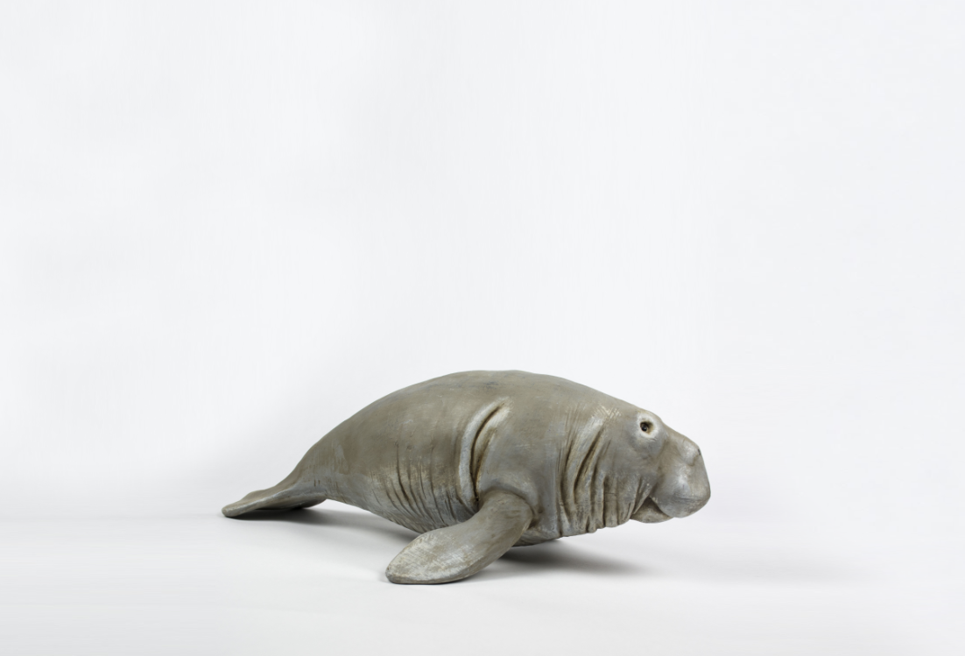
Casting resin
Thermosetting polymer resin is mixed with a hardener and poured into a mould
This is cured before removing the set piece from the mould
Examples include embedding objects in transparent resin, model making, toy animals or small scale industrial artefacts

Slide 16
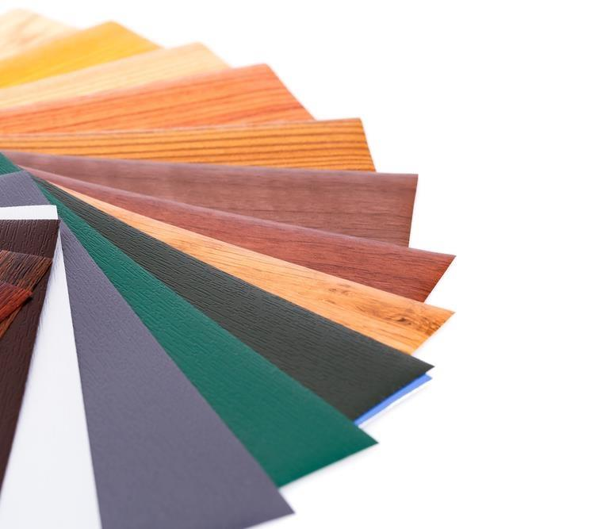
Laminating with plastics
This is the process of bonding strips or sheets of material together in layers
Plastics are laminated with other materials like glass or wood to improve aesthetics or functionality
Suggest an example of plastic lamination
How might the functional properties of plastic be improved through lamination?

Slide 17
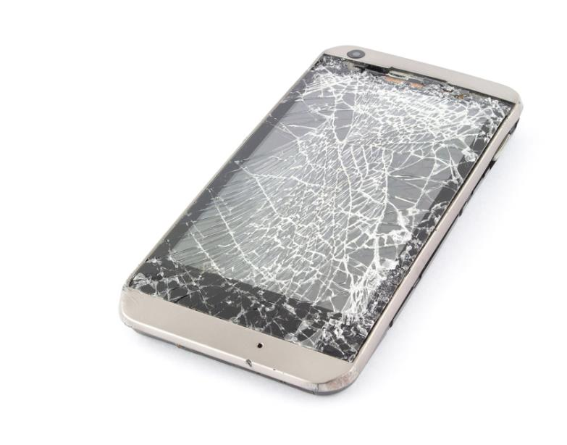
Plastic laminated safety glass
Laminated safety glass is now used in all car windscreens for safety reasons
It contains a thin film of plastic which holds the inner and outer glass layers together when it is cracked or shattered
Some mobile phone glass is also laminated
Why do you think the plastic layer is important?

Slide 18
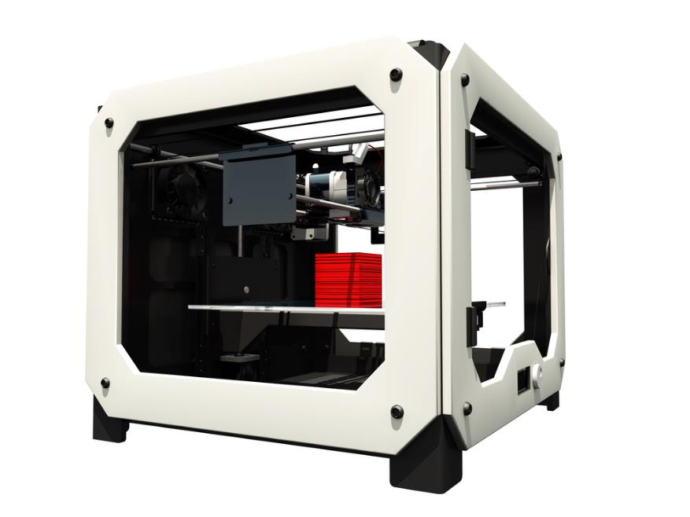
School processing techniques
These include:
Line bending
Vacuum forming
3D printing
Adhesives

Slide 19
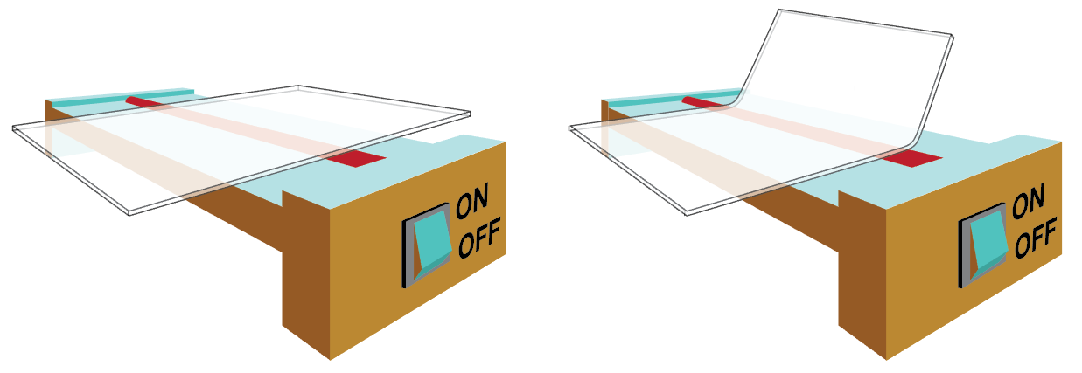
Line bending
Bending most plastics involves heat unless they are very thin
Strip heaters are used to create a permanent fold in a piece of thermoplastic

Slide 20
Line bending process
Steps involved in line bending plastics:
Mark out bend lines
Turn on the strip heater and allow it to reach working temperature
Put on heat-proof gloves and have a tray of water ready to cool the workpiece
Place the marked line of the workpiece across the heating strip
Allow the plastic to heat through then test for flexibility
Bend the workpiece to the required angle using a former or jig
Once the workpiece has set it can be cooled
What might happen if you try to bend it before it is ready?

Slide 21
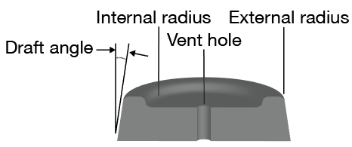
Vacuum forming patterns
An effective former or pattern must have:
A positive draft angle of at least 3°
No undercuts
A profile that is not too deep with vent holes drilled
Corners and edges rounded with a small radius
A smooth finish and/or a release agent applied to the pattern

Slide 22
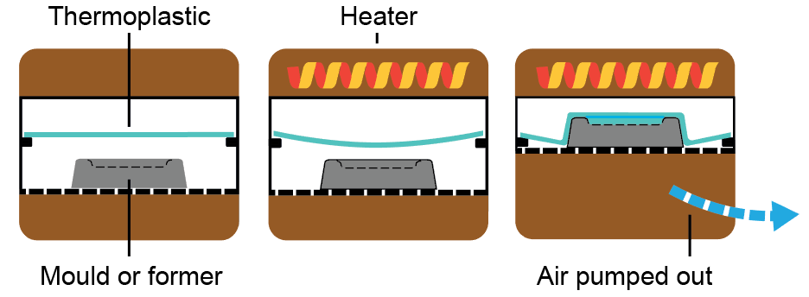
Vacuum forming
HIPS (high impact polystyrene) is commonly used to vacuum-form small items within schools
Commercial products include hot tub pools and egg boxes

Slide 23
Vacuum forming process
Steps involved in line vacuum forming:
Mould is placed on a platform (also known as a platen)
A sheet of thermoplastic is clamped and heated
This now flexible sheet is pulled over a former (mould)
A vacuum sucks the air out
The plastic takes on the shape of the mould, then cools and hardens in position before the mould is removed

Slide 24
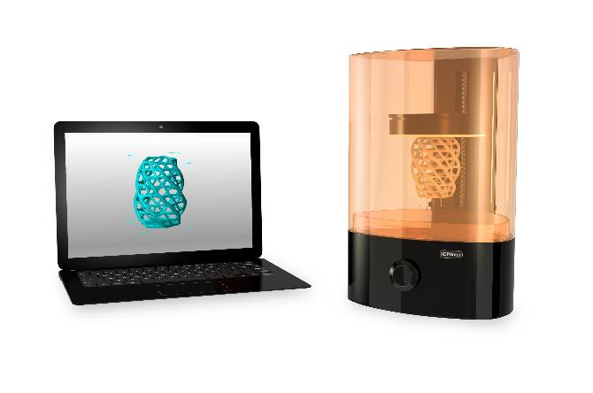
3D printing plastics
Stereolithography (SL)
Uses lasers to part cure the printed shape from a bath of liquid resin
Expensive but accurate
Digital Light Processing (DLP)
Similar to Stereolithography
Uses a powerful light source rather than a laser

Slide 25
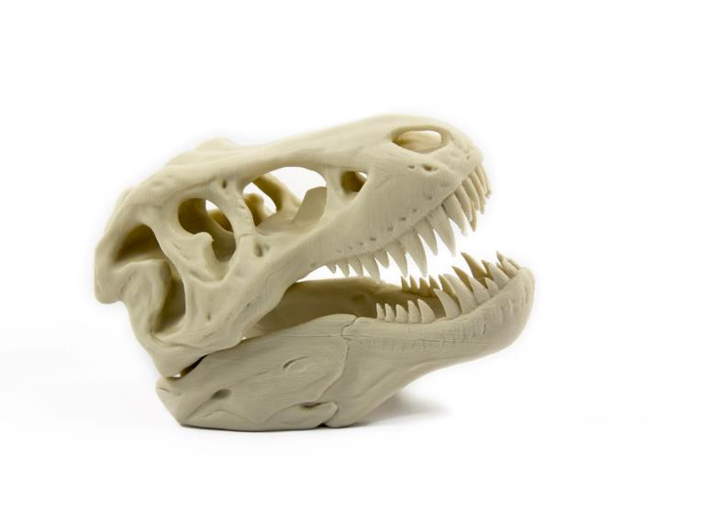
3D printing plastics
Laser sintering
Uses a powdered material instead of a resin bath
The solid shape is created as the heat from the laser fuses and solidifies the powder
Fused Deposition Modelling (FDM)
This is most popular in schools and involves melting a plastic filament with the heated extrusion head
Shapes are built up layer by layer

Slide 26
School-based manufacturing techniques
Complete Tasks 4, 5 and 6 on Worksheet 2

Slide 27
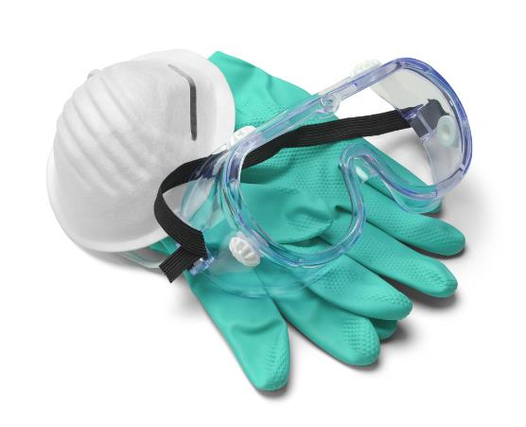
Chemical welding
Chemical welding uses solvents to dissolve the surfaces of two pieces of plastic before joining
Liquid solvent cement – water like consistency
Tensol 12 – a thicker variety
Both are methane-based
What are the advantages of using a thicker cement?
What would be appropriate PPE?

Slide 28
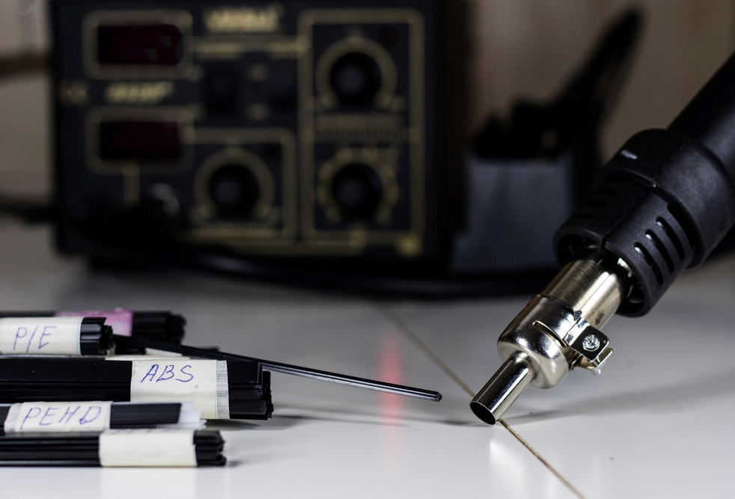
Heat welding
Heat welding plastic involves using a special hot air gun
Accurately heats the surfaces being welded together as well as the plastic filler rod that is applied to the weld joint
Filler rods are available in HDPE, rigid PVC, LDPE, PP and ABS making it a versatile way to join many plastics

Slide 29
Plenary
Plastic materials are available in a wide range of stock forms
What are they?
Plastics can be connected in a number of ways
What are some of these methods?
School and commercial based cutting, forming and processing techniques vary
Name at least three different ways of cutting, forming and processing plastic at school
Which ones are more commonly used commercially?

