Slide 1
BTEC Travel & Tourism
Director- head of sixth form - Mr James kimber (TEACHER OF BTEC T&T)
Head of Geography/BTEC T&T - Mr willcox

Slide 2
A-Level Geography or BTEC Travel & Tourism?
A-Level Geography
7 is preferable, minimum 6 required
Make a decision based on YOUR grade
BTEC Travel & Tourism
Working towards 4 in Geography/English (note do not have to have studied GCSE Geog)
Ideal for those who like exams and essay writing (exams are essay based)
2 exams at the end of course
1 Non-examined-assessment consisting of a University style dissertation
No re-takes or re-submissions
Ideal for those that will find essay writing hard
2 external assessments ( can be re-taken)
Internal Assignments set in class
Opportunity to re-submit assignments and re-take external assessments/exams

Slide 3
Why should you choose BTEC Travel & Tourism?
Allows students to continue to study elements of geography whilst taking an interest in the world of economics, tourism, business and entrepreneurship
Great for those also interested in a career in one of the worlds leading industries
The qualification is equivalent in size to one A Level
This qualification gives a broad introduction to the travel and tourism industry, with an emphasis on core knowledge and fundamental skills that are transferable across other subjects

Slide 4
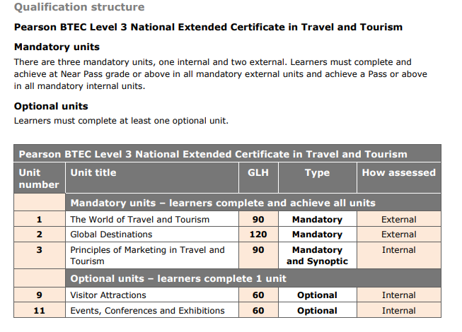
BTEC Course content & Assessment
Year 12 | Year 13
Unit 2: Global Destinations (Exam May Year 12, 3 hours medium control, 2 pages of notes allowed) | Unit 1: The World of Travel & Tourism (Exam January Year 13)
Unit 9: Visitor Attractions (Internal coursework assignments x 3) | Unit 3: Principles of Marketing (Internal coursework assignments x 2)
Note: 12 lessons a fortnight, 2 teachers. E.G. Year 12
Teacher 1: Unit 2, 8 lessons
Teacher 2: Unit 9, 4 lessons

Slide 5
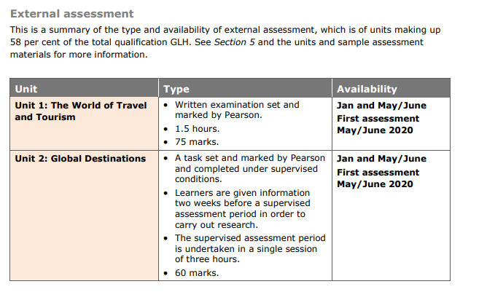
BTEC Course content & External Assessment
UNIT 1: January Year 13 Exam
Exams can be re-taken (January and May of Year 13)
UNIT 2: May Year 12 Exam
Units 1 & 2 are externally assessed written exam (1) and pre-release materials (2)
(2) Is a 3 hour exam done in medium control conditions

Slide 6
BTEC Future pathways
Learners can progress to degree courses and areas of work such as:
Hospitality, Leisure, Sport, Tourism
Sport Management, Business, Business Management
Travel Management; Event Management; Tourism Management; Transport Studies; Hospitality Management;
Accounting, Finance, Marketing & International Tourism Management

Slide 7
BTEC Expectations of students
Grade 4 in Geography & English /working towards – Note, you do not need GCSE Geography in order to study T&T
The ability to learn independently
The ability to research actively and methodically
Be able to give presentations and being working in a group
Wider reading and research​ (researching essential skill at BTEC)
Commitment to 2-3 hours of reading and ‘prep’ each week​​
Reading technical texts
Effective writing
Analytical and evaluative skills

Slide 8
Differences between BTEC Travel & Tourism and A-Level Geography?
A-Level Geography | BTEC L3 Travel & Tourism (Extended Certificate)
80% Exam / 20% Coursework No re-sits or re-submissions Can achieve A*/A/B/C/D/E Fieldwork expectation (6 day residential in Summer Term of Year 12) Exams in May/June of Year 13 Essay based Must complete NEA (coursework) independently over the summer of Year 12, no drafts or feedback allowed | 58% Exam/ 42% Coursework Re-sits & Re-submissions Can achieve Distinction*/ Distinction / Merit / Pass (A*/ A / C / E) No B or D grade equivalent No fieldwork Exams in May of Year 12 & January/May of Year 13 Mixture of short response and longer response questions

Slide 9
BTEC Myth debunking!
Russell Group Universities do not accept BTECs – Wrong
BTECs are easier – Wrong
BTECs are a ‘lesser’ qualification - Wrong

Slide 10
Any questions?

