Slide 1
A Level & BTEC Business
Seaford college
Mrs m. Mackenzie-foster

Slide 2
Why should you choose Business?
Provides the link between education and work
All organisations are structured like a business, so you will have an understanding of their operations and why certain decisions are made
Provides skills and knowledge for all types of jobs
Help with setting up your own business / life skills

Slide 3
Sixth-Form Business at Seaford
2 COURSES:
A LEVEL – exam-based
BTEC – mixture of coursework and exams

Slide 4
Course structure – A Level (Exam board Edexcel / Pearson)
Theme 1 = Marketing and People (Y12)
Theme 2 = Managing business activities (Y12)
Theme 3 = Business decision& strategies (Y13)
Theme 4 = Global business (Y13)

Slide 5
Assessment – A Level
3 exams (all sat at the end of Y13):
Paper 1 = Marketing, People and global business (35%)
Paper 2 = Business activities & strategies (35%)
Paper 3 = Competitive environment (30%)

Slide 6
Course structure – BTEC
2 year course
Equivalent to one A Level
Range of assessment methods & tasks
You study 4 Units during the course

Slide 7
Assessment – BTEC
Unit 1 - Exploring Business (Internal assessment) Y12
Unit 2 - Developing a Marketing Campaign (Controlled assessment) Y13
Unit 3 - Personal and Business Finance (Exam assessment) Y12
Unit 14 - Investigating Customer Service (Internal assessment) Y13
You must pass ALL 4 Units in order to complete the qualification

Slide 8
What’s similar and different between A Level and BTEC?
Both courses have 2 teachers
A Level is all exams, answering mainly longer extended questions balancing competing viewpoints
BTEC has a more practical focus based on completing vocational type tasks including an exam and a controlled assessment, plus coursework
Approximately 2/3 of subject topics are the same
UCAS points are the same for both

Slide 9
Business and Sport, with Event Management
This course combines extended versions of our existing BTEC Business and BTEC Sport courses. Students gain the following qualifications:
BTEC Foundation Diploma in Business
BTEC Foundation Diploma in Sport
Both of these qualifications are equivalent to 1 ½ A Levels each and both include an event management module as a part of them. In order to access these qualifications, they must both be taken and will not be able to be studied alongside any other subjects.

Slide 10
Expectations of students
Research skills – Business is about the real world
Reading and listening to news
Willingness to get involved in discussion and debate
Good reading and written skills – GCSE English Language Grade 5
Numeracy – GCSE Maths Grade 5

Slide 11
Future pathways
Higher Education – Business is the biggest area of HE
Employment (including trainee management)
Apprenticeships – Higher or Degree level apprenticeships
Setting up your own business
Many different areas of Business in Public & Private sector
Marketing
Accountancy
Economics
Human Resources
Operations/ logistics
Entrepreneurship

Slide 12
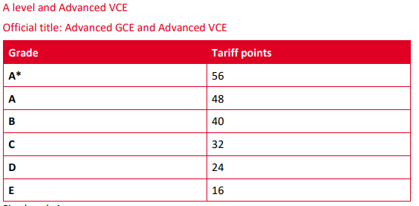
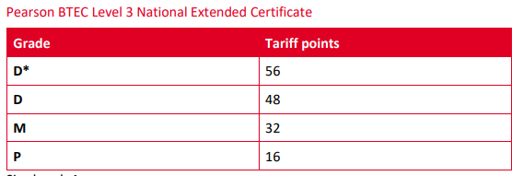
Future pathways
Higher Education – University courses or HND
Employment (including trainee management positions)
Apprenticeships – Higher or Degree level apprenticeships
Setting up your own business

Slide 13
Any questions?
If you have any questions please contact me using
Mmackenzie-Foster@seaford.org
Or Head of Business and Economics
ereynolds@seaford.org

