Slide 1
GCSE Food Preparation & Nutrition
Exam board: AQA 8585
Seaford college
Head of Food – mrs Shaw

Slide 2
Why should you choose it?
This is a GCSE course with a strong practical focus. You’ll master a variety of technical skills and become proficient in the kitchen. In addition, you’ll develop an in-depth knowledge of food science, food safety, food choice, nutrition and health.
You’ll also develop transferable skills such as:
• analysis
• evaluation
• communication skills
• working independently
• time management
• the ability to interpret information and data.
-

Slide 3
How will it fit with my other subjects?
The skills you develop through the study of food preparation and nutrition will support your study of a wide range of other subjects and can be studied in combination with any other GCSE course.
In terms of subject knowledge, the nutrition and health may particularly complement the study of Biology and Physical Education.
Food Preparation and Nutrition also helps you to learn how to work independently and manage your time – skills valued by both higher education institutions and employers alike.

Slide 4
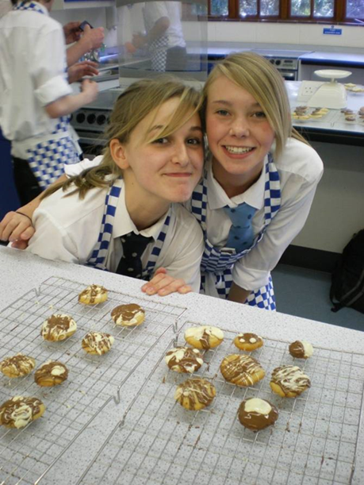
Course content
This qualification is linear. Linear means that students will sit all their exams and submit all their non-exam assessment at the end of the course. The GCSE is 50% Coursework (NEA) and 50% Exam.
SUBJECT CONTENT: Food preparation skills – these are intended to be integrated into the five sections:
Food, Nutrition and Health
Food Science
Food Safety
Food Choice
Food Provenance

Slide 5
1. Food Nutrition & Health
Protein, carbs, fat, vitamins, minerals, water, fibre
Nutritional needs and health
Technological developments associated with better health
Energy needs, special diets
Carry out nutritional analysis
4. Food Choice
Factors affecting food choice
British and international cuisines
Sensory evaluation
Food labelling and marketing
2. Food Science
Cooking of food and heat transfer
Functional and chemical properties of food
5. Food Provenance
Environmental impact & sustainability of food
Food processing & production
3. Food Safety
Food spoilage and contamination
Buying and storing food
Preparing and cooking food

Slide 6
Structure of the course
Year 10
In year 10, students will mainly focus on theory (food, nutrition & health; food science; food safety; food choice; food provenance). Work is currently completed using OneNote.
There will be some practical skill lessons (examples: whisked sponge, marinating, dough making, pastry skills, piping skills, using electrical equipment, sauce making to mention a few!)
Year 11
Year 11 work will be dedicated to completion of coursework (Non-Exam Assessments) and revision of the theory ready for the external exam at the end of the course.

Slide 7
Assessment
AQA GCSE Food Preparation & Nutrition comprises 2 elements:
External Exam - 50% total marks (1hr 45min paper)
Internal Assessment – Non-Exam-Assessment (NEA) coursework 50% total marks:
Comprising 2 pieces of coursework:
NEA1 – Food Investigation 15% of total marks
NEA2 - Food Preparation 35% of total marks
50% total marks

Slide 8
How it is assessed
EXAM - Paper 1: Food Preparation and Nutrition – 50% of the GCSE, external exam taken at the end of year 11.
COURSEWORK (Non-Exam-Assessment-NEA) – 50% of the GCSE, internal assessment completed in year 11:
Task 1: Food Investigation (15% of GCSE)
Students' understanding of the working characteristics, functional and chemical properties of ingredients. Practical investigations are a compulsory element of this NEA task. Written or electronic report (1,500–2,000 words) including photographic evidence of the practical investigation.
Task 2: Food Preparation Assessment (35% of GCSE) -3 hour practical exam
Students' knowledge, skills and understanding in relation to the planning, preparation, cooking, presentation of food and application of nutrition related to the chosen task (tasks are released by the exam board and change each year). Students will prepare, cook and present a final menu of three dishes within a single period of no more than three hours, planning in advance how this will be achieved. Written or electronic portfolio including photographic evidence. Photographic evidence

Slide 9
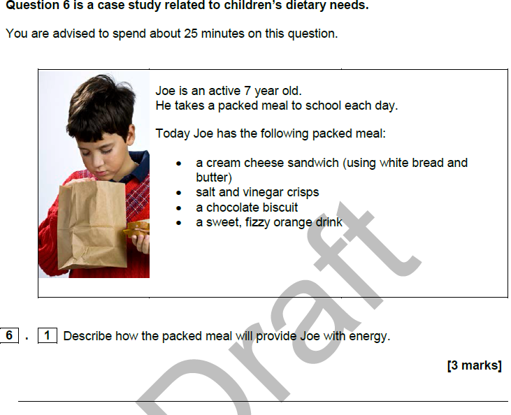
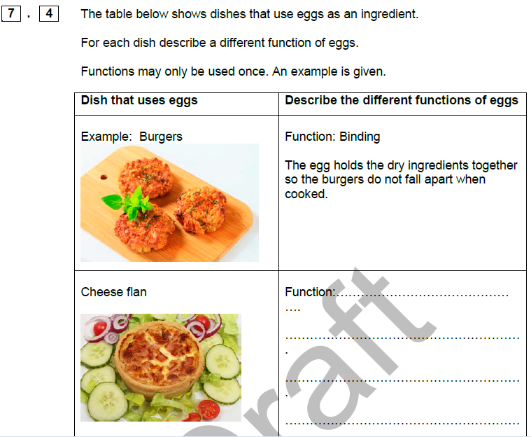
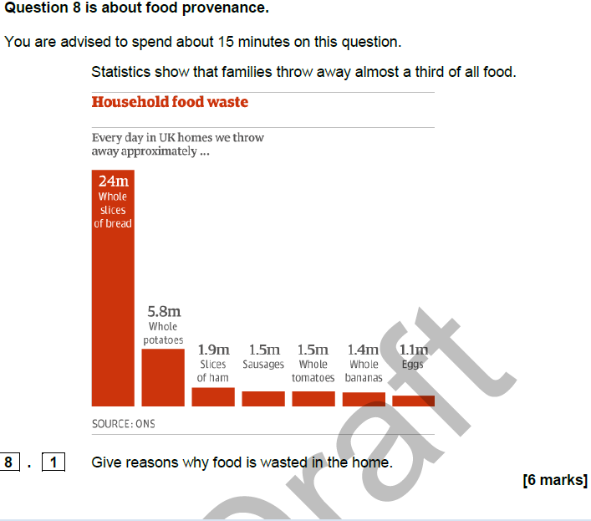
Sample Exam Questions

Slide 10
Practical Skill Requirement
There are 12 skills that are fundamental to the practical element of the course:
General practical skills: weighing, measuring, selecting & adjusting cooking times, testing readiness, judge & modify sensory qualities.
Knife skills: cutting fruit & veg, meat, fish & alternatives
Preparing fruit & veg
Use of the cooker: using the hob, grill & oven
Use of equipment: blender, food processor, mixer, pasta machine, microwave etc.
Cooking methods: water-based, dry heat, fat based methods
Prepare, combine & shape: roll, wrap, mix, coat, layer etc.
Sauce making: starch based, reduction, emulsion
Tenderise & marinade: acid to denature protein, marinade to add flavour & moisture
Dough: bread, pastry, pasta – shaping & finishing
Raising agents: chemical, steam, mechanical, biological
Setting mixtures: removal of heat, protein, gels

Slide 11
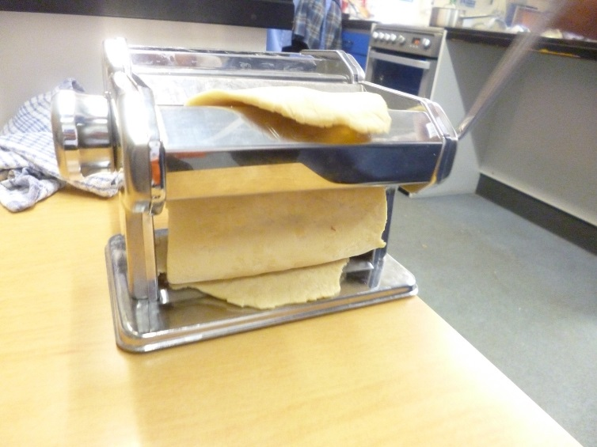
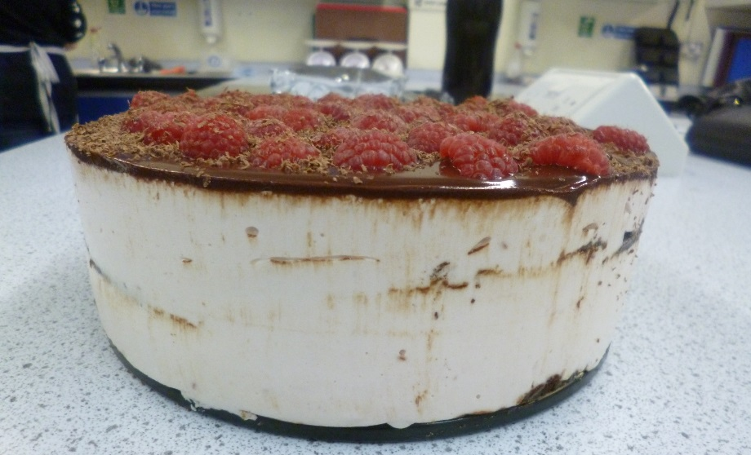
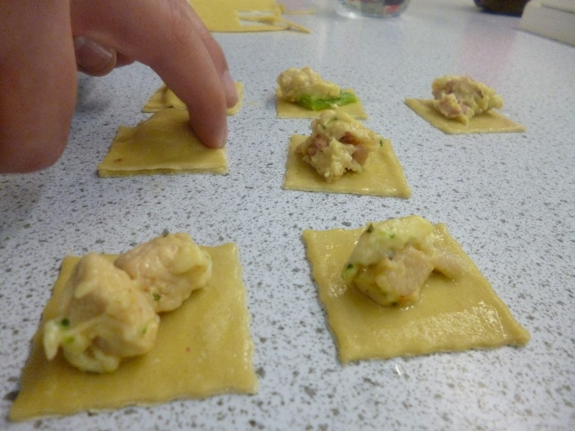
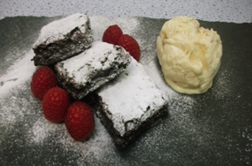
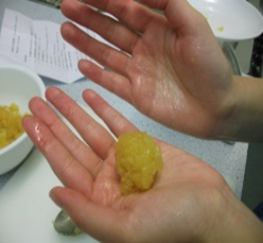
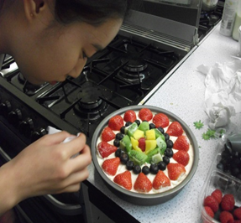
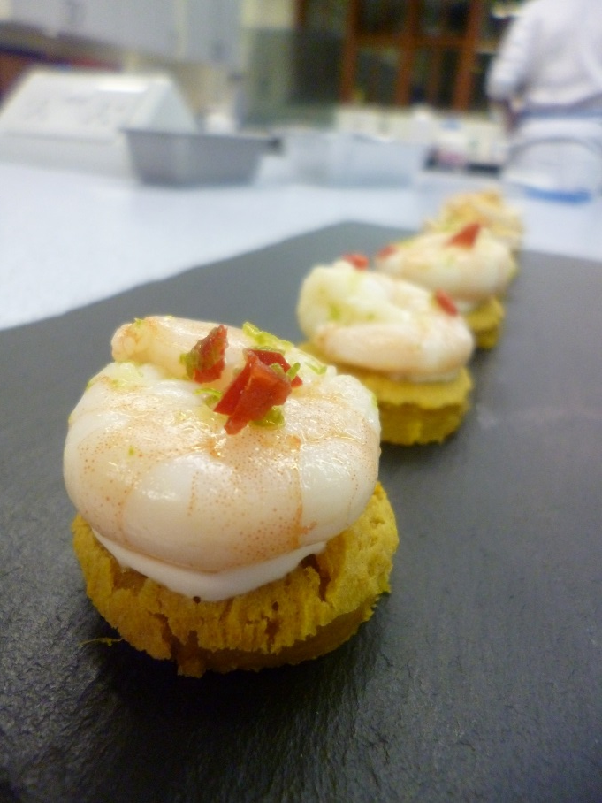
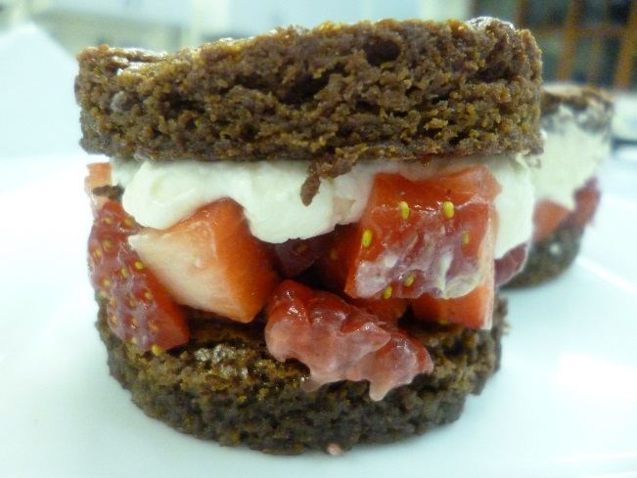
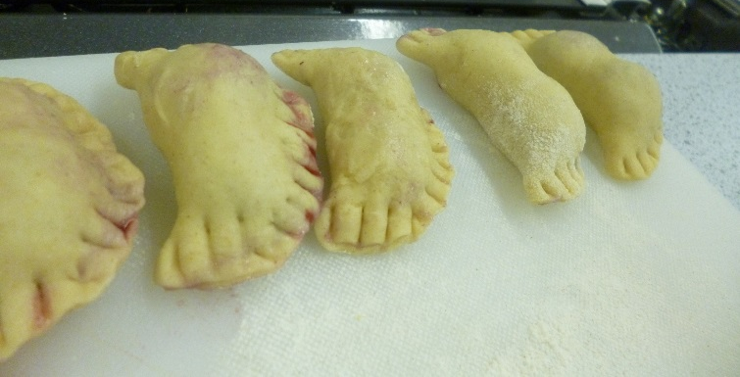
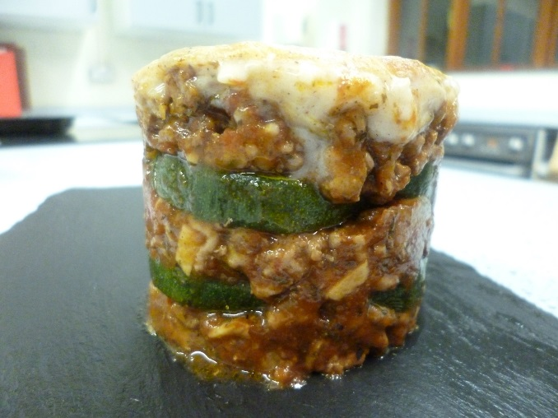

Slide 12
Expectations of students
To be totally interested in food in all forms: cooking, presentation, nutrition, hygiene & more!
Expect to work hard in practical lessons, starting early if needed
Practice making dishes and experimenting with recipes at home
Revise hard with the theory – this will mainly be covered in year 10, along with skills practical work
Have an enquiring mind – working out investigations with ingredients (how they work)
Be organised – plan ahead with recipes
Cook at home – the more practice the better
Watch ‘foody’ TV programmes – both documentaries (theory) and cooking/making
Be ‘health aware’
Enjoy and appreciate food!

Slide 13
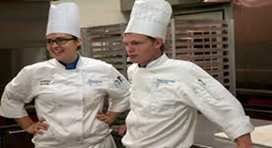
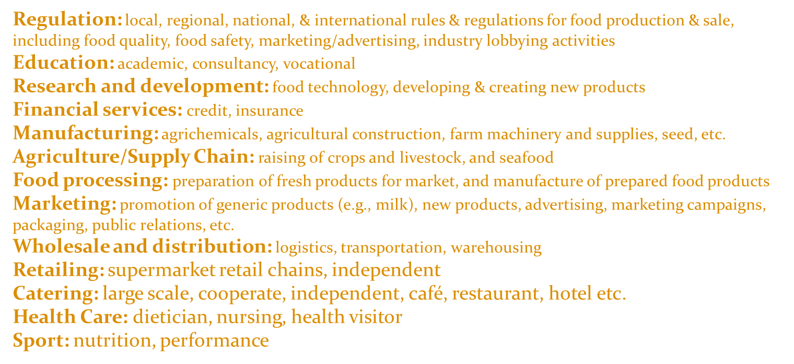
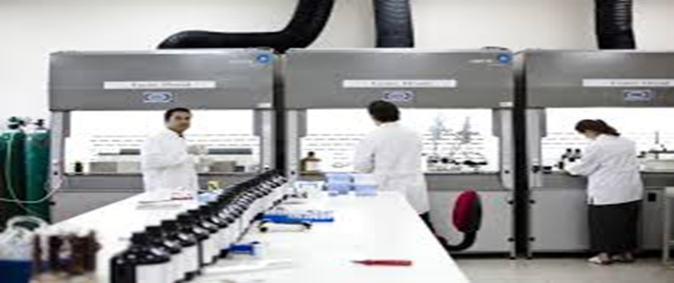
Future pathways
The food industry is a complex, global collective of diverse businesses that supply much of the food and food energy consumed by the world population. It is worth £96.1 billion to the UK economy.

Slide 14
Any questions?
If you have any questions regarding the content of the course please contact:
Mrs Amanda Shaw ashaw@seaford.org
Mrs Sarah Cullen scullen@seaford.org

