Slide 1
AQA
GCSE
Design and Technology 8552
Sources, origins and properties
Unit 5D
Polymers
1

Slide 2
Objectives
Know the primary sources of polymers
Understand the processes involved in refining, fractional distillation and cracking to produce workable forms of polymers
Understand how plastics can be modified to enhance their properties
Be aware of sustainability and ethical issues in plastics production, in use and end of life

Slide 3
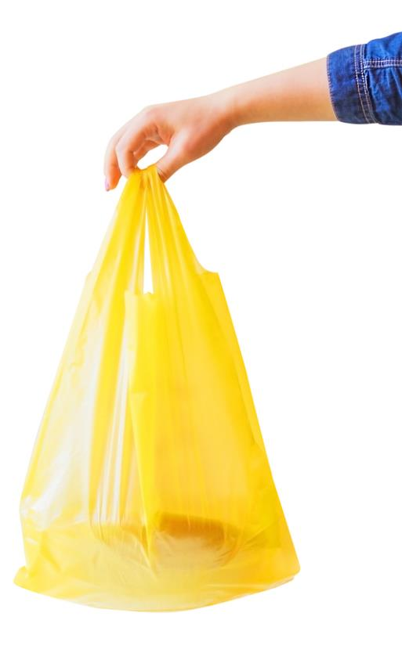
What is plastic?
The word plastic means ‘easily shaped or moulded’ and is derived from the Greek work ‘plastikos’
Plastics are made from polymers which is a Greek word meaning many: ‘poly’ - parts: ‘mer’
Plastics are semi-organic and always derived from oil or petroleum
Plastics are synthetic materials. What is meant by synthetic?

Slide 4
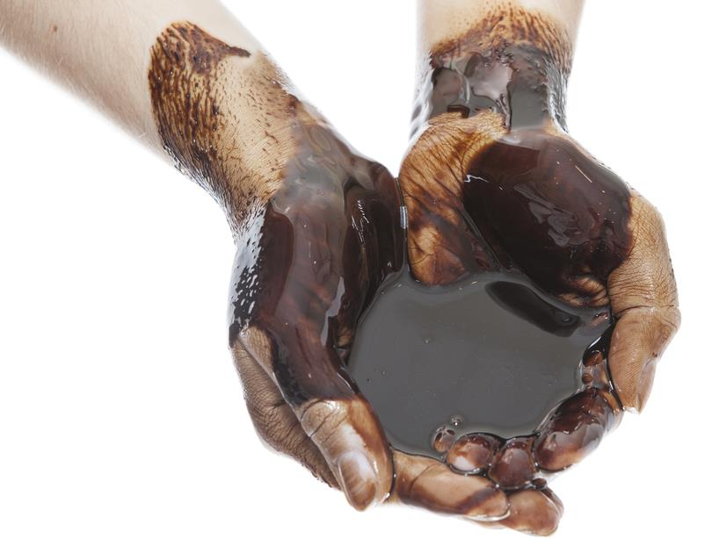
The origins of plastics
Different polymers are derived from different sources
These can produce different types of plastics:
Natural plastics made from rubber or latex
Bio-plastics made from vegetable starches or algae
Synthetic plastics made from petrochemical sources

Slide 5
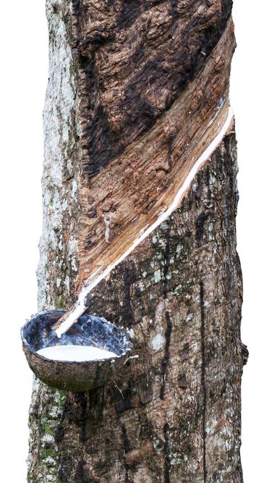
Natural plastics
There are some naturally occurring plastics:
Amber (fossilised tree resin) and
Latex (a form of rubber)
Natural latex is harvested from the Rubber tree (Hevea Brasiliensis)
The bark is scored (tapped) to allow the milky sap to run out into a container

Slide 6
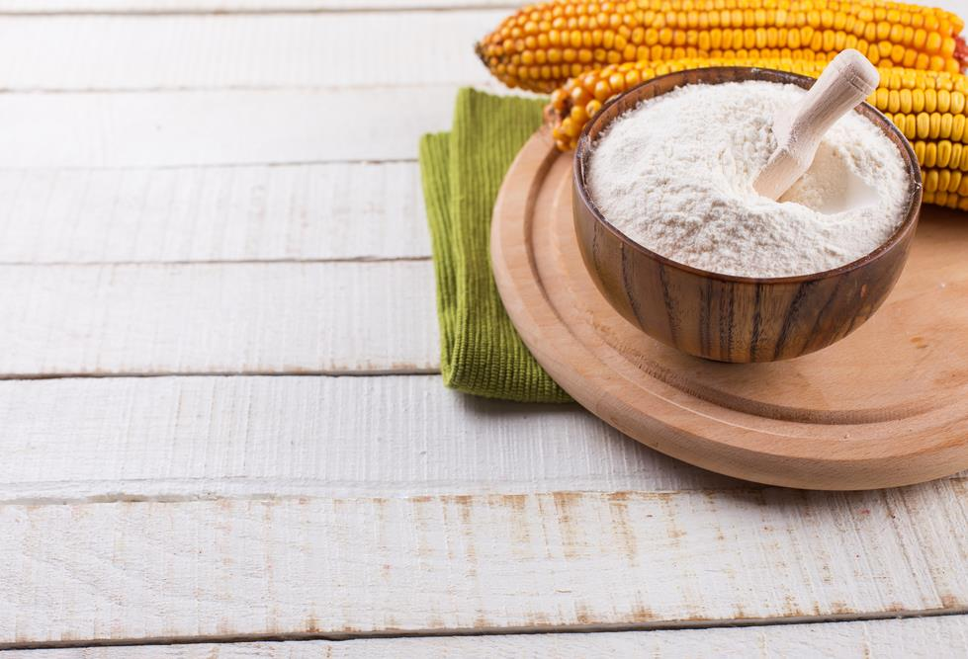
Bioplastics
These are commonly made from corn or vegetable starches
Fully biodegradable if composted
Bacteria in the soil breaks down the plastic quickly
However, they cannot be recycled in a traditional way
Why not?

Slide 7
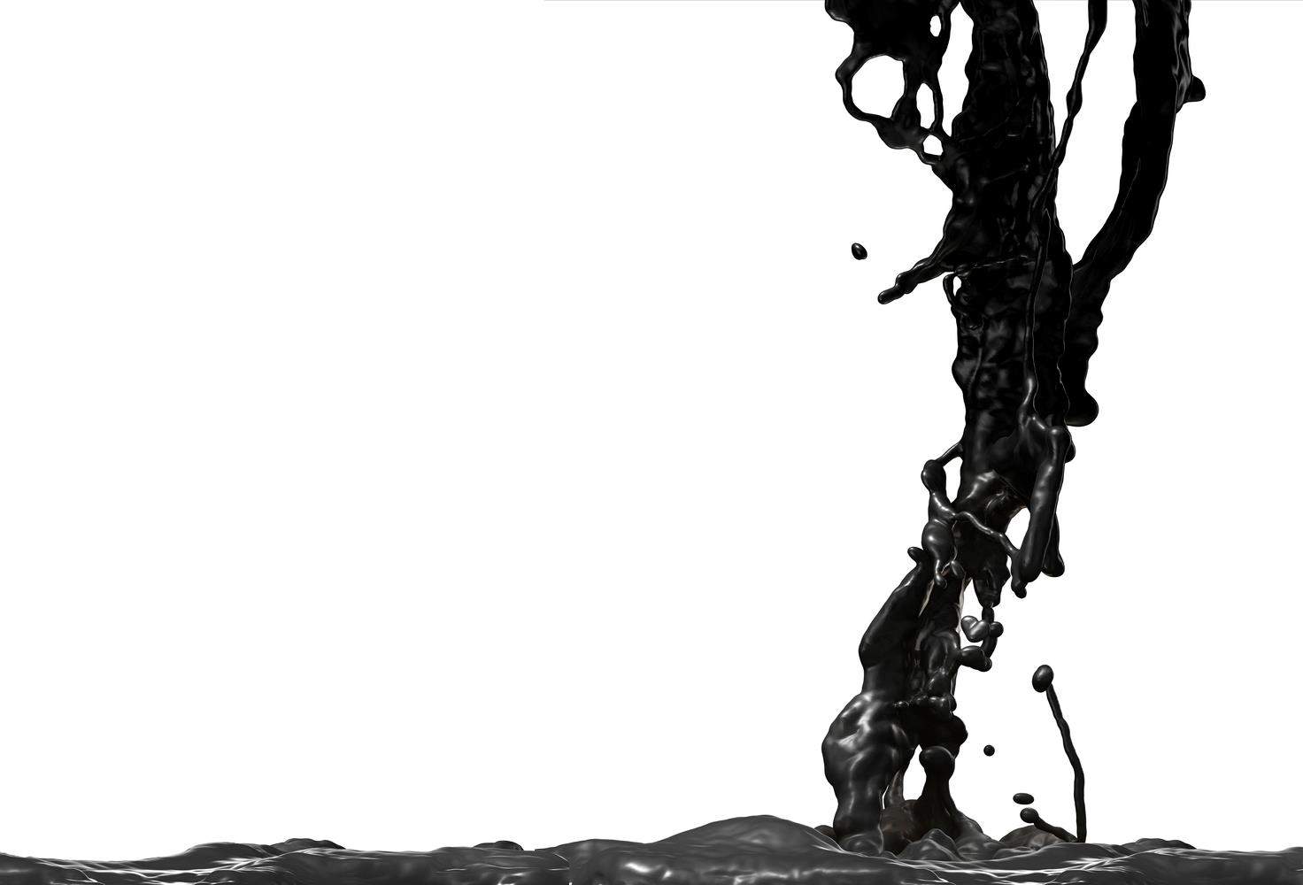
Synthetic plastics
Synthetic plastics are made from polymers
These come from finite petrochemical resources; usually crude oil
Plastics can also be derived from natural gas and coal

Slide 8
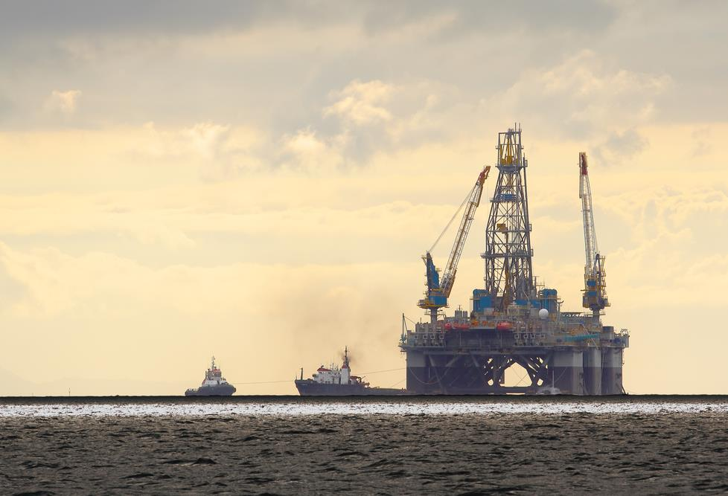
Producing polymers
Polymers are produced through a lengthy process called refining
Unprocessed (crude) oil is first extracted from underground, either at sea using an oil rig, or on land
It is then transported to a plant for conversion

Slide 9
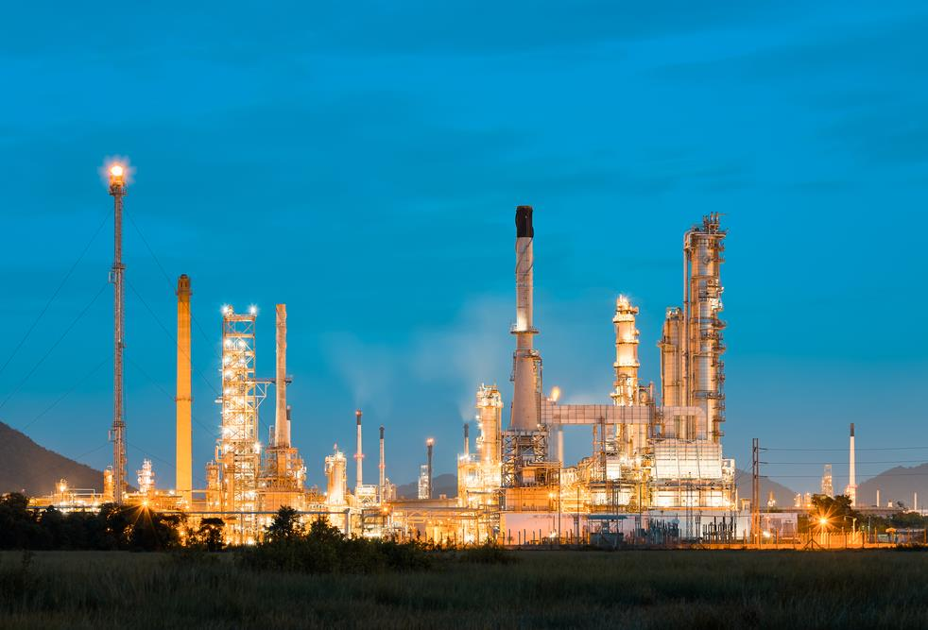
Refining crude oil
Heavy, sticky black crude oil is virtually unusable in its unrefined state
It has to be converted and refined into other more useable products such as fuels

Slide 10
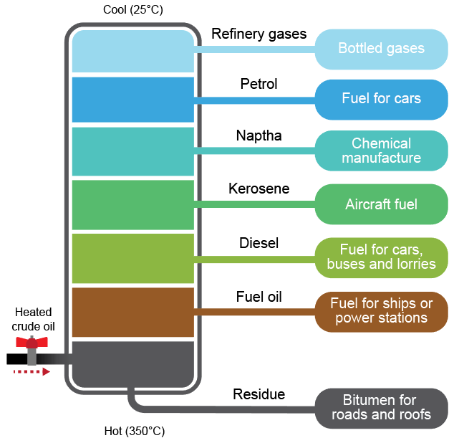
Fractional distillation
Fractional distillation occurs when crude oil is heated in the crude oil distillation unit
Each product has different sized molecules with different boiling points
How can this be used to separate petrol from diesel?

Slide 11
Fractional distillation process
The different stages are:
Crude oil is heated to 350°C
Hot oil is pumped into the base of the distillation tower
The crude oil vaporises and rises up the tower
As the crude oil cools, the molecules condense
Heavier molecules stay at the bottom and lighter molecules rise to the top
The fractions (hydrocarbons) are siphoned off for cracking

Slide 12
Fractional distillation
Complete Task 1 on Worksheet 1 to explain the different stages of fractional distillation

Slide 13
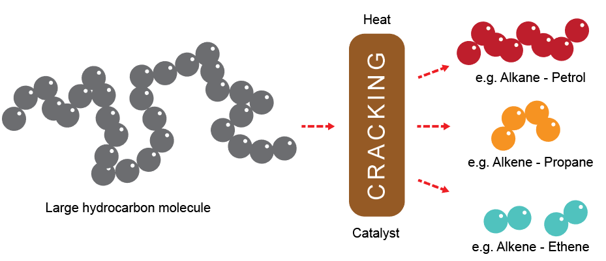
Cracking
This is the process of converting the large hydrocarbon molecules found in the separated fuel types into smaller, more useful versions
The large molecules do not flow very well and are not suitable to be converted into plastics
Heat and pressure are used to break them up

Slide 14
Polymerisation
After hydrocarbons are obtained from cracking, they are then chemically processed:
Molecules of single compounds known as monomers join together
These atoms are joined end to end to form long chains
The long chains of molecules are called polymers
MONO (one) → → → POLY (many)
Polymers are the building blocks of all plastics

Slide 15
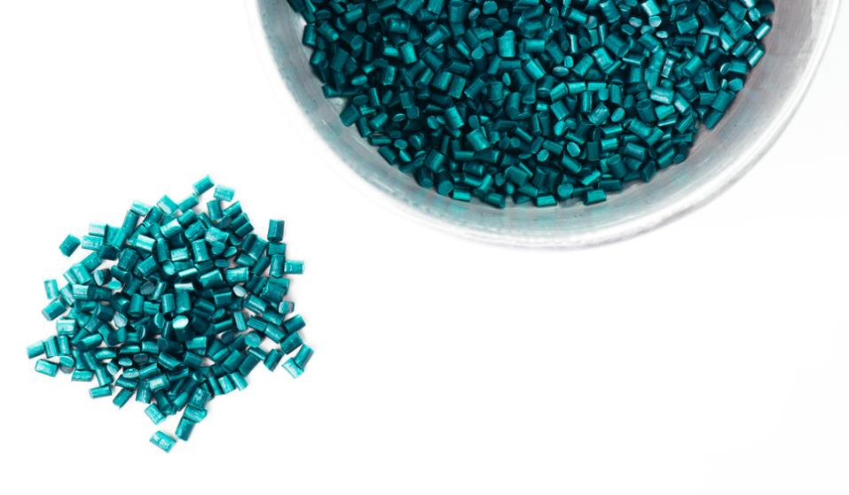
Categories of plastic
There are two categories of plastic:
Thermoplastics and
Thermosetting plastics
Each type is dependent on the end molecular structure after polymerisation
Polymers are usually in the form of pellets or beads
These can then be processed into different forms, such as sheets, bars, pipes, films and fibres

Slide 16
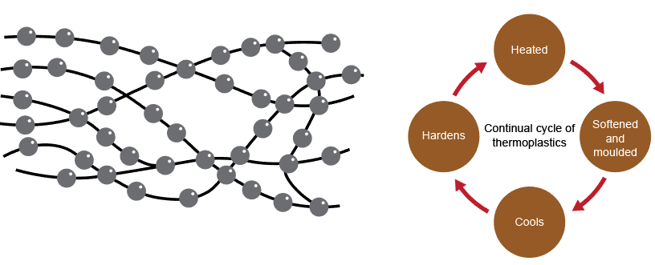
Thermoplastics
Thermoplastics are the most commonly used type
They have long chains of molecules, tangled together with no fixed structure or pattern
They are generally soft and flexible with shape memory

Slide 17
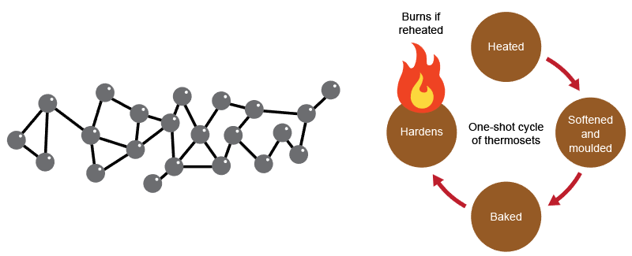
Thermosetting plastics
Thermosets are more brittle than thermoplastics and are best suited to stiffer mouldings
They have long chains of molecules, cross-linked that form a very rigid molecular structure
Very hard and waterproof when solid - ideal for adhesives

Slide 18
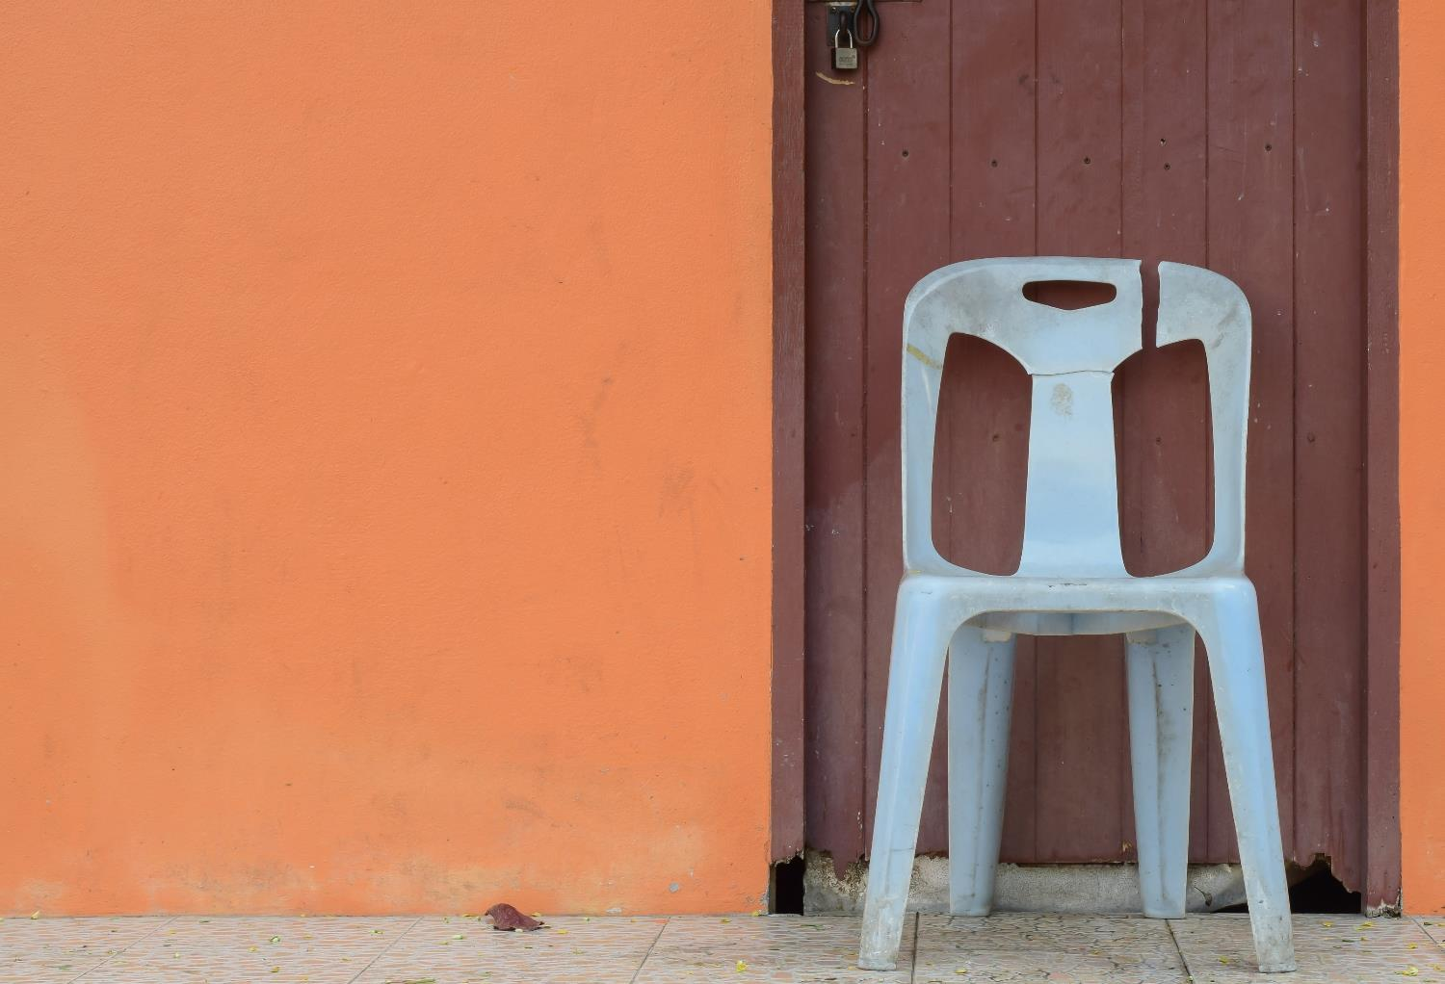
Plastic additives
Plastic can be adapted for different applications by adding chemicals, additives and compounds during manufacture
Stabilisers help to make it more heat and light (UV) resistant
What effect does UV light have on plastic?

Slide 19
Tailoring plastics for use
Pigments are added to change the colour of plastic
Plasticisers are added to make it more flexible
In what applications are fragrances added to plastics?
Where would antibacterial additives be helpful?

Slide 20
Why are plastics so affordable?
They are cheaper than similar products made from wood or metal because:
They have a very high strength-to-weight ratio and many versatile properties
The raw materials are cheaper
Less energy is needed to make the products than other materials
Products are easily mass produced
Transport and fuel costs are less – why?

Slide 21
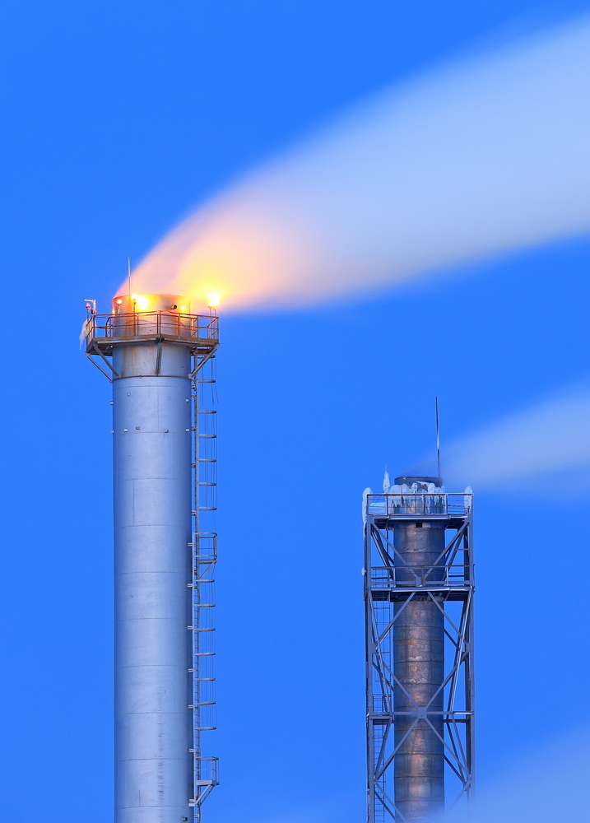
Ethical issues in production
Negatives to manufacturing synthetic plastics:
Producing polymers uses crude oil – a finite resource
Produces pollutants – bad for the environment
Processing polymers requires energy – global warming
Some carcinogenic toxins found in PVC
Is this acceptable? Can we live without plastics?

Slide 22
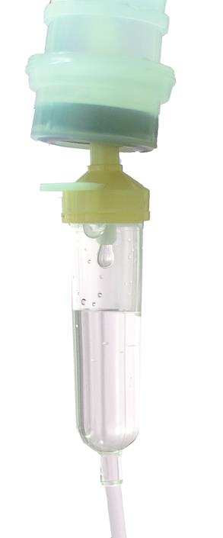
Plastics in use
Plastic is seen as a disposable item by consumers
Low cost leads to a throwaway culture (e.g. packaging)
Plastic straws and cotton buds are only used once – what else could they be made from?
Plasticisers used in contact with foodstuffs can leach chemicals into the food – should they continue to be used?
How does this apply to plastic medical supplies?

Slide 23
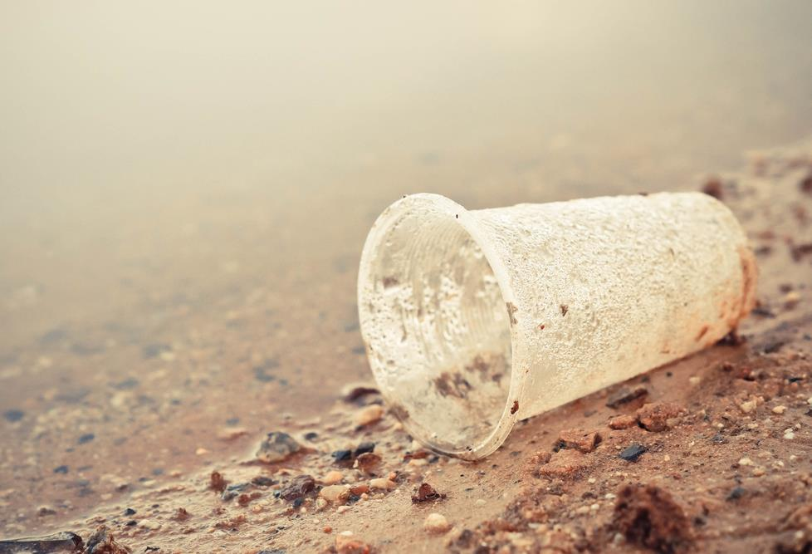
Ethical issues at end of life
What problems are caused by throwing plastics away rather than recycling or reusing them?

Slide 24
Ethical issues at end of life
Plastics products do not rot or corrode easily but are often thrown away as landfill
By ending up on landfill this adds to greenhouse gases
Scars the landscape - countryside, rivers and oceans
Discarded plastic bags affect marine life and coral reefs. They are often ingested by birds and fish
Poisonous incineration - if burnt they produce black choking gases
Toxins from microscopic plastic particles can enter the food chain and affect marine life and human health

Slide 25
Recycling plastics
Thermoplastics can be recycled
This reduces the disposal problems (landfill) and the amount of virgin crude oil used
The different types of polymers must be separated from each other first – how simple do you think this is?
They can also be recovered through Energy from Waste incineration (EfW) to provide electricity
Roads are now being made with recycled plastic instead of bitumen
They are much more durable, quicker to lay and allow for better drainage

Slide 26
How sustainable are plastics?
Almost all plastics are recyclable or biodegradable in some form
Thermoplastics can be recycled by melting them down and reforming their shape into new products
However, their usefulness can become limited with frequent reheating and reforming
Can we make plastics more sustainable?

Slide 27
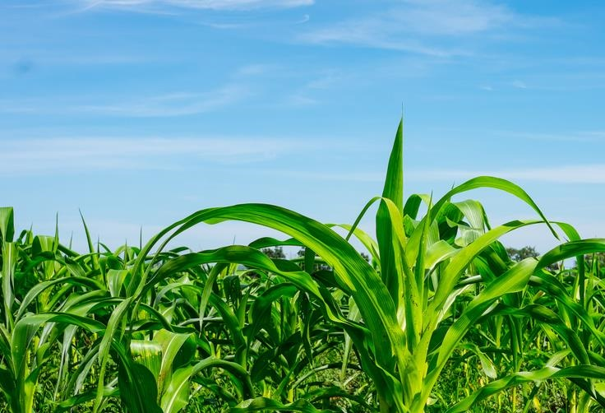
Sustainable plastic production
Bio plastics are produced from vegetable starches such as corn
What issues might there be with corn being grown specifically for making plastic?

Slide 28
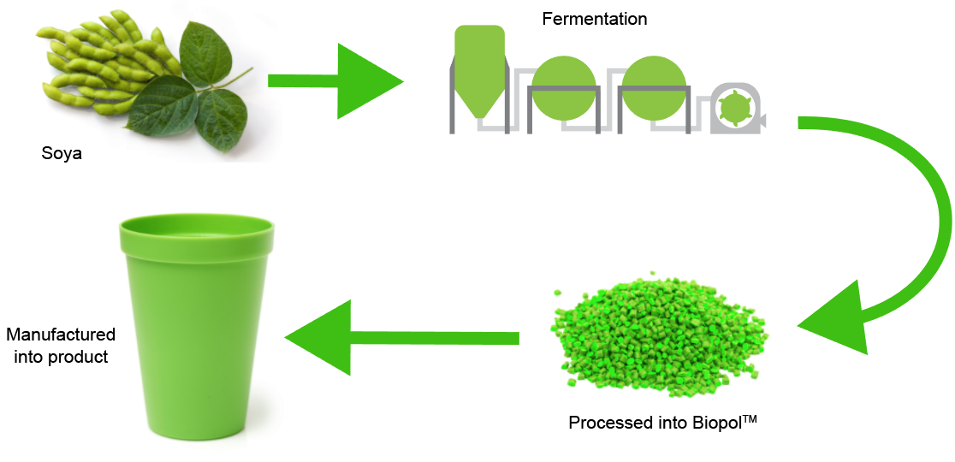
Modern bioplastics
BiopolTM can be manufactured from plant sugars and glucose from soya, pea or potato starches

Slide 29
Bioplastics
Polylactic Acid (PLA) – Extracts carbon from plants
A biodegradable plastic made from corn starch
Polycaprolactone (PCL) – e.g. Polymorph
Low melting point, good modelling plastic
Polyhydroxybutyrate (PHB) – Biopol™
Non-toxic, insoluble in water, high melting point

Slide 30
Sustainability of plastics
Watch Link Video Sustainability on the life cycle of plastic bottles
Complete Tasks 2 and 3 of the worksheet

Slide 31
Nylon – Thermoplastic
Can be woven into fabrics
Resilient to wear
Low friction
Tough
What else is made from Nylon?

Slide 32
The future of plastics?
We need to find other alternatives to petrochemicals to produce plastic. Some interesting developments include exploration of:
Bioplastics (using corn starch)
Algae (high growth rate) Latex
Castor oil
Plant-oil derived
Fermentation of monomers
Protein derived – e.g. chicken feathers

Slide 33
Key terminology
Check that you understand the following:
Fossil fuels
Polymers
Thermoforming polymers / Thermoplastics
Thermosetting polymers / Thermosets
Cracking
Fractional distillation
Bioplastics

Slide 34
Match up the correct terms
Key word |  | Definition
Polymerisation |  | When thermoplastics are reheated they try to return to their original shape
Plastic memory |  | Plastics which soften when heated, harden when cooled and can be softened again numerous times
Thermosets |  | Finite resources such as oil, gas and coal which are used to make petrochemicals
Polymers |  | Plastics which soften when heated, harden when baked but won’t change shape when reheated
Fossil fuels |  | The name for monomers when joined together to form long chains of molecules
Thermoplastics |  | Polymers are chemically processed to join together
Cracking |  | Large hydrocarbons are converted into smaller, more useful versions using heat and pressure

Slide 35
Answers
Key word |  | Definition
Polymerisation |  | When thermoplastics are reheated they try to return to their original shape
Plastic memory |  | Plastics which soften when heated, harden when cooled and can be softened again numerous times
Thermosets |  | Finite resources such as oil, gas and coal which are used to make petrochemicals
Polymers |  | Plastics which soften when heated, harden when baked but won’t change shape when reheated
Fossil fuels |  | The name for monomers when joined together to form long chains of molecules
Thermoplastics |  | Polymers are chemically processed to join together
Cracking |  | Large hydrocarbons are converted into smaller, more useful versions using heat and pressure

