Slide 1
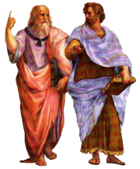
GCSE – Philosophy, Religion & Ethics

Slide 2
Philosophy, Religion & Ethics (PRE)
Seaford college
Head of PRE – Adam C. Stark

Slide 3
Why should you choose it?
The GCSE is vastly different to PRE in Year 9 and in prep school.
Learning is mostly discussion based
Personal perspectives are welcome– even criticisms against religion (but not irrational ranting)...
We create an inclusive environment based on mutual respect for all.
Broad and themes-based.
Focus on four global themes and just two religions.
We explore the intersections between religion and society.
Great resources and exam support – we have the PRE GCSE Navigator.
You will not be taught how to be religious.
You do not have to be religious.
You will not be encouraged to be religious – that's your decision to make!
In PRE, we embrace pluralism – the view that all spiritualities are valid.

Slide 4
Why should you choose it?
What makes PRE unique at SEAFORD COLLEGE?
Unparalleled standards of teaching, resources and support.
Constantly being reviewed and updated in response to real-world events and students' needs.
Discussion-based, focused lessons.
Our cohort is always well drilled and enthusiastic to listen, learn and contribute.
Students are provided access to our bespoke PRE GCSE Navigator.
Admin and revision is made much easier.

Slide 5
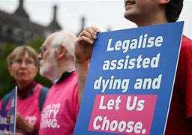
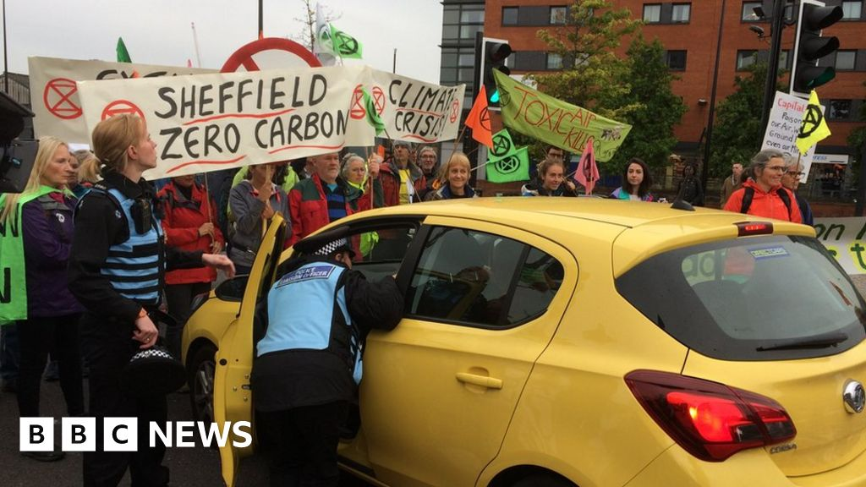
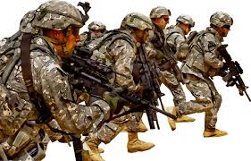
Why should you choose it?
Antagonism is becoming the modus operandi, the typical way to argue in the era of the internet. And oversimplification, or 'the death of nuance', is plaguing popular knowledge. PRE attempts to address this by fostering scepticism, tolerance, compassion, reason and, above all, an appreciation for the 'grey areas'.
Some of our most popular topics:
Just War Theory
Euthanasia (Assisted Dying)
Jihad (Struggle)
Racism and Sexism
Peaceful and Violent Protesting
Original Sin and Salvation

Slide 6
Course content
COMPONENT 1: Religious Studies
Islamic beliefs and practices
The 6 Articles of Faith; the 5 Roots; The 5 Pillars of Islam; the 10 Obligatory Acts; festivals; and more.
Christian beliefs and practices
The nature of God; the afterlife; Sin, Adam & Eve; Salvation; Jesus' role and teachings; festivals; and more.

Slide 7
Course content
COMPONENT 2: Thematic Studies
Theme B: Religion & Life
Euthanasia; abortions; the value of life; evolution and creation; God and the big bang; animal experimentation; stewardship and dominion; the use and abuse of the environment; and Christian & Muslim views on all these issues/topics.
Theme D: Religion, Peace & Conflict
Just war theory; pacifism; conscientiously objecting; activism; peaceful and violent protesting; terrorism; responses to conflict; religious responses to conflict; and Christian & Muslim views on all of these issues/topics.
Theme E: Religion, Crime & Punishment
Reasons form crime; responses to crime; reconciliation; reformation; retribution; deterrence; and Christian & Muslim views on all these issues/topics.
Theme F: Religion, Human Rights & Social Justice
Human Rights; moral responsibilities; Segregation and Apartheid; racism; sexism; homophobia; heteronormativity; ablism; inclusivity; equity vs equality; and Christian & Muslim views on all these issues/topics.

Slide 8
Assessment
Exam 1
Religious beliefs and practices (1 hour 45 mins)
Christian beliefs
Christian practices
Islamic beliefs
Islamic practices
Exam 2
Thematic Studies (1 hour 45 mins)
Theme B: Religion & Life
Theme D: Religion, Peace & Conflict
Theme E: Religion, Crime & Punishment
Theme F: Religion, Human Rights & Social Justice

Slide 9
Assessment
50% of all marks are attached to 12-mark essay questions.
To prepare students for these, two lessons in every half term are dedicated writing workshops.

Slide 10
Expectations of students
Interested in global events and issues.
Willing to participate is meaningful whole-class discussions.
Philosophically minded—being open to understanding the perspectives of others and to question your own.
We strive for inclusivity and an appreciation of pluralism and pluriversality (that there are a wide range of valid and valuable ways of seeing, living and being in this world; if religion and ethics is absolute, then no one person, organisation or community is the arbiter of it).

Slide 11
Future pathways
A-Level: Philosophy, Religion & Ethics; Sociology; Politics; History.
Out-of-the-box thinking and analytical skills. Lots of transferable skills.
Global learning for future global citizens.
University: Humanities—specifically Philosophy or PPE.
Can lead to or support career pursuits in law, politics, social work, academics etc.

Slide 12
"Faith without action is dead" (James 2:20)
Caring for those is need, whether by volunteering, giving to charity or being a 'good Samaritan', is central to both Christianity and Islam—our focus religions.
Putting theory into practice is at the heart of these religions.
Hence, our non-examined PRE classes (Years 9, 10 and 12) facilitate the packing and shipping of food parcels for the Chichester District Foodbanks.

Slide 13
Any questions?
If you have any questions regarding the content of the course please contact me using astark@seaford.org

