Slide 1
A Level – Philosophy, Religion & Ethics

Slide 2
Philosophy, Religion & Ethics (PRE)
Seaford college
Head of PRE – Adam Stark

Slide 3
Why should you choose it?
What makes PRE unique at SEAFORD COLLEGE?
Unparalleled standards of teaching, resources and support.
Constantly being reviewed and updated in response to real-world events and students' needs.
Discussion-based, focused lessons.
Our cohort is always well drilled and enthusiastic to listen, learn and contribute.
Students are provided access to our bespoke PRE A-Level Navigator.
Admin and revision is made much easier.

Slide 4
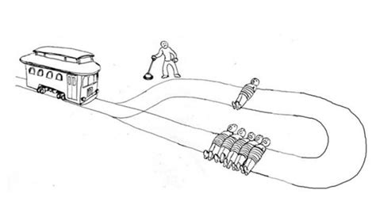
Why should you choose it?
Antagonism is becoming the modus operandi, the typical way to argue in the era of the internet. And oversimplification, or 'the death of nuance', is plaguing popular knowledge. PRE attempts to address this by fostering scepticism, tolerance, compassion, reason and, above all, an appreciation for the 'grey areas'.
Some of our most popular topics:
Utilitarianism
The Problem of Evil
Wigtenstein's Language Games
Euthanasia
Business Ethics
The Mind-Body Problem

Slide 5
Course content
Exam body: OCR
There are three components:
Philosophy (Mr Stark);
Ethics (Mr Stark); and
Theology (Miss Hamilton).

Slide 6
End of Unit Assessments
40-minute closed-book essay assessments

Slide 7
End of Course Assessment
Philosophy
4 essay questions to choose from
You will answer 3 questions
2hr exam (~40min per question)
Ethics
4 essay questions to choose from
You will answer 3 questions
2hr exam (~40min per question)
Christian Developments
4 essay questions to choose from
You will answer 3 questions
2hr exam (~40min per question)

Slide 8
Expectations of students
Independence
You will have regular compulsory readings to complete in your own time.
Dialogic learning
students should strive to get involved in the discussions.
Genuine interest
You must be interested in looking closer at things and going deeper.
Diligence
This course requires sustained hard work inside and outside of the classroom.
Academic
6 or higher in English required; and preferably studied PRE at GCSE level.

Slide 9
Future pathways
University: Humanities—specifically Philosophy, Sociology or PPE.
Complimentary subjects: Sociology, Psychology, Politics.
Out-of-the-box thinking and analytical skills. Lots of transferable skills.
Can lead to or support career pursuits in law, politics, social work, academia etcetera.
Global learning for future global citizens.

Slide 10
Any questions?
If you have any questions regarding the content of the course, please contact me using astark@seaford.org

