Slide 1
GCSE Music
Seaford college
Head of Music – Mrs J Hawkins

Slide 2
Why should you choose it?
Music is a highly interactive and practical subject. It is a lesson that students always look forward to! It is fun to teach and be part of the lesson.
Students are able to develop their skills as performers and play and compose music that they love, as well as develop their understanding of music history and theory. It is a great all round course.
Students who chose music are highly motivated to achieve their absolute best and come to the lessons eager to improve and become more able musicians.

Slide 3
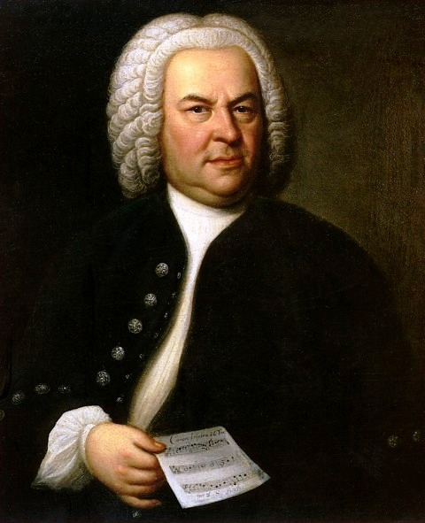
Course content
Component 1 Performance. Students perform one solo and one ensemble piece, lasting in total 4 minutes. Grade 4 is the benchmark standard, but you don’t have to have taken grades to do the course, just be of that equivalent standard.
Component 2 Composition. Students compose 2 pieces over the 2 years, lasting in total 3 minutes. One piece is a free choice composition and the other piece is chosen by the board.
Component 3 Listening and appraising exam. We study eight different pieces from across the musical genres, starting with Bach and Beethoven and finishing with an excerpt from ‘Wicked’, Star Wars and some Queen! We learn how to analyse music and understand how and why the composers have written in the way that they have.

Slide 4
Assessment
Edexcel GCSE Music has 3 components:
Component 1: Performance - 30% total marks –internally assessed coursework
Component 2:Composition - 30% total marks-internally assessed coursework
Component 3: Appraising - 40% total marks (1 hour 45 mins listening paper)

Slide 5
Expectations of students
Students should be able to play an instrument or sing and have some understanding of music theory. Year 9 music theory club is ideal to get you to a place where theory is less scary before GCSE Music.
Students should be interested in becoming better all round musicians, keen to learn to perform, compose and understand all types of music.

Slide 6
Future pathways
Courses post GCSE Music include A-level Music and Music Technology and B-Tech Performing Arts.
A musical education is very attractive to colleges, universities and employers alike. You need self-discipline and organisation to practise regularly, creativity to compose and analytical skills in order to understand the history and context of the music that we study.
Career opportunities are many and varied, from performer through to composer and studio or live sound engineer.

Slide 7
Any questions?
If you have any questions regarding the content of the course please contact me using jhawkins@seaford.org

